Slide 1


Introducing the Internet-Free Education Resource Bank (IFERB) Innovation Development Directorate
Estimated Reading Time: 6-10 hours.

Slide 2
Table of Content
Preface
Who is this toolkit for?
How to Read This Toolkit?
How Do You Develop Competencies?
Icons Used In The Toolkit
What Is IFERB?
Introduction
What Is Project Based Learning (PBL)?
Why Is PBL A Powerful Tool For Teachers & Students?
How To Use IFERB Projects Bank?
IFERB PBL Impact (Success Stories)
Booklet 1: Project Selection
1.1. Project Selection Overview
1.2. How to Access IFERB Projects Bank?
1.2.1. If Offline Projects Documents are Available:
How to Read Projects’ Documents?
1.2.2. If Online Access is Available:
How to Use Online Filters?
1.3. How to Select Projects – Quick Start.
1.3.1. Select by Subject
1.3.2. Select by Context – Based on:
A) Students’ Level
B) Students’ Environment & Interests
C) Students’ Engagement
D) Guidance & Resource Requirements
1.4. Application Exercise
1.5. Summary/Checklist
Booklet 2: Project Contextualization
2.1. Overview of Project Contextualization
2.2. Before Contextualization:
2.2.1. Get Familiar with Project Document
2.2.2. Understand the Project
2.2.3. Assess Students’ Previous Learning
2.3. Contextualize Projects Based on:
2.3.1. Students’ Learning Level
2.3.2. Students’ Environment & Relevance
2.3.3. Available Supplies
2.4. Summary
2.5. Checklist
Booklet 3: Project Implementation
3.1. Overview for Project Implementation:
3.1.1. What is Project Implementation?
3.1.2. Remote Communication Channels
3.1.3. Implementation Guidelines Overview
3.2. Giving Instructions to Students:
3.2.1. Introduce Activities to Students
3.2.2. Differentiating Instructions
3.3. Fostering Effective Learning Environment
3.3.1. How to setup an effective learning environment?
3.3.2. How to Effectively Involve Parents?
3.3.3. Guidelines to working with students – KWL framework:
A) Build Curiosity and Interest
B) Create Space for Creativity & Ownership
C) Develop Capacity for Reflection

Slide 3
Table of Content
Booklet 3: Project Implementation …(cont.)
3.4. Receiving Students’ Work
3.5. Conducting Assessments & Evaluation – Assessment Framework:
3.5.1. Baseline & End-line Assessments
3.5.2. KWL Framework
3.5.3. Daily Observations
3.5.4. Quizzes
3.6. Conducting Remote Assessments
3.7. Summary
Appendix A: Additional Reading
A.1. IFERB Overview Document
A.2. Exercise Projects Options
A.3. Exercise Projects Options’ Contextualization Examples
A.4. Toolkit Contextualization Example – Water is Life Project
A.5. Project Selection Checklist
A.6. IFERB Project Contextualization Examples
A.7. Original Project & Contextualized Project Scripts
A.8. Extra Example for Project Selection & Contextualization – Code Languages (Level 2)
Appendix B: Educators’ General Tools
B.1. Non-Academic Skills
B.2. Activities’ Strategies & Instructions
B.3. Managing Students’ Behavioral Challenges
B.4. IFERB Projects’ Questions Bank
B.5 21st Century Rubric
Appendix C: Educators’ Advanced Tools
C.1. Project Selection – Advanced Practices (Optional)
C.1.1. Select by Specific Skill (Academic or Non-Academic)
C.2. Project Contextualization – Advanced Practices (Optional)
C.2.1. Before Contextualization: Extract Subjects from Project Document
C.2.2. Curriculum Mapping & Contextualization
A) Map Curriculum to Project
B) Map Project’s Difficulty to Curriculum C) Map/Inject Curriculum Skills into Project
Appendix D: Tips for NGOs/Schools
D.1. Training the volunteers
D.2. Projects’ Evaluation
Appendix E: Sources Used in Toolkit
E.1. Sources

Slide 4
Preface
Competencies & Learning Outcomes
You will learn how to read this toolkit to use the Internet Free Educational Resource Bank.
Content
Why Are You Reading This Toolkit?
How to Read This Toolkit?
Icons Used In The Toolkit
What Is IFERB?

Slide 5


















Preface
I. Who is this Toolkit For?
This toolkit is provided by Education Above All Foundation (EAA, for short) to help educators (teachers, facilitators, volunteers, NGOs or parents) overcome many challenges related to school closures, school partial opening, and/or lack of enrichment activities.
It is for educators who are looking for an innovative teaching method that elevate students’ learning and skills-set while overcoming the following challenges:
This toolkit will guide you on how to use EAA’s Internet Free Education Resource Bank (IFERB, for short) to deliver an engaging learning experience for your students.
Distance learning for marginalized learners
Lack of resources and/or alternative learning materials, such as textbooks, educational games …etc.
Global pandemic that forced schools to close
Students are disengaged with classroom learning as it is not applied (interactive), relevant, or engaging
Limited internet access
Students are out of school; how are you going to reach them? Or how will their parents educate them?
II. How to Read this Toolkit?
Depending on your preference, you can either read the whole toolkit (or the whole Booklet) and then answer the included questions and exercises. Alternatively, you can answer them as you go (i.e. when you come across a question or exercise while reading, pause your reading and attempt answering them). Attempt to answer all of them to help you develop and apply these new skills.
Have a notebook ready to write down your answers and/or notes. If you are not sure how to answer a question/exercise, do not panic! Just read the provided example.
Please note that in some cases there is no right or wrong answers. However, you can compare your answers with examples of other educators’ work provided in Appendix A - Additional Reading.
This toolkit includes appendices for further reading. If you are a parent and/or new to teaching/facilitating, you can refer to Appendix B – Educators’ General Tools to read more about foundational concepts. Appendix C – Educators’ Advanced Tools will cover additional skills and applications if you are an experienced teacher. Lastly, Appendix D – Tips for NGOs/Schools includes specific practices that apply to NGOs, schools or organizations who are running IFERB programs. Lastly, Appendix A includes optional Additional Readings.
In this toolkit, you will learn how to use and adapt IFERB available resources to meet the needs of your students and unique context – both for classroom and/or remote settings.
It will take you on a three stages journey where you will create your first adapted lesson for your students. These stages are sequentially organized; try to go over them in the listed order.
Each stage is covered in a separate booklet. However, all three booklets are included in one document to make it easier for you to navigate through them.
This toolkit thoroughly explains all needed steps/topics in detail to avoid ambiguity. However, if you are already familiar with any of the steps/topics, feel free to skim through them.
It also includes questions and exercises for you to apply your newly acquired skills.
When you apply the following guidelines to read this toolkit, you will end up with at least one complete and fully adapted lesson for your students and context.
The average time to successfully complete reading and applying this toolkit is between 6 to 10 hours; hence, your first lesson will take this long to prepare.
Keep in mind that with more practice, you will be able to prepare these lessons in a shorter amount of time; e.g., preparing 12 lessons in a week!
Stage 2
Stage 3
Stage 1
This toolkit is detailed!
It takes 6-10 hours :)
You can do it!

Slide 6














Preface
III. Icons Used In This Toolkit
Exercise
[sources:#]: A list of all sources used is listed in Appendix E. The list is numbered to help you find the source (link to a website, book …etc.) for your reference.
Toolkit Tip
Extra Reading
These blocks include the exercises that help you practice new concepts.
Tip
Provides tips that are related to benefiting from this toolkit.
Provides additional reading from Appendices & documents available with this toolkit.
Provides specific tips for an accelerated competency development.
Advanced Tips are for experienced educators. If you are a parent or new to teaching, you can skip these tips and go back to them later.
Further Reading
Remember
Question
Provides additional reading from different online sources, e.g., websites, blogs …etc.
Provides previously mentioned points and/or tips to help you connect the dots.
Provides reflective questions to help you process presented concepts.
Impact/success stories: Success stories are shared to inspire you to achieving your own success
Our Example:
These examples are a reference point to help you get started with the exercises.
These characters are educators who will guide you through this toolkit by sharing their own experiences.
Their experiences will help you to apply your newly acquired knowledge.
IV. What Is IFERB?
IFERB stands for Internet Free Education Resources Bank provided by EAA (Education Above All Foundation).
This bank includes resources that are suitable for 3 age groups:
These resources were originally developed to be a stop-gap solution to continue learning in emergency contexts and can be used:
The resources can also be delivered in regular classrooms or through remote channels, such as: phone (voice/audio, SMS/TEXT, WhatsApp), radio, zoom …etc.
IFERB is available in English, French, Arabic, and Hindi.
Level 1: 04 - 07 years
1
Level 2: 08 – 10 years
2
Extra Reading
Level 3: 11 – 14 years
3
You can learn More about IFERB in Appendix A: IFERB Overview Document (Section A.1).
to continue learning in distance learning contexts as a standalone learning resource.
as part of a blended learning program to support continued learning when schools are partially opened.
as additional or enrichment learning in classrooms, during summer, and/or after school activities.
Further Reading
You can learn More about EAA on their website: https://educationaboveall.org/
Let’s Start!

Slide 7
Introduction
Project Based Learning (PBL) Overview
Competencies & Learning Outcomes
You will have a general overview of what Project Based Learning is and how you can use IFERB project bank to continue educating learners even if a crisis emerges.
Content
What is Project Based Learning (PBL)?
Why is PBL a Powerful Tool For Teachers & Students?
How to Use IFERB Projects Bank?
IFERB PBL Impact (Success Stories)

Slide 8
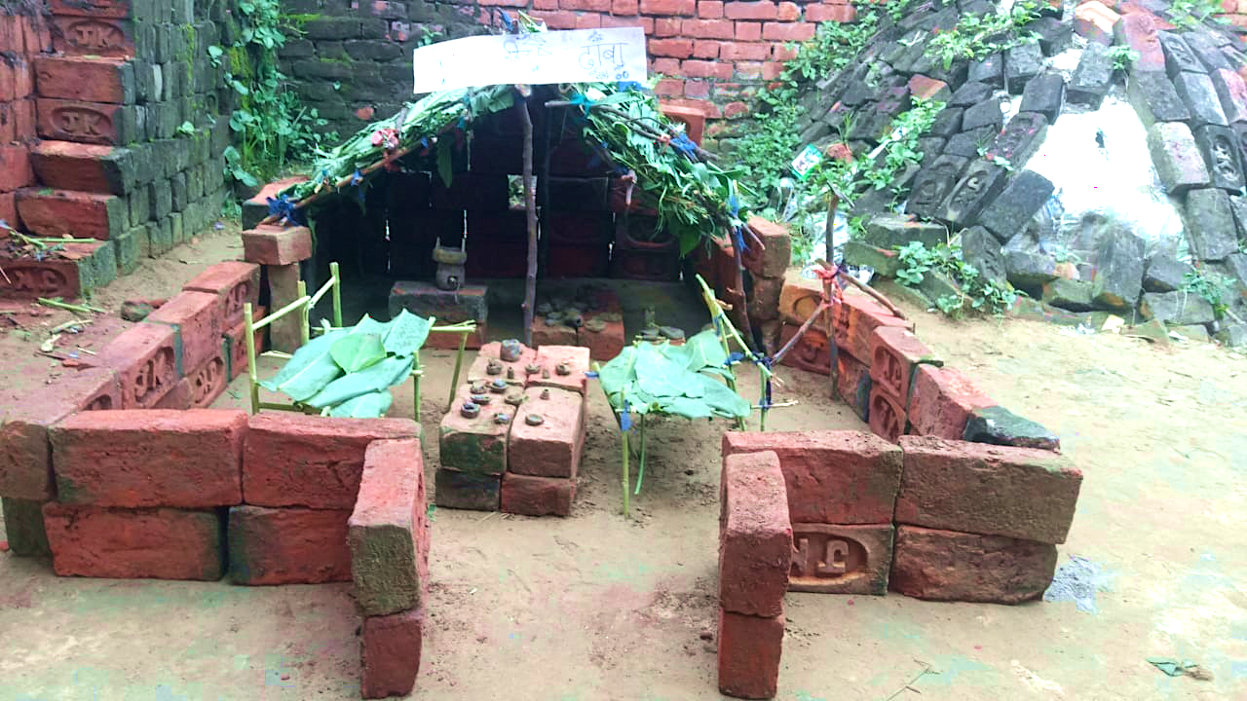
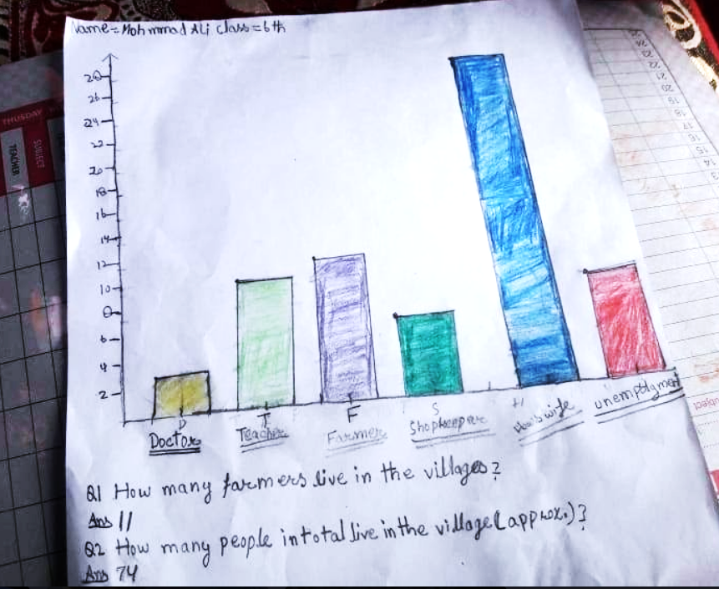
Introduction
1. What is Project Based Learning (PBL)?
Project-based learning is an educational method designed to give students the opportunity to develop knowledge and skills through engaging projects that are set around challenges they may face in the real world.
Project Based Learning (PBL) uses real-world projects to teach math, literacy, science and other subjects covered by national curriculums in addition to skills such as collaboration and creativity.
PBL projects engage students’ interests by ensuring projects’ relevance to students’ real-life environment (such as social norms, currencies, current events …etc.).
Further Reading
Project Based Learning: https://www.schoology.com/blog/project-based-learning-pbl-benefits-examples-and-resources
2. Why is PBL a Powerful Tool For Teachers & Students?
A traditional school project helps students to learn skills that are listed in national curricula through application. PBL goes one step further as it also helps students develop SEL (Social Emotional Learning) skills and 21s century skills such as critical thinking, collaboration, problem solving, and communication; as shown in the examples in Figure 1.
IFERB PBL projects enable educators to choose and modify these projects to fit students’ context and skills. Figure 1 shows examples of students’ work.
My Pop-up Restaurant
This is a project where students create their own physical restaurant, design its menu, calculate its budget and serve real meals to their guests!
Students learned math (budgets), literacy and art (menu design), and, most importantly, working with other students (collaboration).
Population Census
This is a project where students design a census survey, interview members of their family and/or community, and analyze the results to understand their community better.
Students learned math (statistics), communicating professionally to gather data, and to analyze collected data.
Figure 1: Examples of IFERB PBL Projects – Students’ Work

Slide 9





Introduction
3. How to Use IFERB Projects Bank?
IFERB resource bank includes projects that can be implemented in different circumstances to achieve educational objectives.
These projects are designed using Project Based Learning method taking into consideration limited educational resources and/or uncertain access to trained teachers.
Educators may directly visit EAA online resource center (https://resources.educationaboveall.org/) to access available PBL projects.
Educators need to select the most suitable project(s) for their students and modify them to better fit their context so they can successfully deliver the project(s) to students (face-to-face or remotely).
This toolkit includes three main booklets that will guide you throughout the process of Project Selection, Contextualization and Implementation.
Tip:
Please note that once you finish reading and implementing this toolkit, you will have at least one ready contextualized project. The more you practice, the faster and easier the process of project selection, contextualization and implementation will become.
To select the most suitable project(s) for your students, you need to consider the subject you want to teach (or targeted skill, if you are an advanced educator) along with students’ context: level, environment, engagement, required & available supervision & supplies. The more interesting the project is for your students, the more engaged they will be and learn more.
Project Selection
After reading and understanding the selected project(s), you will know what needs to be adjusted to better fit your students’ interests & context, their learning levels, and their available supplies/resources. This booklet shows you how to assess students’ previous knowledge, interests …etc.
It includes exercises to help you develop Project Contextualization competency.
Project Contextualization
To successfully implement contextualized project(s), you need to create an effective learning environment, especially if it is a remote one. This booklet details how to build curiosity and interest, create space for creativity and ownership, and develop capacity for reflection; even when students have different interests and levels. It also provides strategies for conducting effective assessments even remotely.
Project Implementation
(1-2 ) hours
8 pages
(2-3 ) hours
9 pages
(3-5 ) hours
19 pages
4. IFERB PBL Impact (Success Stories)
When IFERB PBL projects are accurately selected, contextualized and implemented, they can have a positive impact on the students’ communities.
Below are couple of examples that showcases such powerful impact:
“My Pop-Up Restaurant” project (Lebanon): Please refer to Figure 1 to learn more about this project. This is what a Lebanese teacher said about her experience with this specific project: “My Pop-Up Restaurant allowed male students to engage with cooking and gain a newfound appreciation for their mothers and helping them out, challenging gender stereotypes.”
“COVID Rules" project (India): As part of the outcome for the “COVID Rules" project, a group of participating students in Udaipur created contactless sanitizers and water dispensers to keep their neighborhoods safe. The story grew popular and was featured on their local online newspaper. A very powerful impact of education! (sharing life-saving information).
Extra Reading
You can find these projects in Appendix A – IFERB Project Contextualization Examples
(Section A.6).
Project Contextualization
Stage 2
Start
Stage 3
You too can make an impact!
Stage 1
Project Selection
Let’s start your journey!
Project Implementation

Slide 10

Booklet 1
Project Selection
Competencies & Learning Outcomes
By the end of this booklet, you will be able to select 1 or more projects that are suitable for your students’ learning level, environment, supervision level and required supplies to ensure high student engagement. You will also learn how to select projects based on the subject (or, for advanced educators, the skill) you want to cover.
Booklet Content
1.1. Project Selection Overview
1.2. How to Access IFERB Projects Bank?
1.2.1. If Offline Projects Documents are Available:
How to Read Projects’ Documents?
1.2.2. If Online Access is Available:
How to Use Online Filters?
1.3. How to Select Projects – Quick Start.
1.3.1. Select by Subject
1.3.2. Select by Context – Based on:
A) Students’ Level
B) Students’ Environment & Interests
C) Students’ Engagement
D) Guidance & Resource Requirements
1.4. Application Exercise
1.5. Summary/Checklist
Project
Selection
Project
Contextualization
Project
Implementation

Slide 11
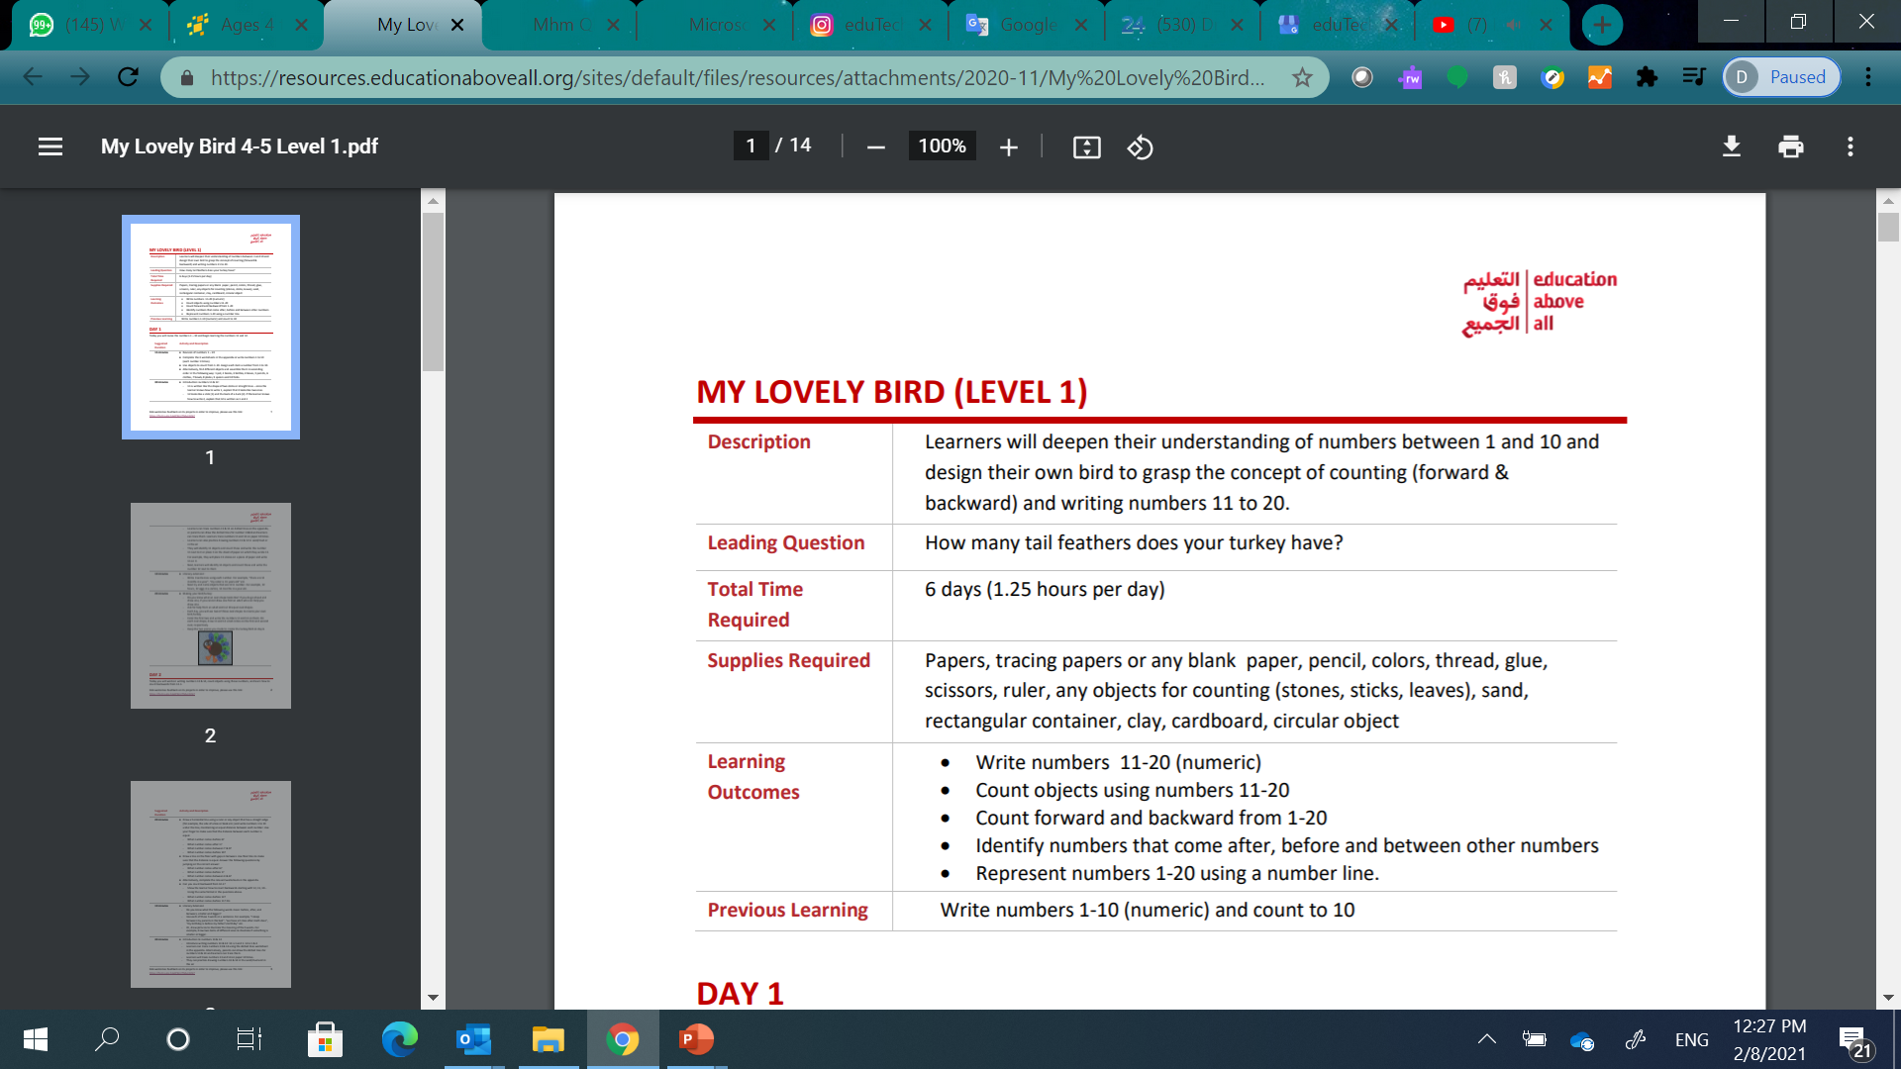
Booklet 1 – Project Selection
1.1. Project Selection Overview
Access IFERB Projects Bank see section 1.2
Figure 1.1 shows an overview of the selection process.
First you will need to access IFERB projects. Guidelines are provided for those who have internet access and those who don’t.
If you are an advanced educator, you can refer to Appendix C for more detailed guidance on how to start Project Selection process from a targeted skill - (section C.1).
If you are a beginner or a new educator, you can start with targeted subject – Math, Literacy, Science etc. You can identify project(s) that cover the subject you are targeting.
If you do not have a targeted subject, you can directly select based on your students’ context . Students’ context includes their learning levels, their environments & interest and their engagement.
When considering students’ context for project selection purposes, you will also need to consider students’ available support and supplies (resources).
Considering students’ context is part of project selection process whether you have a targeted subject or not.
Once you select most suitable project(s) for your students, you will start contextualizing them; this is covered in Booklet 2.
Do you have a subject you want to target?
No
Yes
Select by Subject see section 1.3.1
Select by Context
see section 1.3.2
(A) Consider your students’ levels
(B) Consider your students’ Environment & Interests
(C) Consider your students’ Engagement
(D) Consider Guidance & Resources Requirements best suited for your students
Tip:
After you finish reading this toolkit, you will be able to select and contextualize multiple projects for your students. For the purpose of this toolkit training, this toolkit will guide you on selecting and contextualizing one project.
Start Project Contextualization
(see Booklet 2)
Figure 1.1: Overview of Project Selection Process
1.2. How to Access IFERB Projects Bank? (1/3)
IFERB resource bank contains PBL projects. Therefore, the first step is to learn how to access these projects.
There are multiple ways to access these projects through accessing the internet and/or working with NGO/school.
1.2.1. If Offline Project Documents are Available: How to Read Projects’ Documents?
If you receive printed versions of the projects, you can use the project brief (e.g., Figure 1.2) to draw your own conclusion on:
what subjects are being covered in the project you are considering
the age group for which it is designed
what kind of supervision it will require to be successfully completed by your students
supplies required to implement the project
Kindly note that this toolkit will cover more about how to read Project Documents in the second booklet, Project Contextualization.
Although you might not have access to online filters, we recommend that you skim though the next section, some information might still be relevant.
Level 1: Age of 4-7 Years
Level 2: Age of 8-10 Years
Level 3: Age of 11-14 Years
If you do not have access to the online IFERB filter to help you select best suited projects based on Subject and Available Supervision & resources, you will need to focus on the Project Brief portion.
Figure 1.2: IFERB Project Document – Project Brief Example

Slide 12
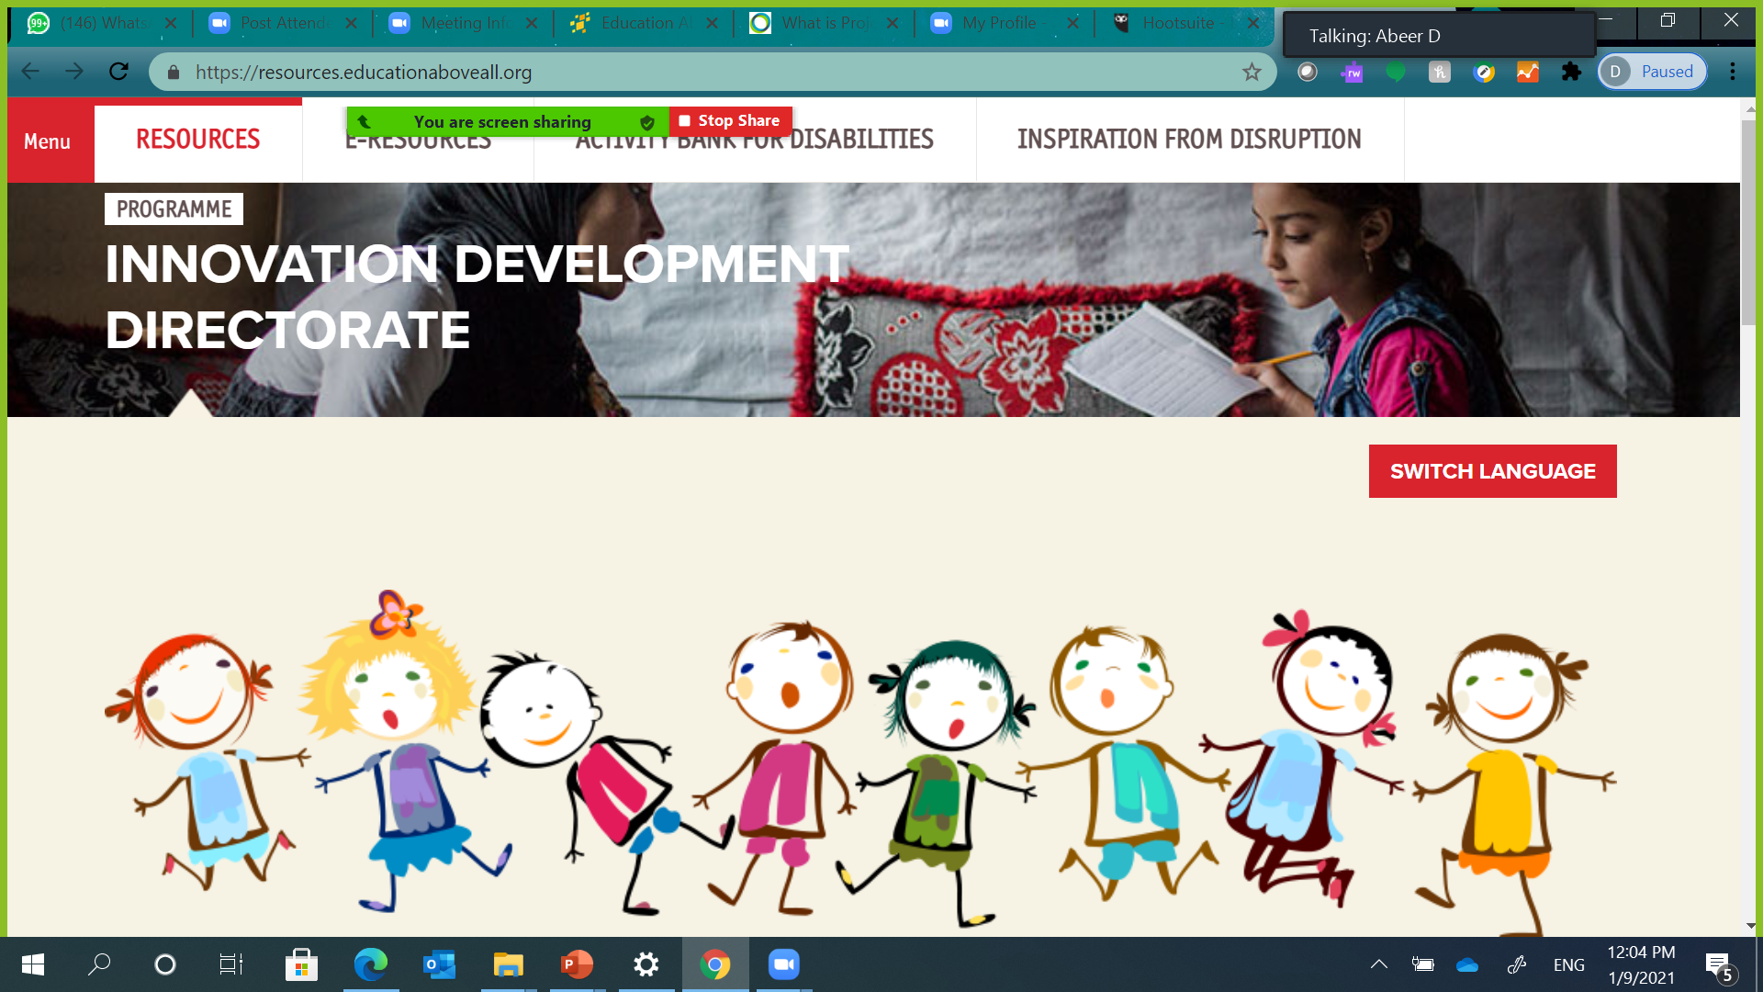
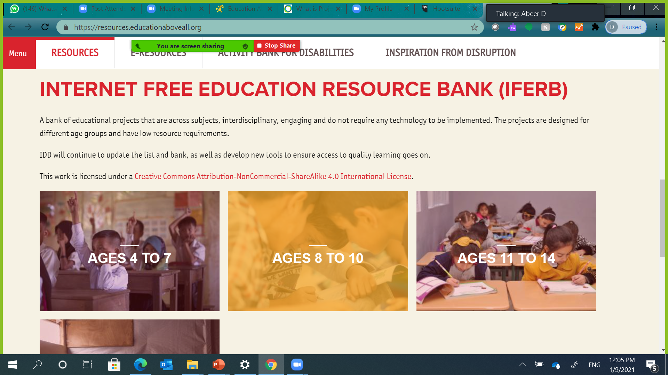
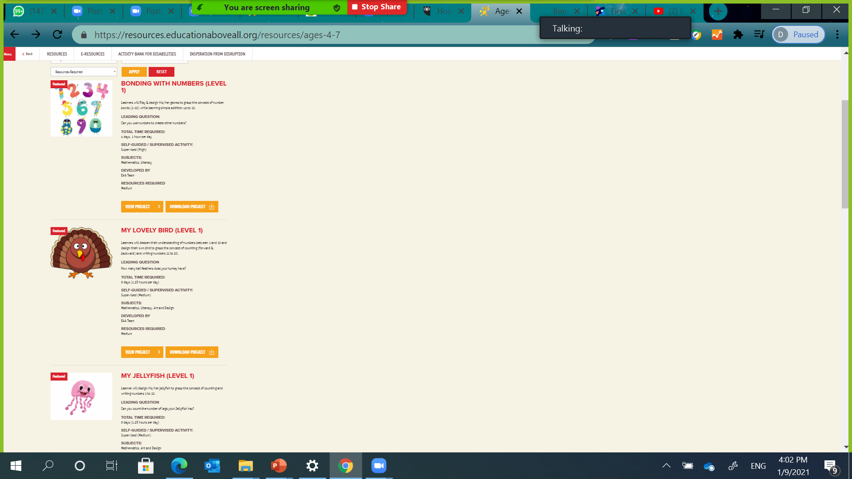
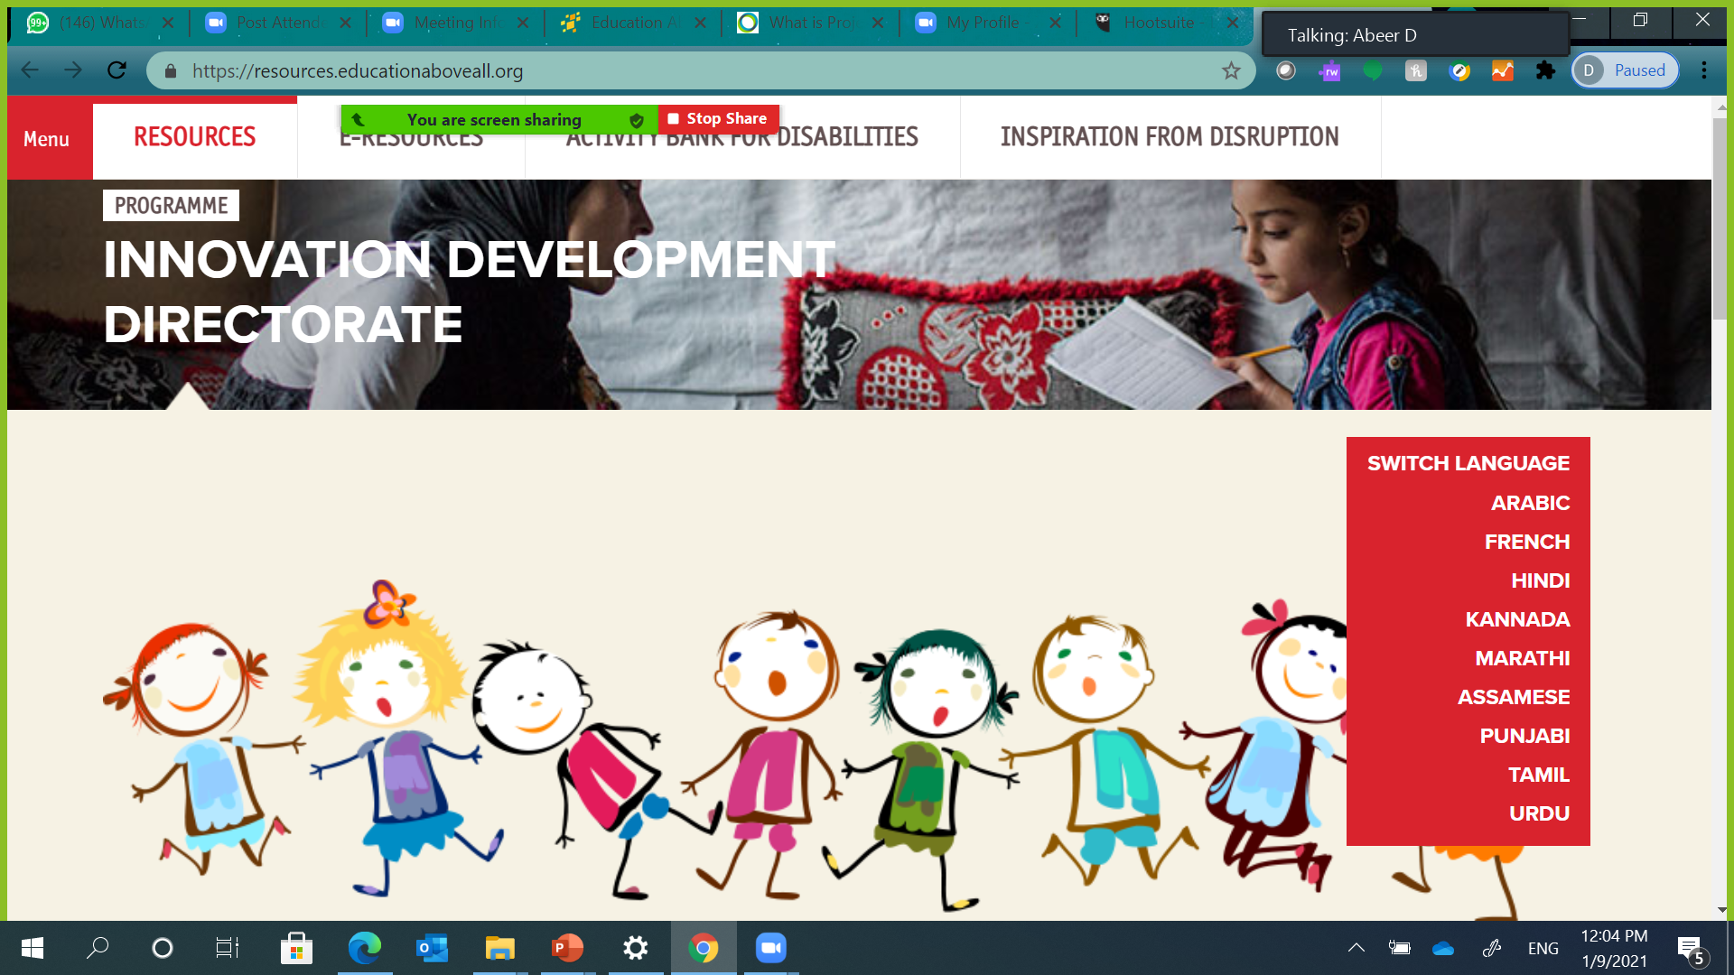
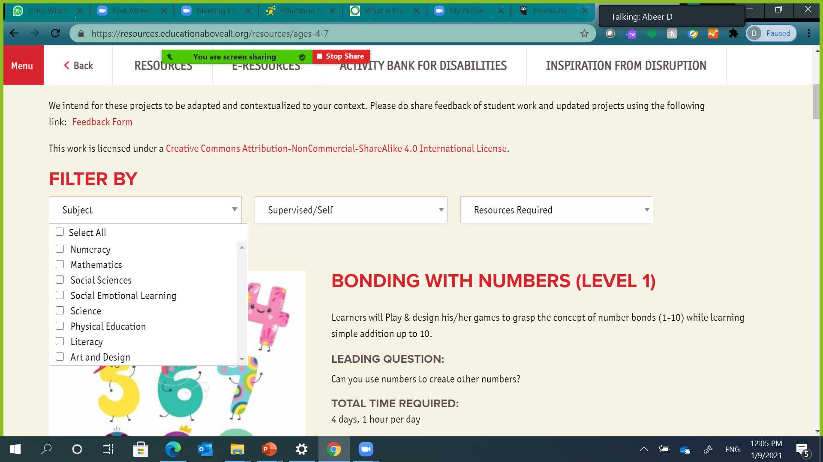
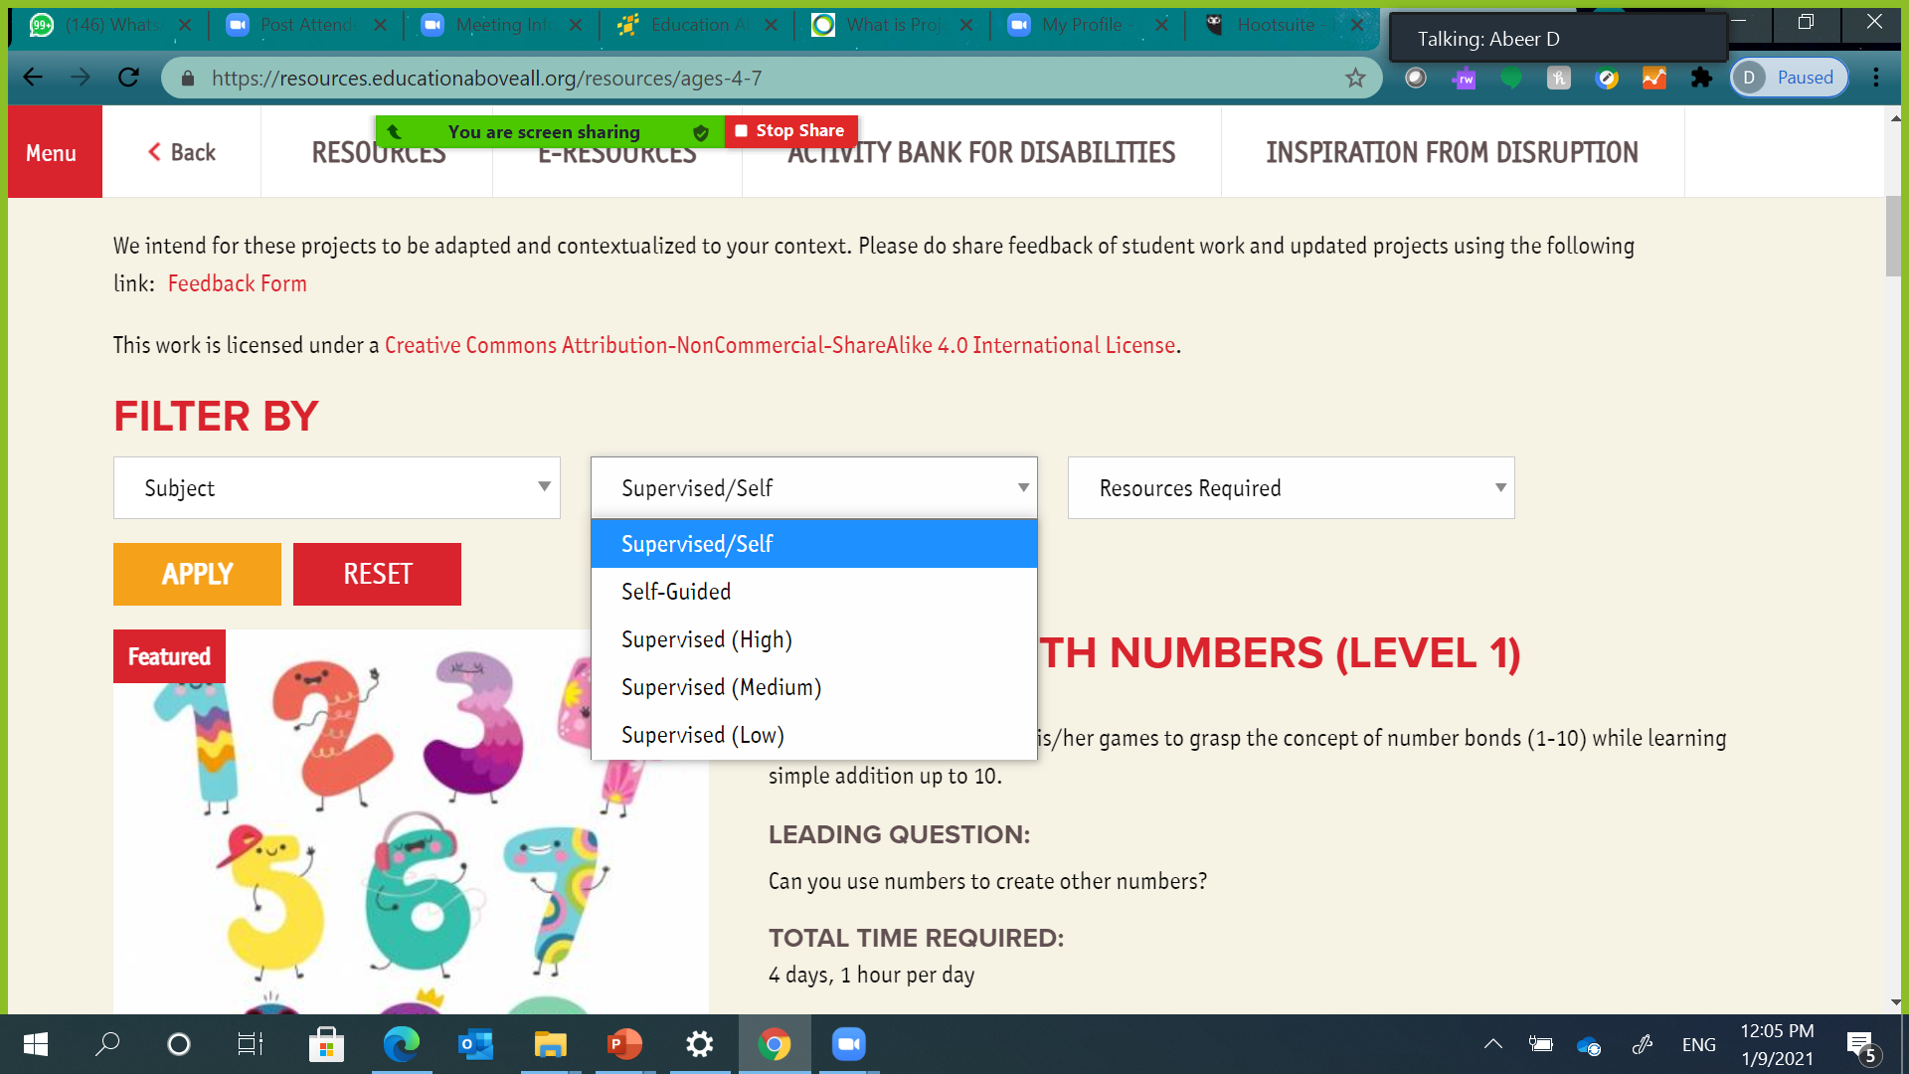
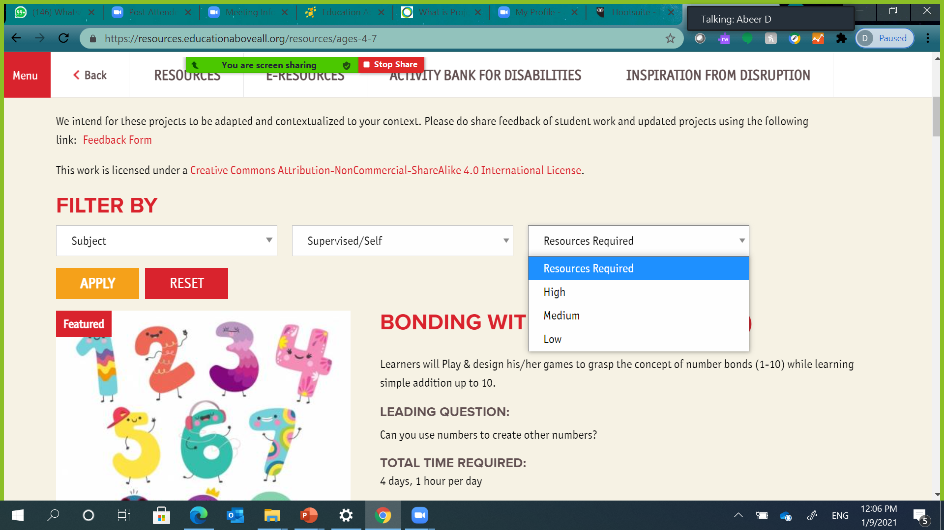
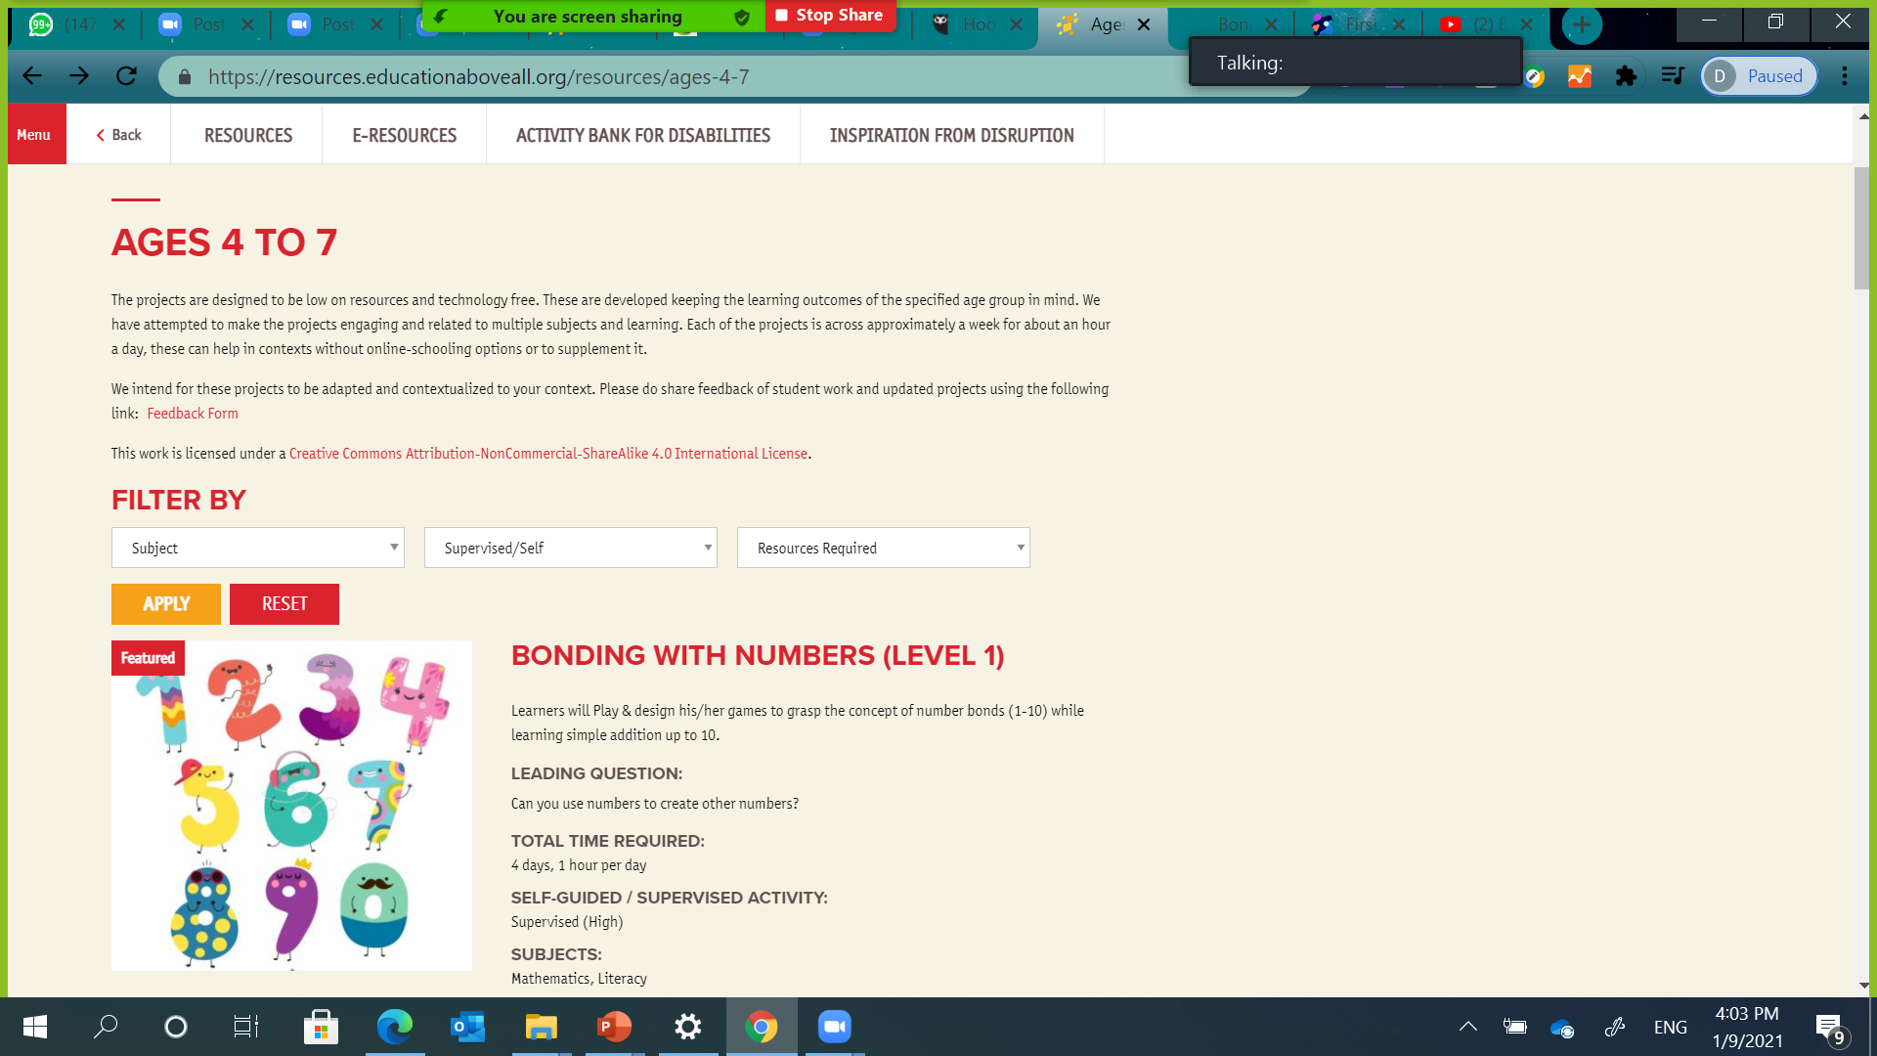
Booklet 1 – Project Selection
1.2. How to Access IFERB Projects Bank? (2/3)
1.2.2. If Online Access is Available: How to Use Online Filters? (1/2)
If you have access to internet, you can use the online filters provided by IFERB Project Bank to help you with your Project Selection.
As you see in Figure 1.3, there are five main steps to effectively use IFERB Online Filtering Tool. Read them and try them yourself.
1
3
Scroll down to choose students’ age group you are working with.
Visit EAA IFERB Resources Page:
https://resources.educationaboveall.org/
2
You can change the language by clicking on the “SWITCH LANGUAGE” button
4
You can use available filters to help you narrow down the projects based on Subject, Supervision Level and/or Resources Required. Click Button. The shortlist will only include projects related to what you are looking for; hence, it will save you time.
5
The projects’ shortlist will be displayed.
Figure 1.3: IFERB Resources Access & Filter Overview

Slide 13

Booklet 1 – Project Selection
1.2. How to Access IFERB Projects Bank? (3/3)
1.2.2. If Online Access is Available: How to Use Online Filters? (2/2)
You can use one or more of the available filters to narrow down suitable projects based on your students’ needs. There are three main filters: Filter by Subject, Supervised/Self-Guidance and Resources required. Below are general guidelines to better utilize these filters as per Figure 1.4.
Filter by Subject:
Filter projects based on the subjects you want to cover. Available subjects are Numeracy, Mathematics, Social Sciences, Social Emotional Learning, Science, Physical Education, Literacy, and Art & Design.
Tip:
Social Emotional Learning is a non-academic skill that you can read more about in Appendix B – Non-Academic Skills (section B.1).
4. You can use available filters to help you narrow down the projects based on Subject, Supervision level and/or Resources Required. Click Button. The shortlist will only include projects related to what you are looking for; hence, it will save you time.
Filter by Supervised/Self-Guidance:
Filter projects based on level of supervision required to carry out projects’ activities.
Figure 1.4: IFERB Online Filtering Tool
Tip:
The projects are categorized into “low-medium-high supervision”:
Low supervision projects imply that they can be done independently by students once the instructions and background are shared with them,
Medium supervision projects require additional inputs from family members
High supervision projects require educators to explain or share some conceptual knowledge
Based on what you know about your students and/or their parents (literate, cooperative …etc.), you can decide on the right level of supervision required to ensure successful implementation for the project.
1.3. How to Select Projects – Quick Start (1/4)
Select project(s) that are most suitable for you and your students.
You will eventually get familiar with project selection process and select multiple projects. In the meantime, the following instructions will help you narrow down your selection to one project that you will contextualize in the next Booklet.
Filter by Resources Required:
Filter projects based on the number and type of resources required to complete them.
Tip:
There are three main levels of required resources to successfully complete the projects:
Low level of resources usually involves just a few scrap materials that are easily found in homes,
Medium level of resources involves a significant number of scrap materials, some of which may not be found in homes.
High level of resources usually requires either sophisticated resources (e.g. non-scrap material) or some visual cues (pictures from textbooks etc.) that need to be provided.
You are a true life-long learner! Keep going!

Slide 14








Booklet 1 – Project Selection
1.3. How to Select Projects – Quick Start (2/4)
1.3.1. Select By Subject
If you are advanced educator and wish to select projects by specific skill(s), please refer to Appendix C for advanced project selection guidelines – (section C.1).
If you know the subject you want to teach, then you can do the following based on your internet access:
If you have been using IFERB Online Filter, you can download Project Documents, as shown in Figure 1.5, to easily consider the next factors.
1
If you have internet access, then use the IFERB online Subject Filter (https://resources.educationaboveall.org/); refer to Figure 1.3 in section 1.2.2.
If you have the projects documents (soft or hard copies) then you will notice that the project brief, Figure 1.2 in section 1.2.1, might not list the subject(s) covered in the project. You can briefly read the Project Document to get a better idea about the covered subject(s). Alternatively, you can just skip to the next step as you cannot select by subject at this point.
Tip – Advanced:
If you are an NGO or a school helping educators with Project Selection, try to categorize the projects by subject, or add the subject on the document. If you are an educator working with an NGO or school, try asking them for help to identify the subjects for the projects.
1
DOWNLOAD PROJECTS
Figure 1.5: IFERB Project Download Button
1.3.2. Select By Context (1/3)
Students’ context means their environment, community, culture, currency, available equipment, religion, situations, academic level, and any other specifics that can affect how students learn.
It is always an advantage if the selected projects are interesting to you. If you are not familiar with the topic, you can study it or explore it with the learners. If you don’t f eel confident that you can guide students in their exploration, you can also choose another project.
Then, you need to consider the following factors to help you with your selection:
A) Students’ Level
Try to get information about your students’ level even before you meet them or start the project with them.
Below are some suggestions for collecting this information:
2
Tip - Advanced:
Many of the projects are designed in sets with all three or two levels (age groups). Check all the levels to choose the level best suited for your students.
From NGOs
Schools’ Report Cards
Assumptions based on Curriculum
Community Visits
Previous Projects
If you are working with an NGO/partner, you can ask them if they have collected specific data about students’ levels and/or academic performance.
You might need to go to the community that you will be serving to get acquainted with the environment and maybe meet some of the students to get a general idea about their levels.
If this is not the first project your students undertake, then you can easily collect such data from previous project submissions and/or educators who taught them.
If you are working in a school, you can get students’ previous report cards. You can also try to acquire report cards directly from parents.
You can infer students’ level based on local curriculum expectations.
Students’ academic level will determine if the project under consideration is too easy or too hard for them. Also, there are non-academic skills that you need to be aware of, especially if you are teaching students from level 1 (ages 4-7); e.g., fine-motor skills, communication, comprehension …etc.
Now you can eliminate projects that are not suitable for your students’ level.
2

Slide 15
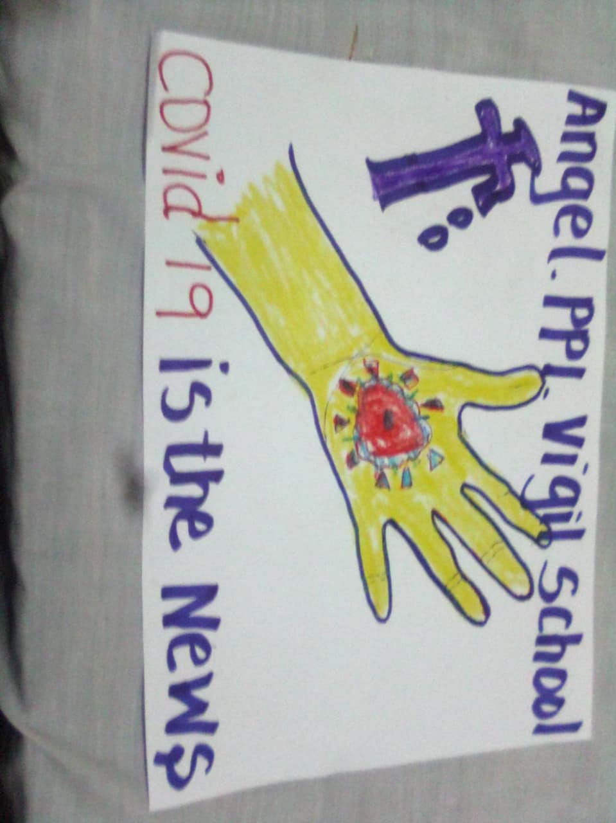
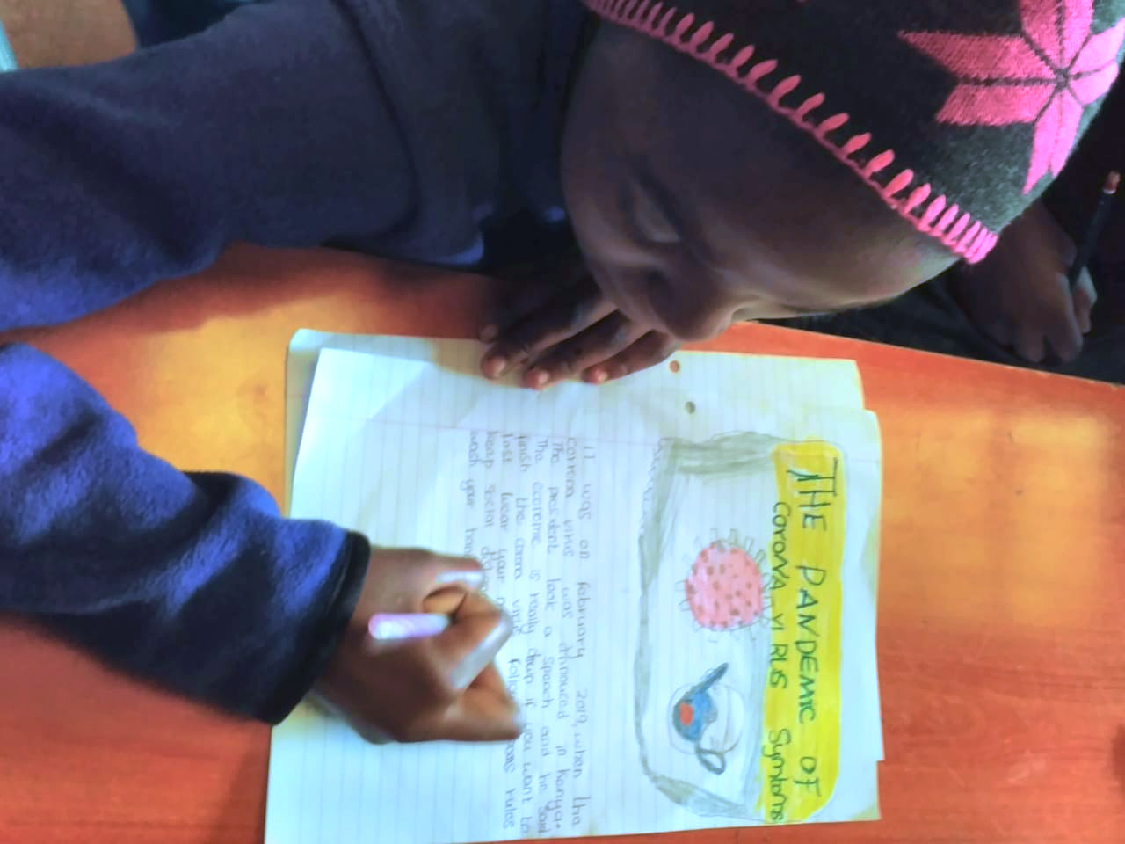
Booklet 1 – Project Selection
1.3. How to Select Projects – Quick Start (3/4)
1.3.2. Select By Context (2/3)
B) Students’ Environment & Interests
D) Guidance & Resource Requirements (1/2)
Selected project(s) need to be relevant to your students’ environment, which consists of their community, culture, news, interests and anything related to where they live and what is happening there.
Based on the news, advertisements, trends and what the local community is talking about, you can select the most relevant project(s) as you are trying to figure out what your students might find exciting.
If you have internet access, you can use IFERB free online filter, as per Figure 1.4 in section 1.2.2. to automatically filter by Guidance and Resources Requirements.
If you do not have internet access and/or only have the Project Document hard/soft copy, then you will need to refer to project brief or scan the projects’ activities to decide the level of supervision required to successfully implement this project.
Available supervision and resources for the students will also dictate whether a project is suitable or not.
Below is a further discussion on what to consider when making decisions about required guidance and resources:
Guidance Requirements
IFERB projects have been designed to be easily done from home with students leading the work; many projects can be done with minimum supervision.
There are three main supervision levels that can be filtered from IFERB projects bank: low, medium and high.
Based on what you know about your students and/or their parents (literate, cooperative …etc.) you can decide on the level of supervision required to ensure learning; you can read the project brief, Figure 1.2, to have a quick idea about the project.
For example, if you know that the parents are busy with work and they cannot offer supervision from home when needed, then maybe it is wiser to select projects that requires less supervision; i.e. low level of supervision.
In other situations, students might be 4 years old, for example, and one of the activities requires cutting a paper with scissors. Such young students will probably require high supervision to successfully cut the paper without hurting themselves. However, older students (8+ years old) probably already know how to cut using scissors, which means they need low supervision for this activity.
Tips:
Select projects based on what would resonate with your learners and being sensitive to their contexts.
For example, you might not want to choose a project on nutrition for those with some food shortages or activities that require outdoor activities for those in an urban setting.
C) Students’ Engagement
IFERB projects are designed to be engaging and to hold students’ attention.
Some projects are designed based on real-life experiences, while others are game-based.
Most projects give an opportunity for students to present in front of their peers, parents and/or community.
Based on what you already know about your students and/or their community, you can consider what project type would be most meaningful to students; the more meaningful the project is, the more engaging it will be.
Please note that the more relevant the project topic to students’ real-life experiences and interests, the more engaging it will be.
Impact of Students’ Successful Engagement When Selecting a Relevant Project
The more relevant the project is to students’ lives, the more likelihood for them to develop genuine interest in the project that can result in higher engagement and real-life impact. Below is an example from our Mantra4Change pilot’s impact:
Our House Rules to Keep Covid-19 Away is a project where students come up with rules to protect against Covid-19. In one village, students developed rules that were then adopted by the village authorities to generalize across households in the village to promote safe and hygienic practices.
Extra Reading
You can access this Project Document from Appendix A - (section A.6)
There is always a first time!
It is okay to make mistakes while learning!

Slide 16























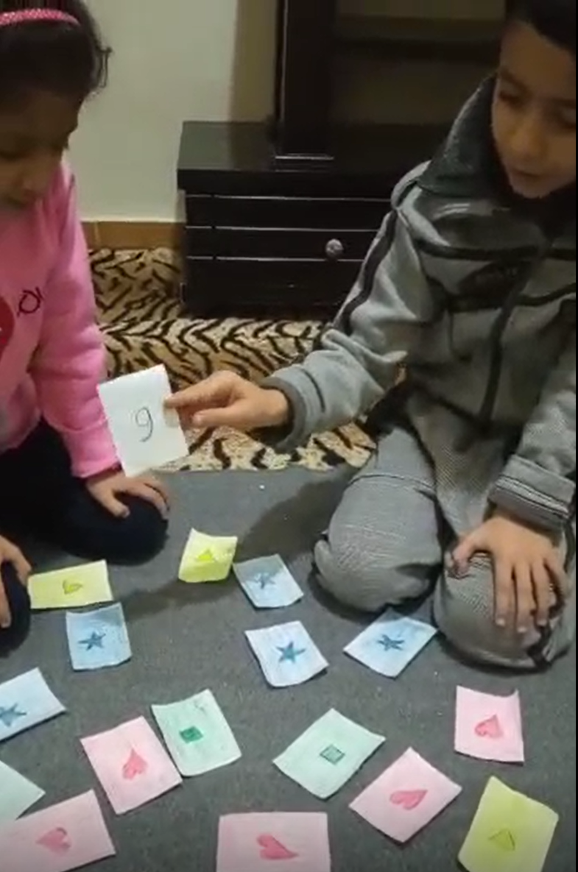

Booklet 1 – Project Selection
1.3. How to Select Projects – Quick Start (4/4)
1.3.2. Select By Context (3/3)
D) Guidance & Resource Requirements (2/2)
Resource Requirements
IFERB projects are also categorized based on the number and type of resources required to complete them.
There are three levels for required resources: low, medium and high.
You can refer to project brief from your projects’ documents, like the one in Figure 1.2, read the Supplies Required section to have an idea about required supplies and resources.
To help you decide the project is a good fit for your students, consider the following:
Tip:
Sometimes you will need to read the Project Document to be able to decide if all activities are suitable for your students or not. At this point, do not worry if some activities are suitable while others are not as this toolkit will guide on how to adjust these activities to meet your guidance level requirements.
Resources Scarcity – Low Resources
Some Resource Availability – Medium Resources
Resources are Available– High Resources
If most of the activities will be conducted from home and under the supervision of parents, then you might want to go for low resources requirements; these may involve just a few scrap materials that are easily found in homes; e.g. salt, sugar, flour…etc. These are usually paper and pencil.
Medium resources examples can include specific type of clothes, rocks, herbs or other scrap materials.
High resources can include specific chemicals and materials for scientific experiments. You need to make sure that these resources are available as well.
This toolkit will give you more guidance on how to substitute supplies for whatever is available around you and your students. This will be covered in the project contextualization section; Booklet 2.
After you go through the Project Contextualization booklet, you will be able to make better decision about supplies based on what you can substitute with available ones.
If you are an experienced educator who is familiar with local curriculums and comfortable with Project Selection so far, then read advanced practices for project selection process that can be found in Appendix C – C.1: Project Selection – Advanced Practices. Otherwise, go directly to section 1.4 to apply your Project Selection knowledge to build this competency.
Remember:
If you are working with an NGO or school, they might have already categorized projects based on guidance level. This is helpful if you only have access to projects’ hard/soft copies without any access to the online filter to help you select projects based on supervision level. Also, NGOs might be able to further guide you on the proper supervision level for your students.
Remember:
If you have internet access, you can use the Guidance and Resources online free filters available at IFERB, to help you filter faster through the available projects. Refer to Figure 1.4 from section 1.2.2 for more details.
Keep going, you almost finished Booklet 1!

Slide 17


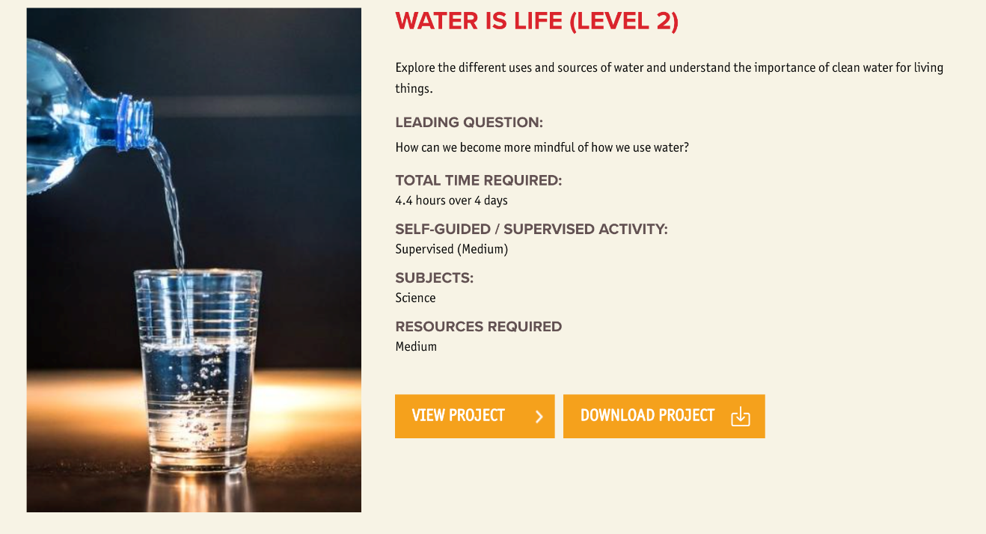

Booklet 1 – Project Selection
1.4. Application Exercise
Exercise/ Application:
Now that you know how to select a suitable project, it is time to apply this knowledge.
You can use IFERB online projects bank and filters if you have internet access, or you can select from most popular projects included in Appendix A – (Section A.2: Exercise Projects Options). This Appendix has three selected projects for different students’ levels for you to choose from.
If you choose to go with the examples included in the toolkit, kindly note that you only need to consider the project brief from the document; as the reading the rest of the document is covered in the next booklet.
Kindly note that there is no right or wrong answer to select or to contextualize projects. These guidelines are offered to help you make more informed choices throughout this process.
It is important that you go through the following exercise to develop Project Selection Competency before reading next booklet - Project Contextualization.
Check Our Example to help you with your Project Selection Exercise.
Exercise: Project Selection
The following questions are designed to help you navigate through the steps for Project Selection. Please rite down the answers to these questions.
Do you have a subject you want to cover?
If Advanced: What skill ( academic or non- academic skill) are you planning on teaching?
Did you narrow down projects to the ones you are familiar with?
Are you able to get information about your students’ level before the start of the project? If yes, how did you manage to get this information?
Can you eliminate any of the narrowed down projects based on what know about your students’ learning level?
Can you find project(s) that are suitable for your students’ environment?
Do you think that your selection so far will engage your students? Why or Why not?
What did you decide for guidance and resource requirements?
What is your final selected project(s)?
Toolkit Tip
When you select from the projects included in this toolkit, you get the advantage of comparing your answers with the provided examples.
Such comparisons will be focused on Project Contextualization, which will be discussed in Booklet 2.
Our Example:
Hi, my name is Mariam, and I am a teacher in Lebanon who started learning about IFERB Resources & PBL. I will show you how I use IFERB projects for my students. Our school is partially open because of current pandemic situation. Since the school is partially open, the medium level supervision is appropriate as I can supervise my students when they are in class and give them instructions for independent activities at home. Also, I will need to limit my projects’ selection for medium resources because the school might not be able to provide all high-level resources.
First, I selected Water is Life (Level 2) because:
My students are in grade 5.
I needed to target specific skills in science; hence, Subject is Science.
If Advanced: My targeted skills revolve around making a hypothesis, record observations, and draw conclusions about water cycle.
Figure 1.6: Advanced Exercise Selected Project Overview
Extra Reading
Hi, my name is Sam, and I will be helping Mariam to show you how we use IFERB projects for our students.
You can check another example found in Appendix A – (Section A.8: Extra Example for Project Selection & Contextualization – Code Languages Level 2
I am excited about this project because Lebanon has a big lake close to where my students live. In fact, Lebanon is known for having a lot of water sources. Lebanon’s weather helps to have huge quantities of water all yearlong. Therefore, my students will be interested in this project’s topic and can relate to it because it is part of their everyday life. Therefore, they need to learn the importance of water and saving it. I am also very familiar with this interesting topic.
You can check out my selected project, Figure 1.6, in Appendix A – (Section A.4: Toolkit Contextualization Example – Water is Life Project) or you can find it directly on EAA IFERB web page:
https://resources.educationaboveall.org/sites/default/files/resources/attachments/2020-07/Water%20is%20life%208-10%20Level%202.pdf

Slide 18


Booklet 1 – Project Selection
1.5. Summary/Checklist
Did you Access IFERB Projects Bank? Remember you will access them differently depending on your internet access.
Do you have a specific subject you want to target?
If you do not have subject in mind, then you need to select your project(s) using your students’ context as decision factor
If you have internet access, then you can use the IFERB online, free filters to narrow down suitable projects
Make sure that the project you selected covers your target subject
If you do not have a subject in mind, start your selection process form context (1.3.2)
Select by Context: you need to consider the following factors/elements of your students’ context to select most suited project(s) that your students can relate to.
Remember to consider Students’ Level:
Did you collect information about students’ level from schools, parents or organization…etc. ?
Did you check that you have select projects that are most suitable for your students’ learning level?
Remember to consider Students’ Environment & Interests:
Did you check news, advertisements, trends and what local community are talking about to get a feel of what your students might be interested in?
Did you eliminate any project(s) that are in direct conflict with your students’ context?
Make sure to select projects that are most suitable for your students’ environment and interests
Remember to consider Students’ Engagement:
Did you select projects that can be related to your students’ real-life experience to better engage them? Note: The more engaged they are, the more they will learn.
Remember to consider Guidance & Resource Requirements:
Based on what you know about your students, are you able to decide the level of support they will need to perform project’s activities?
Did you investigate the level of support your students have at home to work on the project?
Make sure to select most suitable projects for the level of guidance required to deliver it.
Did you investigate available resources for you and your students?
Can you find alternatives for some of the unavailable or scarce resources?
Try to select most suitable projects for the available resources.
Project Contextualization
Extra Reading
Detailed Checklist can be found in Appendix A – (Section A.5: Project Selection Checklist).
Stage 2
Stage 3
Stage 1
Project Selection
Project Implementation

Slide 19
Booklet 2
Project Contextualization
Competencies & Learning Outcomes
By the end of this booklet, you will be able to contextualize your selected IFERB project to fit your students’ learning level, environment and available supplies. The more relevant the project is to your students’ context, the higher the engagement and the benefit.
Booklet Content
2.1. Overview of Project Contextualization
2.2. Before Contextualization:
2.2.1. Get Familiar with Project Document
2.2.2. Understand the Project
2.2.3. Assess Students’ Previous Learning
2.3. Contextualize Projects Based on:
2.3.1. Students’ Learning Level
2.3.2. Students’ Environment & Relevance
2.3.3. Available Supplies
2.4. Summary
2.5. Checklist
Project
Selection
Project
Contextualization
Project
Implementation

Slide 20
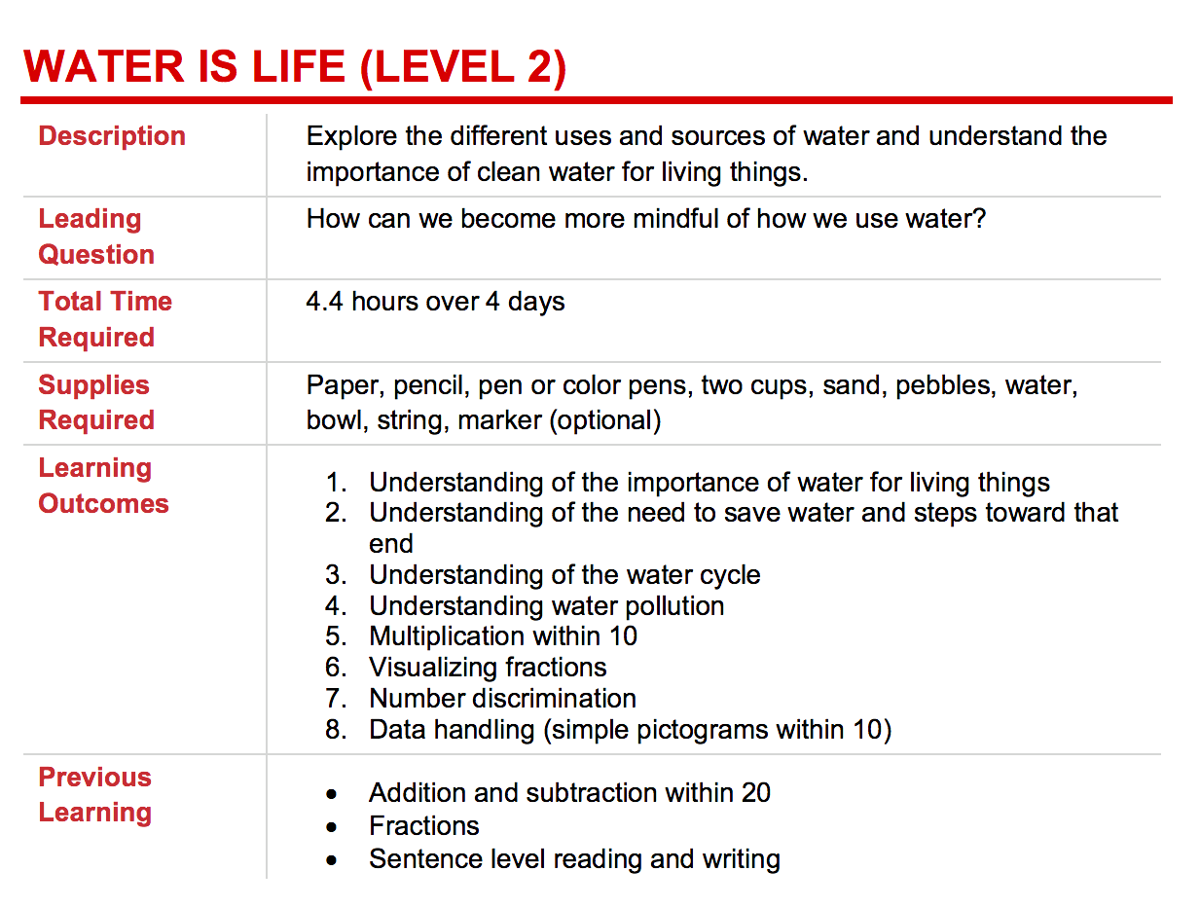
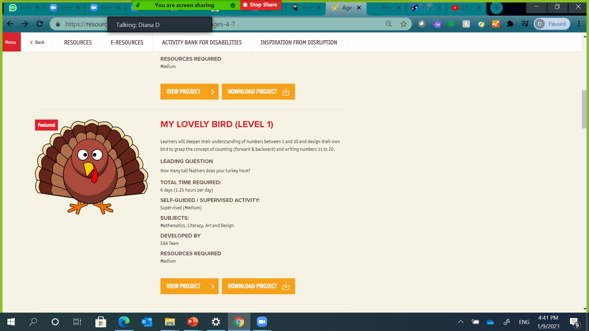
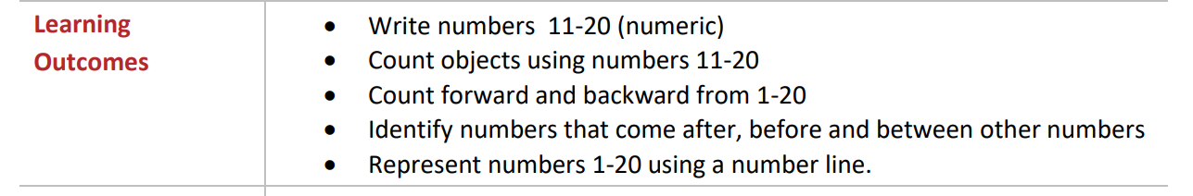
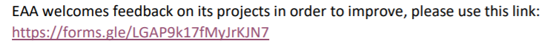

2.2. Before Contextualization (1/4)
Booklet 2 – Project Contextualization
2.1. Overview of Project Contextualization
Get Familiar with Selected Project Document See section 2.1.
This booklet will show you how to modify and adjust your chosen project to fit your and your students’ needs. This process is called “Contextualization.”
A context is defined as the circumstances that form the setting for an event, statement, or idea, and in terms of which it can be fully understood and assessed.
The more relevant the project is, the more engaged your students will be; hence, learn more.
Figure 2.1 showcases an overview of Project Contextualization steps that you need to follow to successfully contextualize your project(s).
Before you start contextualization, you will need to get familiar with IFERB Project Document (its structure).
Then you will find yourself reading the Project Document multiple times for different objectives in mind:
Objective 1: Read it for understanding.
Objective 2: Read activities and assess if they will be too challenging, too easy or just right for your students.
Objective 3: For advanced educators, you can refer to Appendix C – (C.2.1: Before Contextualization: Extract Subjects from Project Document) - to learn how you can extract subjects covered in the project.
Once the project is fully read and understood, you will be ready to:
Make the project easier or more challenging for your students based on their level.
Adjust the project to be more relevant to your students’ environment.
Prepare supplies and/or their alternatives.
Read & Understand Project
See section 2.2.1-2.2.2.
Assess Students’ Previous Learning
See section 2.3.2.
Start Contextualizing based on:
See section 2.3.
Students’ Learning Level
See section 2.3.1.
Students’ Environment & Relevance
See section 2.3.2.
Students’ Available Supplies/ Resources
See section 2.3.3.
Start Project Implementation (see Booklet 3)
Figure 2.1: Project Contextualization Steps Overview
2.2.1. Get Familiar with Project Document (1/2)
Before reading the selected project, let us give you an overview of the document’s different sections.
As per Figure 2.2, right below the title Water is Life (Level 2), you will find the project’s brief block that includes:
Description of the project – It explains the main idea of the project
Leading Question – It is a question that triggers students’ curiosity and interest to learn more about the project’s topic.
Total Time Required – It indicates expected time needed to successfully complete this project. Kindly note that your students may require less or more time.
Supplies Required – All needed supplies will be listed here.
Figure 2.2: Project Document – Block #1
Learning Outcomes – It includes a list of the learning results that this project is designed to accomplish. For example, My Lovely Bird (Level 1) project , Figure 2.3, will be reduced to an art and craft project if the project outcome “counting from 11 to 20” is not achieved; other skills, like fine motor, creativity, and eye-hand coordination will still be developed.
Previous Learning – This section will indicate if any specific prior knowledge is required for your students to successfully implement the project.
Figure 2.3: My Lovely Bird Project Overview
Kindly note that at the end of every page of the project document, EAA provides you with a form to submit your feedback about the any project; as shown in Figure 2.4, you only need to click on the link to access the form.
Figure 2.4: Project Document – Footer at every page

Slide 21
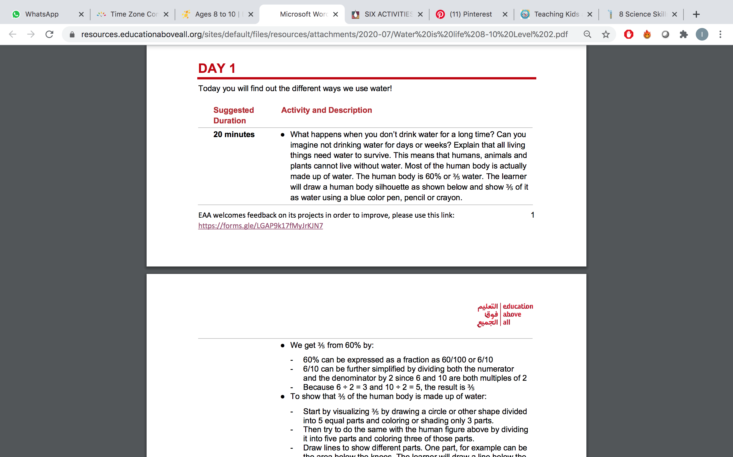
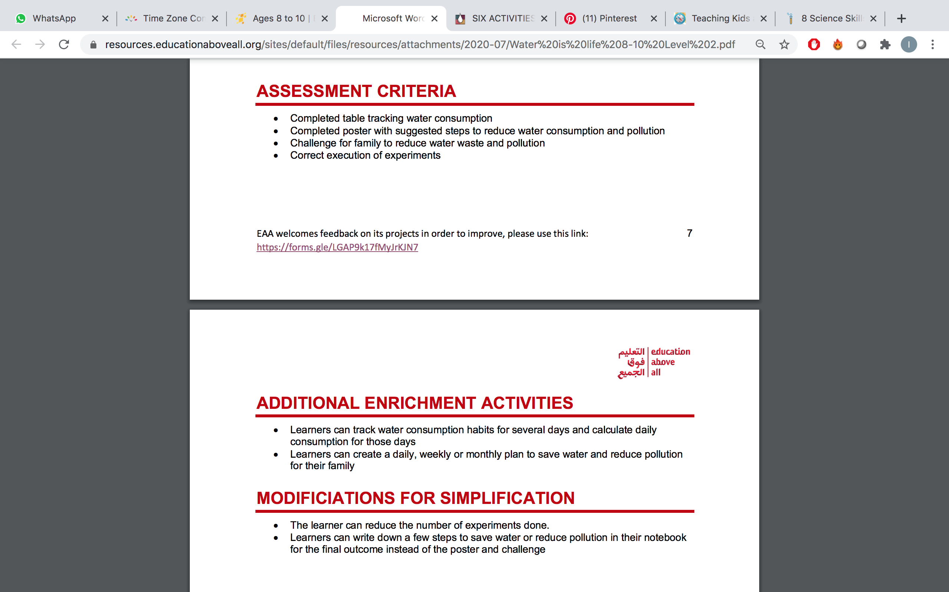
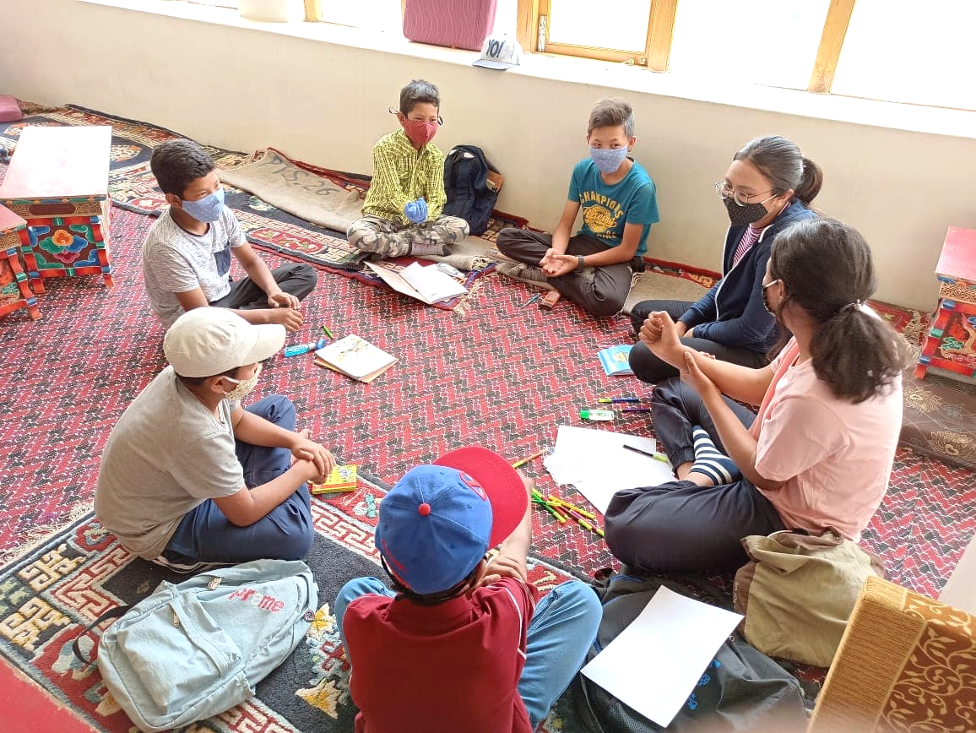
2.2. Before Contextualization (2/4)
Booklet 2 – Project Contextualization
2.2.1. Get Familiar with Project Document (2/2)
The next consecutive blocks are titled Day 1, Day 2 …etc. These include the daily activities/lesson plan.
Right below the block title (e.g., Day 1), you will find a sentence indicating the main objective of the lesson plan of that day. For example, in Figure 2.5, this objective is: “Today you will find out the different ways we use water!.”
Each daily lesson plan is divided into several activities that are organized in a table that indicates the Suggested Duration for every activity. All activities are detailed in Activity and Description column of the organized table.
Tip:
Suggested Duration for each activity gives you an indication of how long it takes. If you need more or less time to conduct a specific activity, do not panic! It is okay as you will continue the rest of activities the next day.
The following major block, Figure 2.6, is Assessment Criteria, outlines quality criteria based on which students’ work can be assessed. This criteria is usually in alignment with Learning Outcomes.
Block #4, Additional Enrichment Activities, includes a list of suggested activities to be used if the project’s main activities were too easy for students or if students can handle more challenging tasks for further enrichment and engagement purposes. An example is provided in Figure 2.7.
However, if the project and/or its activities seem to be hard for students, the Modifications for simplification block has suggestions to simplify some activities.
Figure 2.5: Project Document – Block #2
Figure 2.6: Project Document – Block #3
2.2.2. Understand the Project (1/2)
Now that you know the different blocks of the project document, it is time to read it.
If you read a new word that you are unfamiliar with its meaning, you can refer to the dictionary or https://translate.google.com to find the meaning. If there are multiple meanings for a word, pick the meaning that is closest to educational context.
Write down your notes when reading the project document along with any other questions.
Figure 2.7: Project Document – Block #4 & Block #5
Exercise: Read to understand the project
After selecting your project, start reading the Project Document and make sure you understand the project’s objective(s) along with any new vocabulary. Make sure to use the new vocabulary meaning in the education context. It might be helpful to write down the list of new words and their meanings in a notebook for your future reference.
Explore any new concepts/topics introduced in the project. Again, writing down a list of your questions about the project can be helpful if you want to further discuss with your peers.

Slide 22

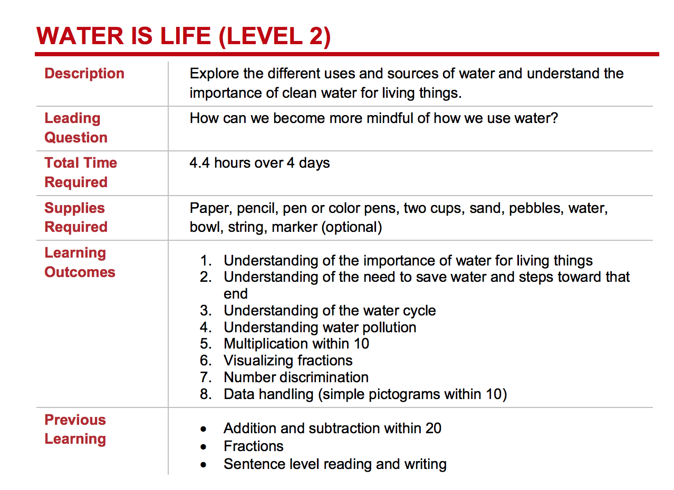
2.2. Before Contextualization (3/4)
Booklet 2 – Project Contextualization
2.2.2. Understand the Project (2/2)
You didn’t come this far to only come this far! Keep reading :)
Our Example:
First thing I had to do is to understand the objective of the project, Figure 2.8. When I did not know what a word meant, I looked it up and made sure I learned its meaning. I read the full project carefully and made sure that I fully understood the leading question and the activities included.
When I was looking for new vocabulary meanings, I noticed that some words might have multiple meanings/uses. For example, the word “Data” can refer to your phone internet data plan. However, in educational context, it refers to a collection of information, statistics, facts …etc.
A lot of the project’s concepts are explained in the Project Document. However, I had to further research the following concepts to make sure I fully understand them:
Source of water
Clean water
Water cycle
These concepts are crucial for understanding the project.
Figure 2.8: Project brief - Water is Life Project Document.
2.2.3. Assess Students’ Previous Learning (1/2)
As discussed earlier, when selecting the project, you can collect data to assess previous learning to ensure that they can successfully teach the selected project.
Start by checking Previous Learning Section from block #1 portion of the project document; refer to Figure 2.2 in section 2.2.1 to locate this block.
Try to ensure that your students have the necessary previous learning indicated in the project. You can always refer to local curriculum to give you an indication. If your students are not attending school and/or not following a local curriculum, you can still use the following steps to assess their previous learning.
The next step is to check Daily Activities (e.g., Day 1, Day 2 …etc.) from Project Document to anticipate any missing previous learning skills.
One way to help you anticipate these gaps is to picture a sample of students who you have taught before and who are close in age and context to your students.
Now try to imagine how will they react if you teach them the daily activities (do this for all daily activities to make sure you are well prepared).
During your imagination exercise, ask yourself the following questions:
Tip:
If you have not taught officially in schools, you can refer to your own experiences teaching/tutoring your children, neighbors, friends, relatives …etc. to get a feel of students’ possible previous learning.
Are there any skills that you are not sure your students are ready for? If so, then it is a good idea to dedicate one day (or activity) to validate if students’ skills and needed previous learning. For example, if you are not sure if your 4-years old students can use scissors, you can create an activity on the first day of the project to find out.
Keep in mind that students might not be experienced with this type of learning. However, their learning will start when they start doing and experiencing the activities. Try to decide if it is okay that they do not know a specific topic or activity before; they are expected to learn new topics, activities and skills.
2
3
1
Will they face any specific difficulties?

Slide 23


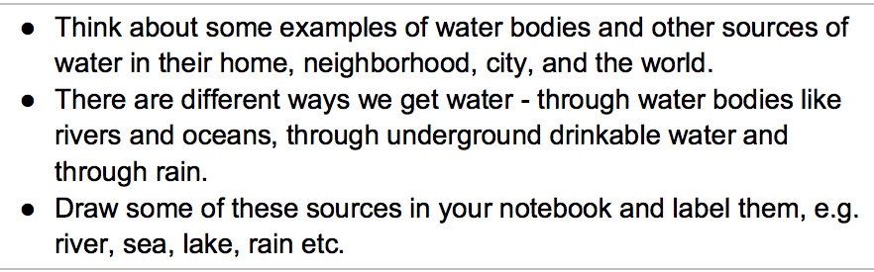
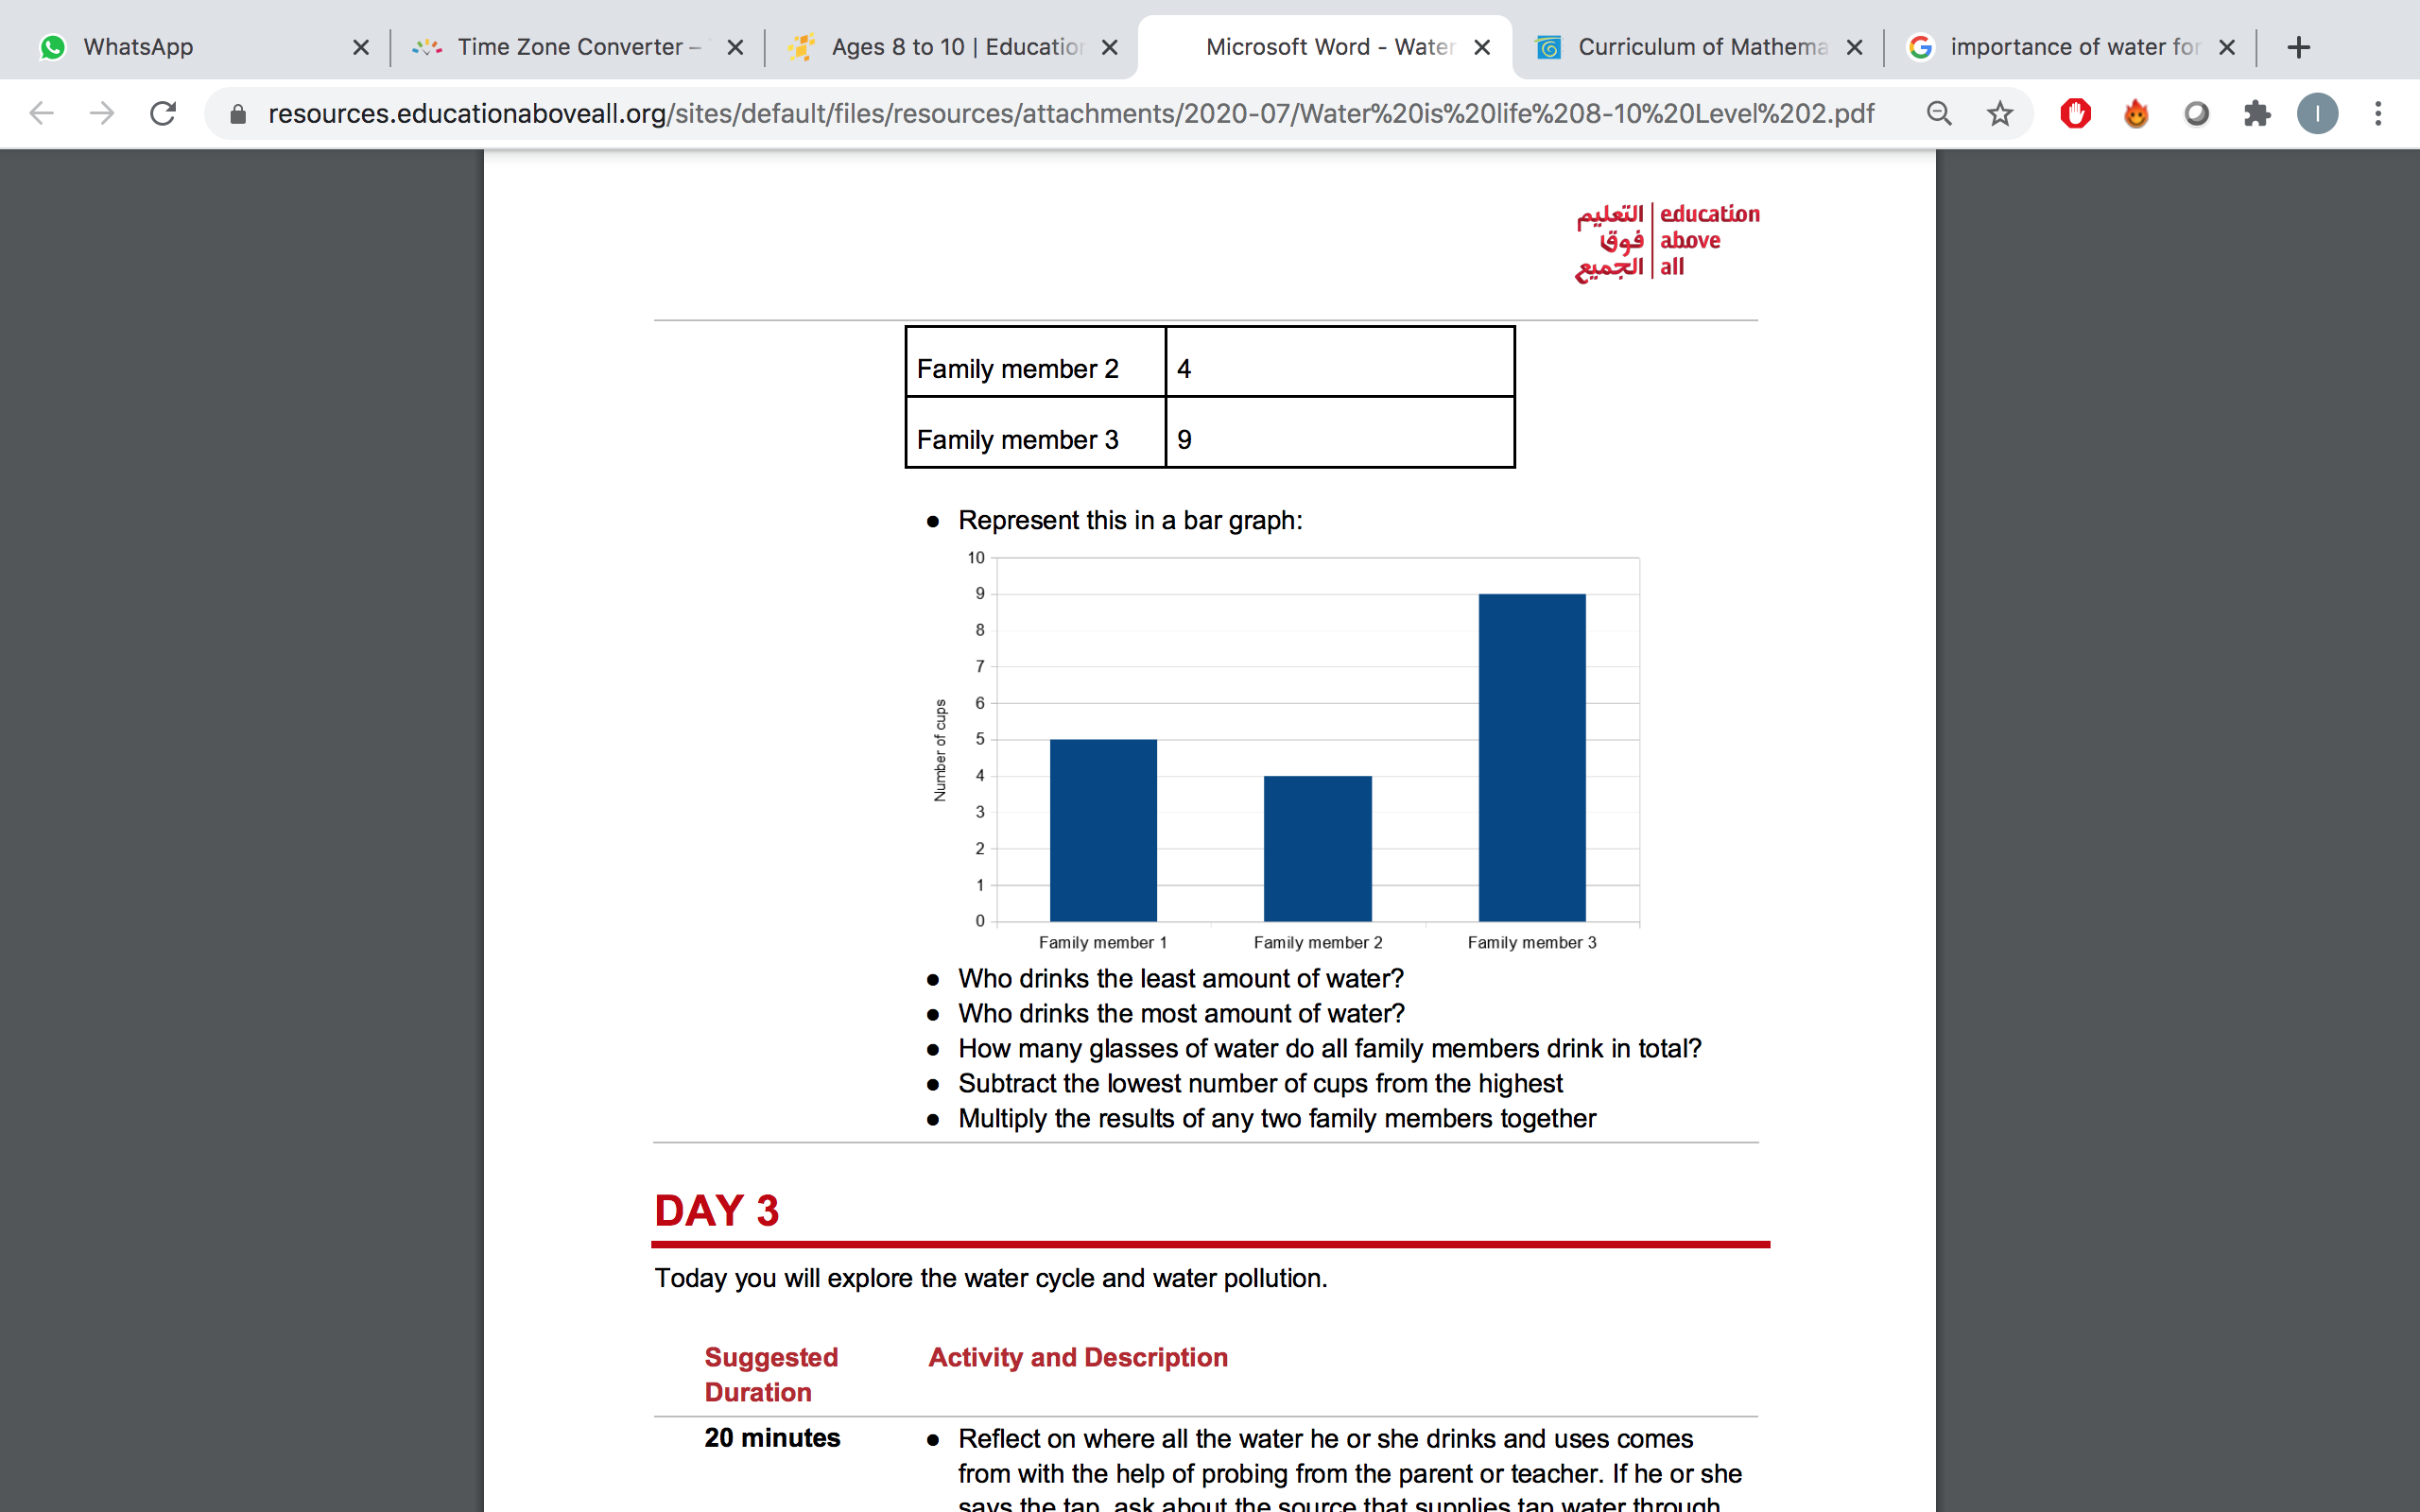

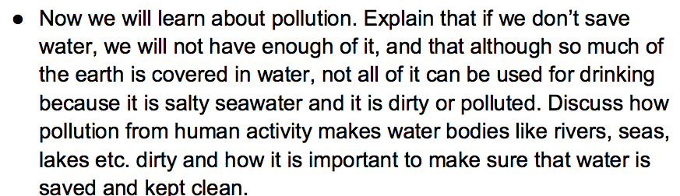
2.2. Before Contextualization (4/4)
Booklet 2 – Project Contextualization
2.2.3. Assess Students’ Previous Learning (2/2)
Always try to think about alternative activities (easier or harder), in case it is needed.
You can also check Block #1 from Project Document and read Learning Outcomes to further ensure that your students can achieve them.
If you are not sure if your students can achieve the Learning Outcomes, then you will need to take a second look at the skills students need to develop so they can perform project’s tasks and achieve the desired learning outcome. Instructions will be covered in more details later in the Implementation Booklet.
Let’s explore multiple examples to give you a better idea on how to anticipate skills’ gaps when reading Daily Activities
Question: What if you discovered that in the project that you have selected there is a big gap between required previous learning and students’ current level?
Tip:
Iterations & modifications are part of the process; even if it means you must change your selected project.
Rest assured that you have not wasted your time as you will probably get to use it in another context or later with the same students after they have developed required previous learning.
Our Example:
Activity from Project Document:
I am trying to assess students’ previous learning without having access to report cards and I have not taught them before.
All I did is try to put myself in my students’ shoes; I tried to think like an 8-year-old boy or girl. Sometimes I try to see if I know anyone who is 8 years old and try to see what I know about their knowledge.
You can see in Figures 2.9, 2.10 & 2.11 that I drafted questions to help me assess students’ previous knowledge.
My Questions:
Do students know the difference between river, ocean, sea, lake?
Do sutdents know what does drinkable water means?
Usually, I cannot inquire further information about my students until I meet them. So, a lot of times I decide to dedicate the first day for assessing their previous learning. The Project Implementation Booklet will cover this in more details.
Figure 2.9: Assessing Students’ Previous Learning- Example A
Activity from Project Document:
I also try to prepare myself that I will need to explain these concepts as new topics for my students before we start working on the project’s activity. Now remember that I still need to adjust project difficulty accordingly.
I have a confession! Sometimes I miss few concepts and I realize during the class that there are other gaps. For example, I never thought that some of my 7 years old students would not be able to use scissors. I had to create a gap-activity in the middle of the project where I asked all students to draw different lines on a paper, and then start cutting the papers carefully over the lines. Then I paid extra attention to the students who had this gap. The Project Implementation Booklet will cover dealing with different students’ levels in more details.
My Question: Do students know how to read or make a graph?
Figure 2.10: Assessing Students’ Previous Learning- Example B
Activity from Project Document:
Exercise: Assess your students’ previous
Try to assess your students’ previous learning required for your selected project(s).
My Question: Do they know what does pollution mean in general?
Figure 2.11: Assessing Students’ Previous Learning- Example C

Slide 24
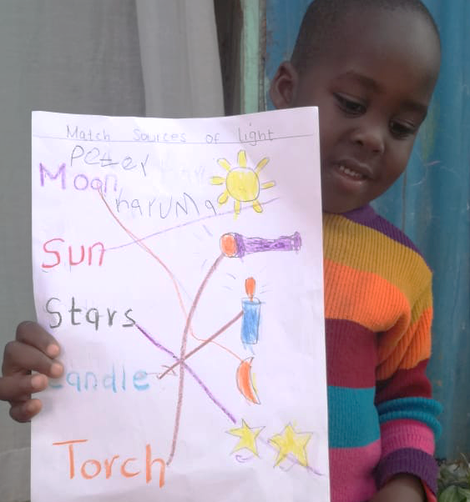

Booklet 2 – Project Contextualization
2.3. Contextualize Projects Based on: (1/3)
2.3.1. Students’ Learning Level
Based on your assessment of your students’ learning in section 2.2.3, you now have a better idea if the projects’ activities are too easy or too hard for your students.
At this point, there are multiple decisions you will need to make:
A) Simplifying your project
Sometimes you need to simplify the activities to ensure they are doable by your students. There are three options to simplify your project:
Option 1: Some activities contain suggestions to make them easier on your students. For example, one activity requires exploring students’ city, state, country and continent. This specific activity has a suggestion to only explore students’ city and country to simplify it for learners. So, keep an eye for these useful suggestions.
Option 2: You can simplify the whole project by referring to the Modifications for Simplification block found towards the end of your Project Document.
Option 3: If you think that an activity is too challenging and cannot be simplified enough to match your students’ learning levels, you can eliminate this activity as long as you make sure that the project is still coherent as a whole and that its learning outcomes can still be achieved.
B) Enriching your project
If you think that some activities are too easy for your students and that they can handle more challenging ones, then you can refer to the Additional Enrichment Activities block for suggestions to elevate the project’s activities to match your students’ advanced level.
You can also eliminate an activity if it is too easy for your students and if you cannot enrich it enough to match their learning level. Make sure that the project’s coherence and learning objectives are still intact after this elimination.
Exercise: Contextualize your selected project based on your students’ learning level
Make sure to decide if you need to use Modifications for Simplification or Additional Enrichment Activities blocks.
2.3.2. Students’ Environment & Relevance (1/2)
At this point, you need to go over daily activities and read them again. However, this time you need to read them with an eye for relevance to your students.
For example, if an activity is about nutrition and food while your students’ community faces daily nutrition related challenges, then such activities are not relevant to your students’ context and need to be adjusted or eliminated.
Before you attempt adjusting irrelevant activities, you need to fully understand their objectives. Try to ask yourself the following questions:
For example, if an activity requires a beef burger while it is against some communities’ religion, then this activity can be adjusted by replacing the beef burger with something that is more acceptable and common, but you will need to ensure that the adjusted activity meets the same objectives as the original one.
Sometimes you will only need to adjust the name of the city or country, for example, to make sure that the activity is relevant to students’ environment.
Check our example next page to help you with this exercise.
What does this activity accomplish?
What skills is it developing?
Are there irrelevant pieces in the activity? Why? Could I get rid of them without affecting the flow of the project?
Is there another way that I can achieve the same result?
What other relevant activities can I use to achieve the same goal?
Exercise: Contextualize your selected project based on your students’ learning level
Try to contextualize your selected project to make the activities more relevant to your students’ environment.

Slide 25
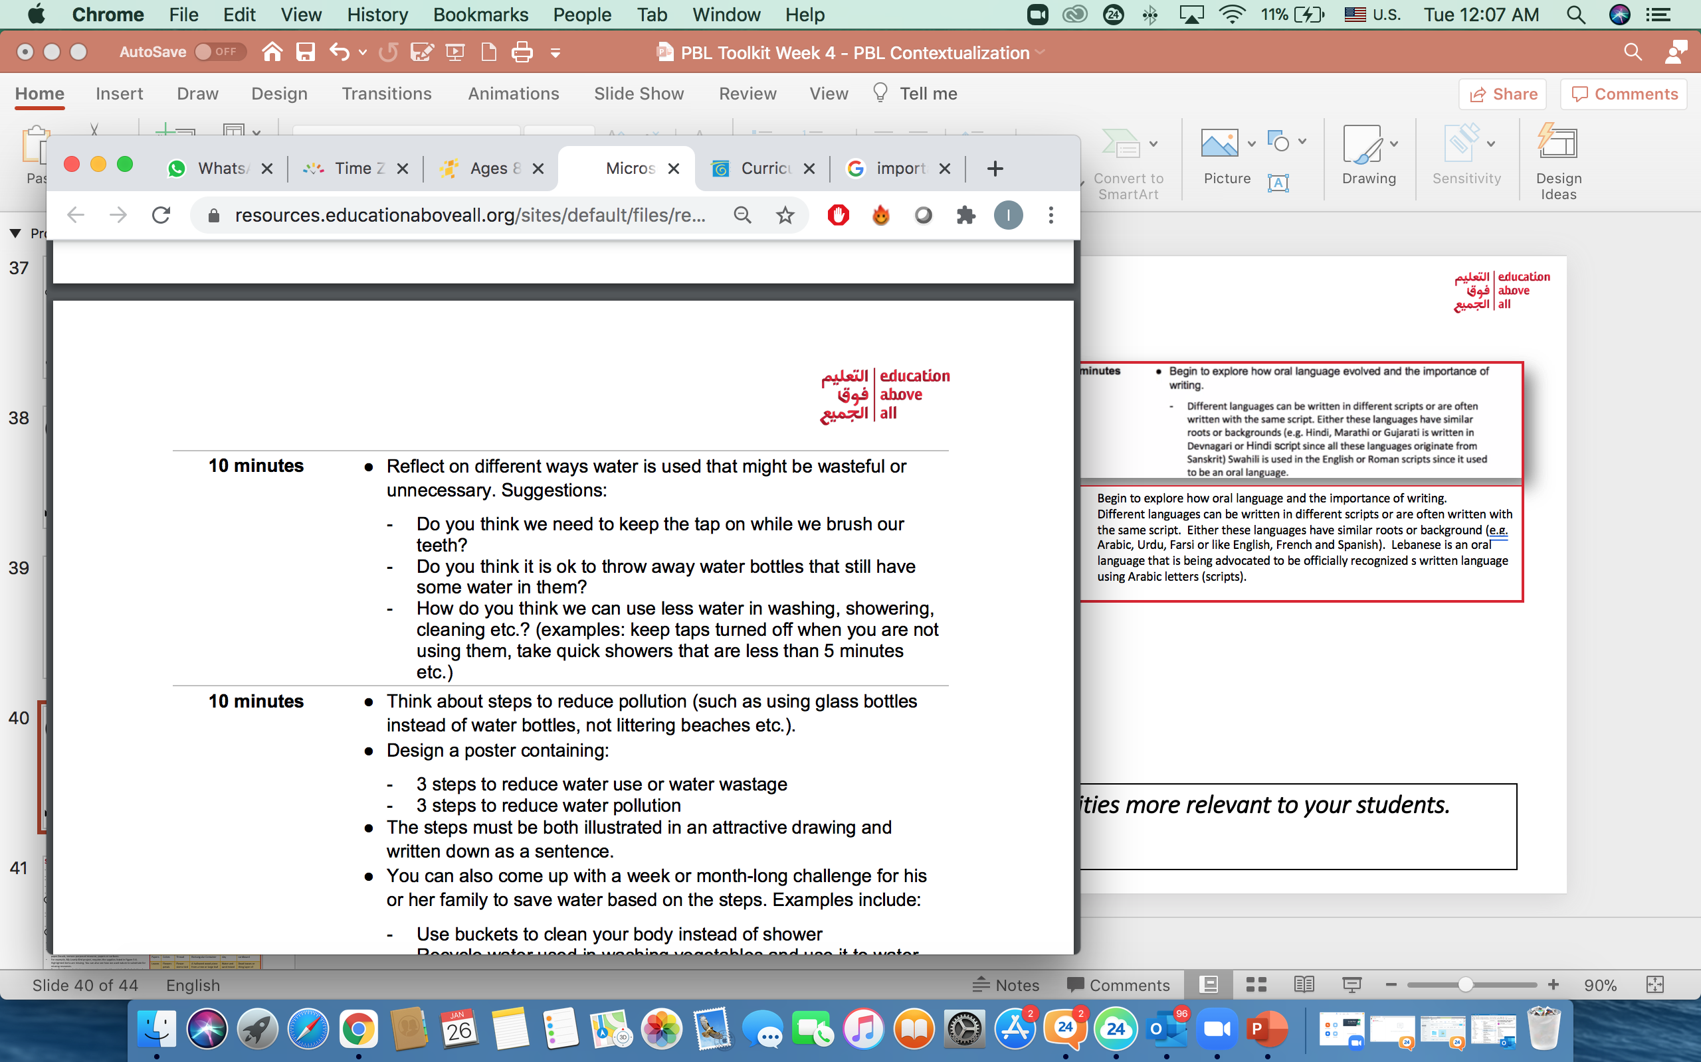
2.3. Contextualize Projects Based on: (2/3)
Booklet 2 – Project Contextualization
Activity from Project Document:
2.3.2. Students’ Environment & Relevance (2/2)
Our Example:
My contextualized script for the above activity:
I bring out my notebook and start writing down everything I know about my students’ community and their general interest. I also try to think of any community-specific factors and stories that explain why water is important to this specific community. For example, why clean water is very important for Lebanese students?
After I finish my thought process about every activity, I modify the wording of some activities to match my findings; check my examples in Figures 2.12 & 2.13.
I added to the suggestions list:
The water problems during the summer. Why should Lebanese people buy water during the summer?
How can we motivate our community to stop wasting water?
1
Figure 2.12: Making project more relevant - Example A
Tip:
If you know you will be working with the same students on multiple projects, then try to scan for missing supplies that are used in all the projects that you are planning to teach. This way, you save time in collecting this information.
Activity from Project Document:
My contextualized script for highlighted steps of the above activity:
The pollution in Lebanon is another big problem that the Lebanese people have been dealing with for years. Think about steps to reduce pollution …
What is our role in stopping this pollution? How to encourage everyone to help?
2.3.3. Available Supplies (1/2)
Figure 2.13: Making project more relevant - Example B
Once you make sure that the project has been modified to fit students’ levels, interests and context, you are ready to check supplies.
After you look at the supplies, check whether they are all available to you.
If you have all of them, congratulations! Now you need to think about your students. If they are going to engage in the projects from home, then you need to consider the possibility that some of the material/supplies are not available to them.
At this point, some educators would choose to visit their students and provide them with the missing supplies.
Alternatively, schools/organizations might be able to provide students with missing supplies. If so, then it is recommended to dedicate a day before starting the project to scan students’ missing so they can be provided to students.
In the event there are missing supplies and there is no easy way you can acquire them or provide them to your students, then you will need to get creative in how to find alternatives.
First, you will need to decide if the missing supply is essential to deliver the learning objective or not. For example, in Water is Life project, you cannot really substitute water (a supply) with something else. Another example, if a project’s activity is to test if salt is water soluble or not (dissolves in water), then you cannot substitute salt with sand because sand cannot be dissolved. However, you can substitute salt with sugar as using any of them will lead to the same learning outcome.
If some non-essential supplies are missing, creativity and resourcefulness become critical to find alternatives for the missing resources.
2
Tip:
It is recommended for educators to share experiences and help each other on how they substituted their missing supplies.
2
1
You got this!

Slide 26








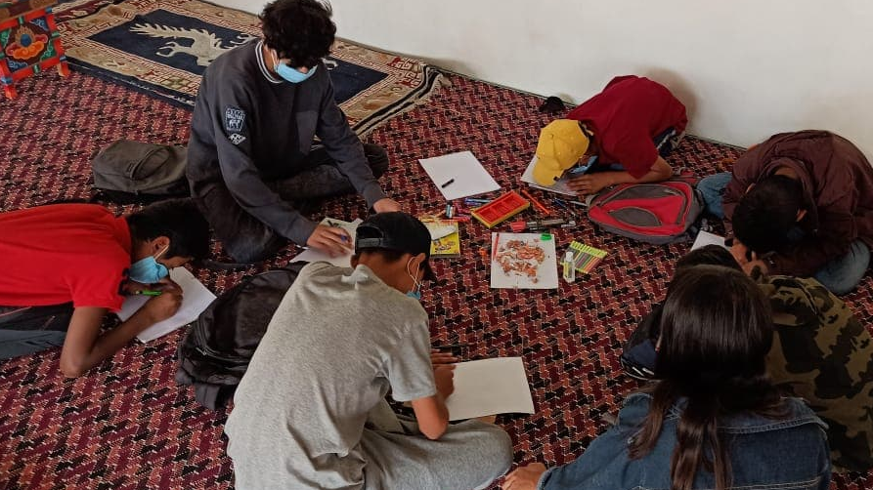
Booklet 2 – Project Contextualization
2.3. Contextualize Projects Based on: (3/3)
2.3.3. Available Supplies (2/2)
To be resourceful, you need to start with your environment; i.e., search for what is naturally around you.
Twigs, tree leaves, flowers, rocks, sand, bird feathers, dead leaves …etc. can be used to substitute a variety of supplies, such as sticks, papers, colors, weights, beads, and/or texture-purposed resource such as papers or surfaces.
For example, My Lovely Bird project requires the supplies listed in Figure 2.14. Highlighted items are missing. You can also see how nature was used to substitute for missing resources.
To confirm if our substitutions are accurate, you should revisit the Daily Activities for each project to make sure that the alternative can achieve the same original purpose.
Supplies Required: Paper, tracing papers or any blank paper, pencil, colors, thread, glue, scissors, ruler, any objects for counting (stone, sticks, leaves), sand, rectangular container, clay, cardboard, circular objects.
Papers | Colors | Thread | Rectangular Container | clay | cardboard
Leaves | Flowers’ petals | Flower stems tied together | A hallowed wood piece from a tree or large leaf | Water and sand mixed | Dead leaves or thin layer of wood from a tree
Exercise: Contextualize Project Based on: Available Resources
Check your selected project’s supplies and decide on alternative supplies based on your and your students’ context and available resources.
Figure 2.14: My Lovely Bird Project – Supplies Contextualization
Supplies Required: Paper, pencil, pen or colors, pens, two cups, sand, water, bowl, string, marker(optional)
Ink can be replaced by → Thyme Oil / Gum Arabic | Matchstick can be replaced by → Lolistocks or branches | Lemon Juice can be replaced by → Vinegar
Our Example:
There is no one specific way of contextualizing resources. I used my own experiences and knowledge about my students’ context (environment and available resources) to find alternative supplies for scarce or missing supplies.
Sand can be replaced
by → flour
Color pens can be replaced by → natural food coloring
String can be replaced by → some green leaves
Check my examples in Figure 2.15 to have a better idea on how to replace project’s supplies with more available ones.
Finding alternative supplies gets easier with practice.
Figure 2.15: Preparing supplies’ alternatives - Examples
Extra Reading
You can read more about this project in Appendix A (A.6: IFERB Project Contextualization Examples).
Impact of Effective Contextualization
The more relevant the project is to students’ context, the more engaged the students will be. Below is an example from our Mantra4Change pilot’s impact :
ABC by Me is a project where students revise their ABCs and create their own ABC book. In our pilot with Mantra4Change, students in one village designed their own ABC books using vocabulary words from their own context and environment. They then donated their books to children who did not have books.

Slide 27
2.4. Summary
Booklet 2 – Project Contextualization
This Project Contextualization flow chart summarizes the key elements and factors you need to consider when contextualizing projects to maximize their relevance to students so that you can maximize their engagement and learning.
When it comes to contextualization, there is no one-size fits all because every context is different. You need to modify the selected project(s) to better fit your students’ learning levels, internet, and environment for the purpose of increasing the project’s relevance so students can better engage with it. You will also need to modify the project based on the available support for your student’s guidance. You will need to simplify activities if there is limited students’ guidance support provided from home and/or school. You will also need to find alternatives to unavailable resources.
Get Familiar with Selected Project Document (see 2.2.)
Read & Understand Project (see 2.2.1. – 2.2.2.)
Assess Students’ Previous Learning (see 2.2.3.)
Read each included activity (see 2.2.3)
Note out the activities that needs to be adjusted & reason for adjustment – as a reference for you. (see 2.2.3)
No
Can your students perform the activity?
Yes
Start Contextualizing based on: (see 2.3)
Students’ Learning Level (see 2.3.1)
Use Modifications for Simplification included in Project Document (see 2.3.1)
Why can’t your student perform specific activity?
Too Challenging
Too Easy
Use Additional Enrichment Activities included in Project Document (see 2.3.1)
Students’ Environment & Relevance (see 2.3.2)
Adjust activity to be more relevant/engaging or eliminate it if you cannot adjust it. (see 2.3.2)
Extra Reading
Is there any activity that is not relevant and/or engaging to students?
Yes
Check out an original IFERB Project Document and compare it with the Contextualized one. Find it in Appendix A (A.7: Original Project & Contextualized Project Scripts). Can you spot the differences?
No
Students’ Available Supplies/ Resources (see 2.3.3)
Are all required resources available?
No
Prepare alternative resources (see 2.3.3)
Yes
Start Project Implementation (see Booklet 3)

Slide 28

2.5. Checklist
Booklet 2 – Project Contextualization
Before you start contextualizing the selected project, make sure that:
You are familiar with Project Document
You have read the Project Document and you Understand the Project and their activities
You Assessed (took notes for) each activity against what you know about your students’ previous learning.
Start contextualizing your selected project:
Adjust activities based on your students’ learning level.
Use Modification for Simplification block in the Project Document to simplify the project, if applicable.
Use Additional Enrichment Activities block found in Project Document to make the project a bit more challenging, if applicable.
Modify or eliminate any activities that are not aligned with your students’ environment (culture, social norms, news, habitat conditions…etc.)
Identify limited or unavailable resources/supplies needed for the project.
Find alternatives for unavailable supplies.
Is there anything extra you need to do to make the project even more relevant to your students?
Project Contextualization
Stage 2
Stage 3
Stage 1
Congratulations! You have made it! Now it’s time for action!
Project Selection
Project Implementation

Slide 29
Booklet 3
Project Implementation
Competencies & Learning Outcomes
By the end of this booklet, you will be equipped with tools and strategies to deliver your project(s) using remote channels without compromising the quality of your interaction with your students. You will learn how to setup an effective teaching and learning environment, where you will be using simplified and differentiating instructions to successfully build students’ curiosity, creativity and reflection skills. You will also learn how to receive your remote students’ work for assessment purposes. Moreover, you will be able to design the best assessment framework that best suits your objectives.
Booklet Content
3.1.1. What is Project Implementation?
3.1.2. Remote Communication Channels
3.1.3. Implementation Guidelines Overview
3.2. Giving Instructions to Students:
3.2.1. Introduce Activities to Students
3.2.2. Differentiating Instructions
3.3. Fostering Effective Learning Environment
3.3.1. How to setup an effective learning environment?
3.3.2. How to Effectively Involve Parents?
3.3.3. Guidelines to working with students – KWL framework:
A) Building Curiosity and Interest
B) Creating Space for Creativity & Ownership
C) Developing Capacity for Reflection
3.4. Receiving Students’ Work
3.5. Conducting Assessments & Evaluation – Assessment Framework:
4.5.1. Baseline & End-line Assessments
4.5.2. KWL Framework
4.5.3. Daily Observations
4.5.4. Quizzes
3.6. Conducting Remote Assessments
3.7. Summary
Project
Selection
Project
Contextualization
Project
Implementation

Slide 30





Booklet 3 – Project Implementation
3.1. Project Implementation Overview (1/2)
Once your project is contextualized and ready for your students, it is time to consider how you will deliver/explain it to them.
It is taking your contextualized project into action so that you can finally interact with your students and enable them to master all the learning outcomes.
Pay attention to how you deliver instructions so that they are clear to students and can be easily followed. Sometimes it is helpful to write down scripts for your instructions- These are discussed in Appendix B - (B.2: Activities’ Strategies & Instructions).
You also need to consider the channel you are using to reach students if they are not going to be in the same classroom with you.
There are multiple ways to remotely reach students. Each remote channel has its own characteristics, advantages and challenges. This booklet will provide you with tips and best practices to overcome these challenges.
This booklet will focus on the following remote channels:
3.1.1. What is Project Implementation?
Phone: A phone is one of the available technologies.
However, not all phones are smartphones, which can be connected to the internet and have advanced features.
Your students may only have access to a basic phone. Therefore, you will need to consider the following when dealing with different levels of available phone technologies.
3.1.2. Remote Communication Channels (1/2)
Voice/Audio:
SMS/TEXT:
Internet-based multimedia messaging apps (e.g. WhatsApp):
Tip:
Availability of mobile devices can be a challenge especially in larger households, where many people are sharing one phone. In this case, you need to be flexible and allow students to work at their own pace. Pre-recorded voice messages can be useful here.
When using your voice to deliver instructions of Daily Activities,
you will face the challenge of not being able to draw a picture or use any visual aids. Some students (and teachers) are highly visual learners, which makes it even more challenging to explain tasks.
if you do not have phone conferencing capabilities, which enables you to do group calls with multiple students, you will likely be calling one student at a time. While calling each student individually can be time consuming, it is an opportunity to bond with each one of them.
you cannot see students’ faces to assess if they understood or need further clarifications. You can only count on audio instructions and feedback.
When you can only send text messages to your students,
you will need to be extra precise in your messages to ensure that your students understand.
One advantage of using SMS over Voice/Audio is that you can save time by copying and pasting your instructions.
One disadvantage is losing real-time feedback from your students. However, students can reply with an SMS with questions if they have sufficient literacy skills.
You might be restricted to specific number of characters (e.g. 160 characters) when composing messages. This restriction will dictate your instructions’ style. To learn more about the latter, refer to Appendix B – (B.2: Activities’ Strategies & Instructions)
If your students have access to WhatsApp,
you can send text instructions, voice messages, images and videos.
You may also have the option of conducting lessons in audio and/or video calls format.
You can create a WhatsApp group where students can also connect and help each other and ask you questions.

Slide 31










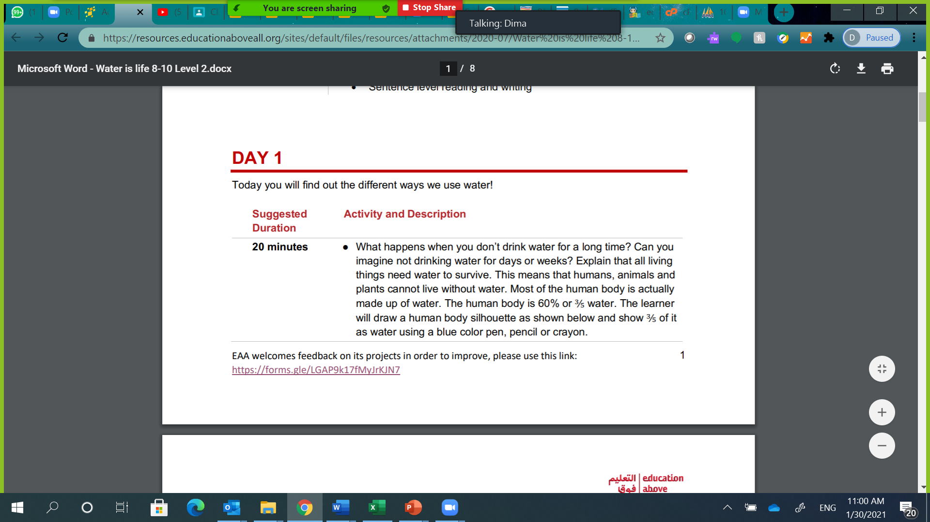
3.1. Project Implementation Overview (2/2)
Booklet 3 – Project Implementation
3.1.2. Remote Communication Channels (2/2)
Radio:
There are two ways to deliver lessons over the radio:
When delivering the lessons over the radio, you will experience the same challenges of using phones for audio/voice instructions. The extra layer of difficulty is that you cannot receive real-time feedback from all students to verify if they have understood the task or if they require further clarifications. While you may not receive real-time feedback from all students, some students can call the radio to ask questions – same way a listener calls a radio station to request songs. This method of delivery may be better suited to deliver stories to enhance students’ listening and comprehension skills.
1) An educator teaching over the radio while students are gathered somewhere listening to the radio with a facilitator/volunteer who will be answering students’ questions and collecting their work.
2) An educator teaching students over the radio while students are listening independently without a facilitator present to guide them.
Internet-Based Video Conferencing – (e.g., Zoom):
When using internet-based video conferencing tools, such as zoom, you get all the benefits of using WhatsApp as a channel. Additionally, you will have the ability of sharing your computer’s screen (to share a PowerPoint or a video) so it will be displayed on your students’ devices as well as yours. You can also interact with your students in real-time and record the session to share it with your students as a reference to help them complete their projects’ assignments. However, there may be some technical difficulties that you might face with Zoom.
3.1.3. Implementation Guidelines Overview
The following section details project implementation guidelines and best practices for successfully introducing the project to your students.
The factors that you need to consider when supporting students in the development of the project are:
Giving instructions to students (section 3.2):
Fostering an effective learning environment (section 3.3):
Simple and clear instructions are essential to successful PBL in a remote environment. Students’ different levels require different types of instructions (differentiating instructions). These instructions are particularly important when supporting a PBL activity; whether remotely or not.
The educators’ mindset is essential to spark students’ interest and curiosity and develop reflection skills along with 21st century skills. The KWL framework (What I Know, what I Want to Know, What I Learned) supports this mindset. Since parents are part of the learning environment, educators can apply specific guidelines for parents’ involvement.
Receiving students’ work (section 3.4):
Conducting assessments & evaluations (section 3.5):
Projects have specific recommendations to help educators overcome challenges related to receiving students’ work in remote learning environments.
IFERB includes an assessment framework designed to help you track students’ understanding and growth.
Lesson Objective
Duration
Activity
Strategy to deliver the activity to meet the objectives
Figure 3.1: IFERB Lesson Plan in Project Document

Slide 32
Booklet 3 – Project Implementation
3.2. Giving Instructions to Students (1/4)
3.2.1. Introduce Activities to Students (1/2)
To prepare for your session, you will need to have a plan for each lesson to smoothly achieve your objectives.
IFERB projects offer you a comprehensive lesson plan in their Projects Documents, as shown in Figure 3.1.
Although the strategy element is embedded in the description of activities, you might want to choose another strategy or different set of instructions to make the activity more relevant and engaging to your students.
Remotely
As it was briefly discussed in section 3.1.1., remote communication channels have their own challenges. The common challenge is delivering instructions in a simplified way so students can understand the activity and implement it.
It is helpful to make sure students have a record of activity’s steps/instructions (Leaving Notes) so they still can implement the activity after the session is over; without forgetting any steps. You can make sure that your students, or their caretakers, write down activity’s instructions. You can also utilize the features available in your remote channels so that you can leave these notes with your students.
Below are some strategies that can help you deliver lesson’s instructions when using the following remote channels:
Phone:
Voice/Audio:
SMS/TEXT:
Internet based multimedia messaging apps (e.g. WhatsApp):
The biggest challenge for this channel is the lack of visual aid to help you explain an activity.
You will need to breakdown instructions as much as possible and to use available supplies at students’ homes to reconstruct your visual aid. If supplies are not available, then you will need to speak to students’ imagination using elements from their environment to achieve your goal.
To overcome SMS/Text channel challenges, you will need to breakdown the instructions as much as possible to simplify them. This time, you will need to use your writing skills to explain to students what needs to be done. Simplifying your text-based instructions is important to succeed with your project implementation; also make sure that your instructions are clear. Keep in mind that you might have limited characters for one SMS/TEXT message.
You do have more options with this communication channel. Audio, text, video, images, and/or video calls can be used depending on the level of internet access you and your students have. You will still need to simplify instructions to have a smoother remote teaching and learning experience. You have more options to leave notes for students; text, audio, images and even videos.
Tip:
Leaving Notes: make sure your students, or their caretakers, have written down these notes. You also need to leave notes for students. Based on the available phone technology, you can also leave voice messages or send a text of instructions after your lesson.
Radio
You can use the same suggestions for phone (Voice/Audio) to deliver instructions over Radio. You can encourage literate audience/students to write down the instructions they hear through the radio as a reference. They can also seek extra support with assigned work from parents, teachers/facilitators or any other literate adult/guardian.
Internet-Based Video Conferencing – (e.g., Zoom): WhatsApp suggestions can be applied for internet-based video conferencing (e.g., Zoom) because it has similar features. With this technology, you might be able to share your device screen (e.g., laptop screen) if you want to show your students a digital visual aid, such as videos and interactive documents (e.g., PowerPoint presentations).
Extra Reading
Exercise:
Pick an Activity from your contextualized project that requires visual aid to be explained. Draft your instructions to be used for Phone (Audio/Voice) remote channel. Check our example for guidance.
For further information on how to create simple and clear instructions, please refer to Appendix B – (B.2: Activities Strategies and Instructions).

Slide 33



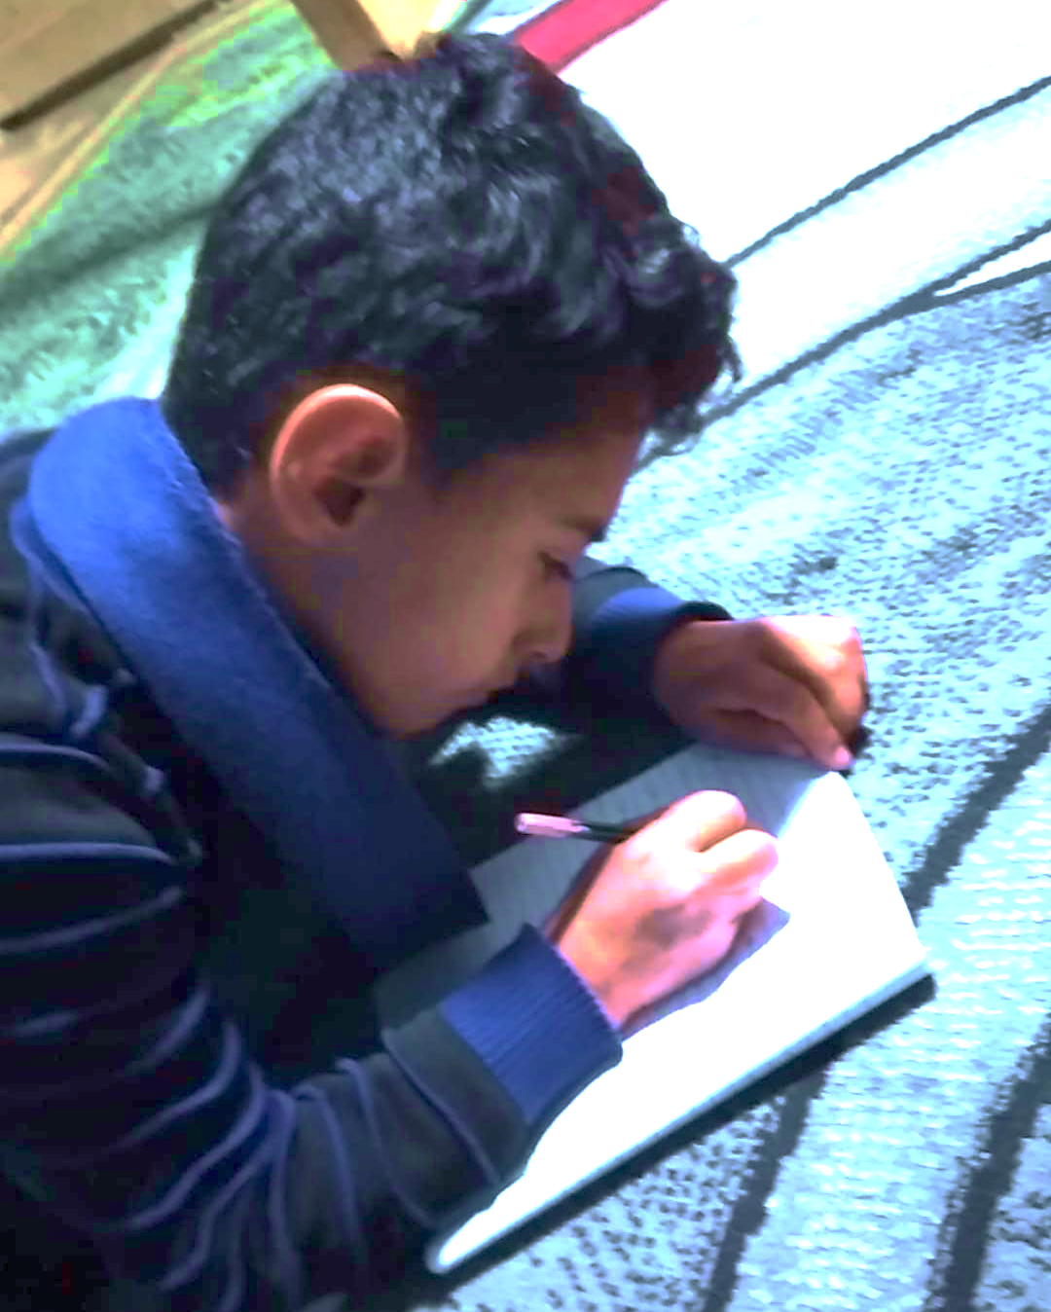



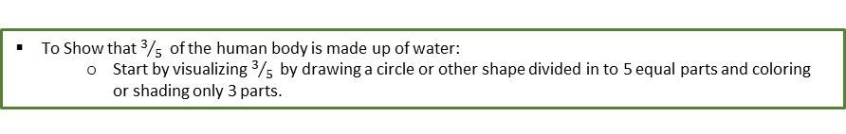
Booklet 3 – Project Implementation
3.2. Giving Instructions to Students (2/4)
3.2.1. Introduce Activities to Students (2/2)
Our Example:
To Show that $3/{5 }$ of the human body is made up of water:
Start by visualizing $3/{5 }$ by drawing a circle or other shape divided in to 5 equal parts and coloring or shading only 3 parts.
According to my contextualized project script, I want to show my students how a cake can be divided. Since I cannot show students a cake over the phone, I, instead, need to describe it (as shown in Figure 3.2).
Sometimes, if I am not too sure about my instructions’ clarity, I call my nephews or neighbors to test the clarity of my instructions.
At the beginning, I was calling a lot and I had to modify my instructions more often. However, with time and practice, I got better at it.
You can also check other scripting examples (writing down instructions) found in Contextualized Projects Examples included in Appendix A – (A.6: IFERB Project Contextualization Examples).
Objective: “find out the different ways we use water!”
Main Takeaway: what does 3/5 look like in real life – beyond the number.
Note: This activity step is part of a bigger picture to help students understand how 3/5 of human body is made of water; hence, humans cannot live without water.
Phone Instructions Set #1:
Imagine you have a cake / pizza / biscuit / bread …etc. (try to choose within your students’ context). For the purpose of this example, we will use cake. Note: you can also utilize the resources available to students, such as paper and pen, to draw a circle and divide it into 5 pieces; instead of visualizing a cake.
Now you want to divide the cake into 5 pieces to share it with your friends.
You and your friends ate 3 pieces of the cake; right?
So, all of you ate 3 pieces out of 5 cake pieces; right?
This is what we call 3 out of 5. We describe this by 3 “slash” 5 or 3 “over” 5 (3/5).
Note: please choose the more relevant description of the fraction (3/5) for your students.
Did you know that you and your friends ate three-fifth of a cake?
Three-fifth of a cake is most of the cake, do you agree?
Now you are ready to introduce the next activities to map this newly acquired knowledge to better visualize that a human body consists of 3/5 water (i.e., most of human body is water; hence humans need water to survive).
Remember:
All projects tackle multiple subjects; hence, Water is Life is also teaching numeracy (fractions).
Figure 3.2: Contextualized Activity Instructions for audio remote channel (e.g., phone)
3.2.2. Differentiating Instructions (1/3)
It is likely that there will be students with different skills levels and learning styles.
Below are some of the best practices to bridge the gap among students’ different levels by enhancing the learning environment and content to fit different students needs:
Your students appreciate your commitment!
Managing students with different learning styles:
Try using a variety of ways to explain a concept or task. For example, some students think better when they move while others need to sit. Another example, some students prefer to play games to learn while others prefer making crafts.
It is usually helpful to create different activities for students to learn and apply their newly acquired knowledge based on their learning style. For instance, you can ask students to write on sand the new vocabulary they have learned today. Another activity can be pulling a word from a hat and creating a sentence using the selected word.
Grouping students based on their learning level (1/2):
You can group students based on the challenges they are facing. For example, if one of the activities involves the skill of reading graphs, like the one in Figure 3.3, some of your students might already know it while others might have not mastered it yet or did not even hear about it. In this case, you have three different learning levels of students: Level 1: Know how to read graphs. Level 2: Familiar with graphs but find it challenging. Level 3: Reading graphs is a new topic for them.

Slide 34





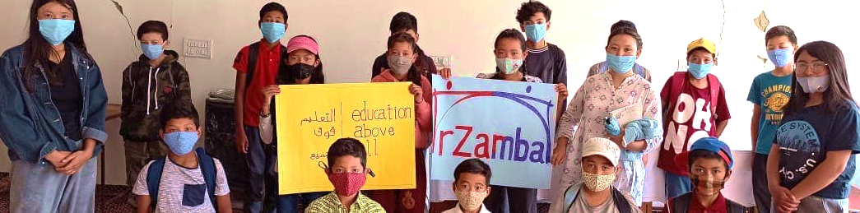
Booklet 3 – Project Implementation
3.2. Giving Instructions to Students (3/4)
3.2.2. Differentiating Instructions (2/3)
There are two different group types: similar levels grouped together, and different levels grouped together.
Similar levels grouped together
One strategy is to group students with similar learning levels together.
Keep in mind that for a group to be effective, it should not have more than 5 students in it; ideally 3 students.
If you have more than 5 students in a group, you can further divide them into subgroups based on their learning styles.
Once students are grouped based on their level, you can tailor the activities to bridge the gap in the groups’ learning levels: Level 1: Prepare enrichment activities so students do not get bored if they finish project’s activity early. Level 2: Give them further instructions to call for help when needed. Level 3: Prepare extra activities to introduce this skill as a new topic.
Figure 3.3: Activity from Water is Life Project
Different levels grouped together
Another strategy is to group students with different learning levels to encourage collaboration and peer support.
If you group students with different levels, make sure to give specific instructions to each student so they are all learning and participating in the project.
If you find that some student’s behavior is disrupting the group activity, then refer to Appendix B for best practices to Managing Students’ Behavioral Challenges (see B.3).
Tip:
You can apply the recommended best practices for Differentiating Instructions when students have different learning levels because there is an age gap among them.
Paying attention to students individually:
When working with groups, please note that paying individual attention to each student is also important.
When working with students individually, you can re-explain an activity and make sure that the student understands your instructions and/or newly introduced topics.
Make sure there is a quiet space for individual work – if you are conducting your lesson over the phone, you might want to call students individually or have individual conversations through text or WhatsApp. If you are using zoom to deliver your lessons, you can use breakout rooms for this purpose.
Cultivating a nurturing learning environment:
It is a good idea to constantly reflect with the learners about their strengths and the challenges that they will work towards overcoming.
Make sure to only highlight students’ strengths; e.g., “Ali has made wonderful progress in Math and Sara is was amazingly creative with the materials in her art project.”
Please keep in mind that your students might have undiagnosed cases of ADHD, Anxiety, Autism or any other learning disability. It is always a good idea to learn the needed tools to manage these students’ behavior without disrupting other learners.
It is very important to be careful when choosing your words to keep the environment positive. For example, instead of saying “this is a wrong answer,” you can replace it with “you are very close.” Having a loving environment is very important for students to learn and prosper.
When teaching students who are finding a task challenging, keep motivating and encouraging them to keep trying or try alternative pathways until they learn the concept and/or successfully complete the task.

Slide 35






Booklet 3 – Project Implementation
3.2. Giving Instructions to Students (4/4)
3.2.2. Differentiating Instructions (3/3)
Motivating students:
Rewards are very important, especially when interacting with students who are finding it challenging to learn.
Simple rewards can include getting a sticker, a star, a certificate or any kind of recognition like asking the other students to clap for them.
Another effective method to motivate your students for learning is to remind them of their previous successes and that they can do it again; make sure to always complement their success.
There are three main keys for your rewards to work effectively:
Initiation & Setup:
Reward Type:
Reward Versus Punishment
(1) You need to let learners know that they will get a reward after they finish the task.
(2) Make sure they know what the reward is and that they are excited to get it.
(3) Refrain from using rewards to punish students – please do not take away a reward if they misbehave. Keep the reward associated with success.
Tip:
You can apply these best practices to motivate students in general. However, motivation is essential when they are facing a learning difficulty.
Create an environment for your students to feel comfortable asking questions when they do not understand something. For example, avoid not answering questions arguing that the student was not paying attention.
Continually ask them if they have questions after you introduce activities and thank them for their questions when they ask.
You can also create a system for questions. For example, you can ask them to quietly raise their hands when they have questions.
Remember:
Your understanding and encouragement are the pillars for this learning experience to result in students’ growth!
Tip - Advanced:
These tips are for advanced educators who feel comfortable working with different students’ levels:
To keep things interesting, you can choose different time slots to alternate between group and individual activities.
If you are individually working with a student, then make sure you have suitable activities (i.e., activities not requiring peers to complete them).
You can also create an individual education plan for your weak students to work with them individually – this plan should be fully customized to your student’s interest, environment and his/her own weaknesses and strengths. This recommendation would be easier if you are in a school environment.

Slide 36







Booklet 3 – Project Implementation
3.3. Fostering Effective Learning Environment (1/4)
A learning environment results from the collaboration between educators (teachers, facilitators, volunteers), students, and parents, as indicated in Figure 3.4.
An effective learning environment enables students to feel safe to make mistakes, so they do not refrain from engaging during the lesson.
With the right mindset and guidance, an educator can overcome a lot of challenges (e.g., remote learning & limited resources) to deliver effective lessons.
Educators can also develop skills to build rapport with their students so that they can mentor them and foster their skill-set growth.
This skill-set goes beyond the academic skills, such as literacy and numeracy, to cover real-life social, emotional and 21st century skills, such as critical thinking, creativity, collaboration and communication.
All IFERB projects include a number of these real-life skills. For example:
3.3.1. How to Setup an Effective Learning Environment?
educators
parents
students
A Learning Environment
goes beyond classrooms and resources.
Figure 3.4: Effective Learning Environment
Critical Thinking
Creativity
Communication
In the Water is Life project, students analyze their household water consumption and determine steps that can be taken to reduce water wastage.
In the ABC by Me project, students create their own alphabet book, think through categories, illustrate ideas, and explore diagraphs!
In most projects, students present their final outcome (a model they design or a piece of writing) to their family and/or peers. You will find presentation assessment criteria in the Project Document itself.
Tip:
Provide students with a structure for their presentation so that they know what is expected from them. An example of a presentation structure can be:
Introduce yourself: e.g., Say your name.
State the problem you are trying to solve.
Explain your solution.
Explain what you learned.
Say “thank you” at the end.
You can learn more about simplifying instructions in Appendix B – (See B.2).
To teach is to touch a life forever!
3.3.2. How to Effectively Involve Parents? (1/2)
Parents are an essential part of the success of PBL projects.
Many projects have activities that require parents’ help. For example, Pop-Up Restaurant requires help with cooking, Grandmother’s Tale requires students to create their own version of a folk story narrated by parents/grandparents and Make ID Cards requires students to interview family members.
However, many educators face challenges in getting buy-ins and cooperation from parents.
It is important to understand that parents are busy and not trained to be educators; some of them are illiterate and might not appreciate PBL outcomes. Communication is important to overcome this challenge.

Slide 37


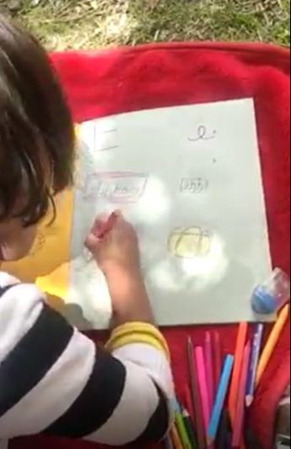
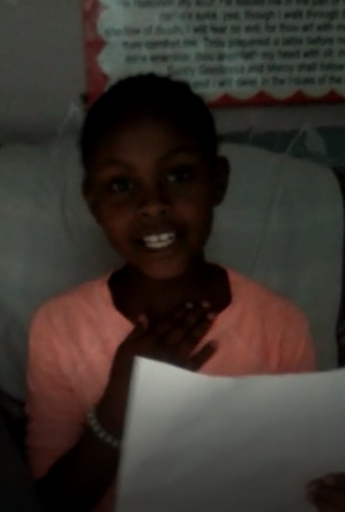



Booklet 3 – Project Implementation
3.3. Fostering Effective Learning Environment (2/4)
How to inform parents about the program?
Ideally, you want to gather the parents in one place and provide them with a face-to-face workshop to explain the program to them.
However sometimes, face-to-face workshop is not an option so you will need to use remote channels to communicate your message to parents. Therefore, refer to sections 3.1-3.2 as you will need to apply remote channel communication best practices when informing parents.
How to motivate parents about the program?
One effective strategy is to ask parents the following scripted questions either before the workshop itself or after providing the general information about the workshop:
Then you can cater the program benefits’ presentation to show them how this program can help them achieve their ultimate goals for their kids.
3.3.2. How to Effectively Involve Parents? (2/2)
What do you like the most about the program?
Why are you interested in this program?
What do you want for your child(ren)’s future?
How to involve engaged parents?
It is important to explain precisely what is expected from parents to support their kids in this program.
Try to simplify their role as much as you can. Keep in mind, parents have other jobs and responsibilities, and they might not be able to be there for their kids all the time. This does not make them bad parents.
These expectations need to be explained very clearly. Once you clarify parents’ role in the project, you need to investigate how realistic your expectations are. You can ask them “is this easy or will you need extra support for this item/task?” If you are expecting too much from them, then you will need to try to further simplify their role and/or involvement.
How to involve unengaged parents?
When dealing with unengaged parents, try to get more creative on how to minimize parents’ involvement at home so students can participate and deliver assignments as independently as possible.
For such independence to be achieved, you need to deliver crystal clear instructions to students so they can perform tasks with minimum support from parents.
You can also assign students’ groups, if you intend to work with groups, based on how close they live to each other to carve more support for students and parents.
Tip - Advanced:
Parents can be given a simple rubric or mechanism to check students' work. Educators can communicate with them to get updates and give them sense of involvement and allow them to see their child's progress at the same time.
37

Slide 38
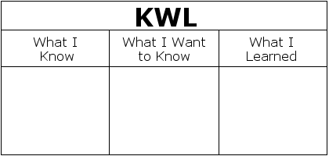

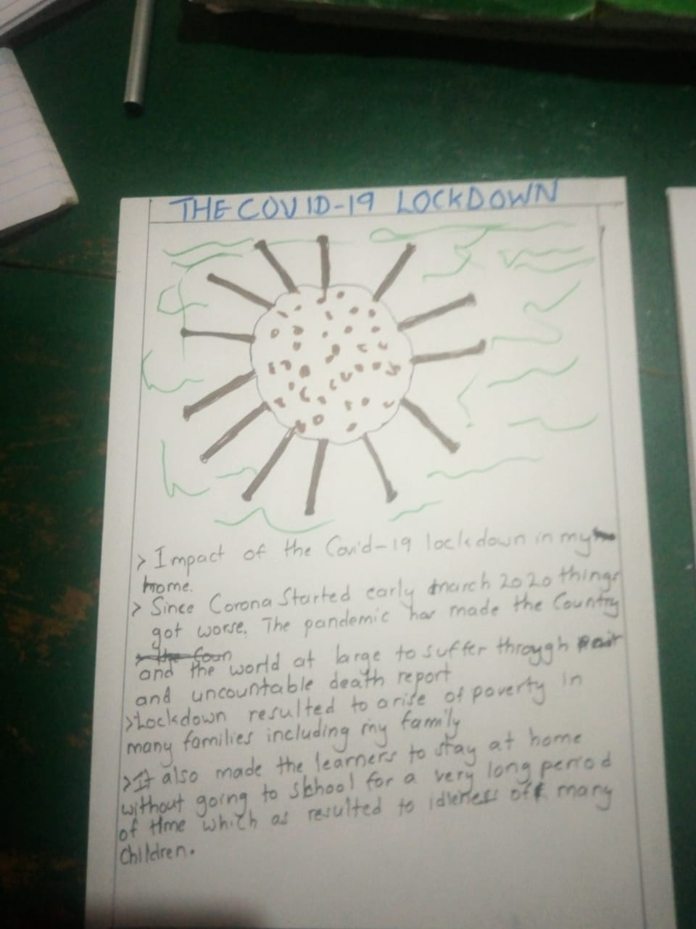
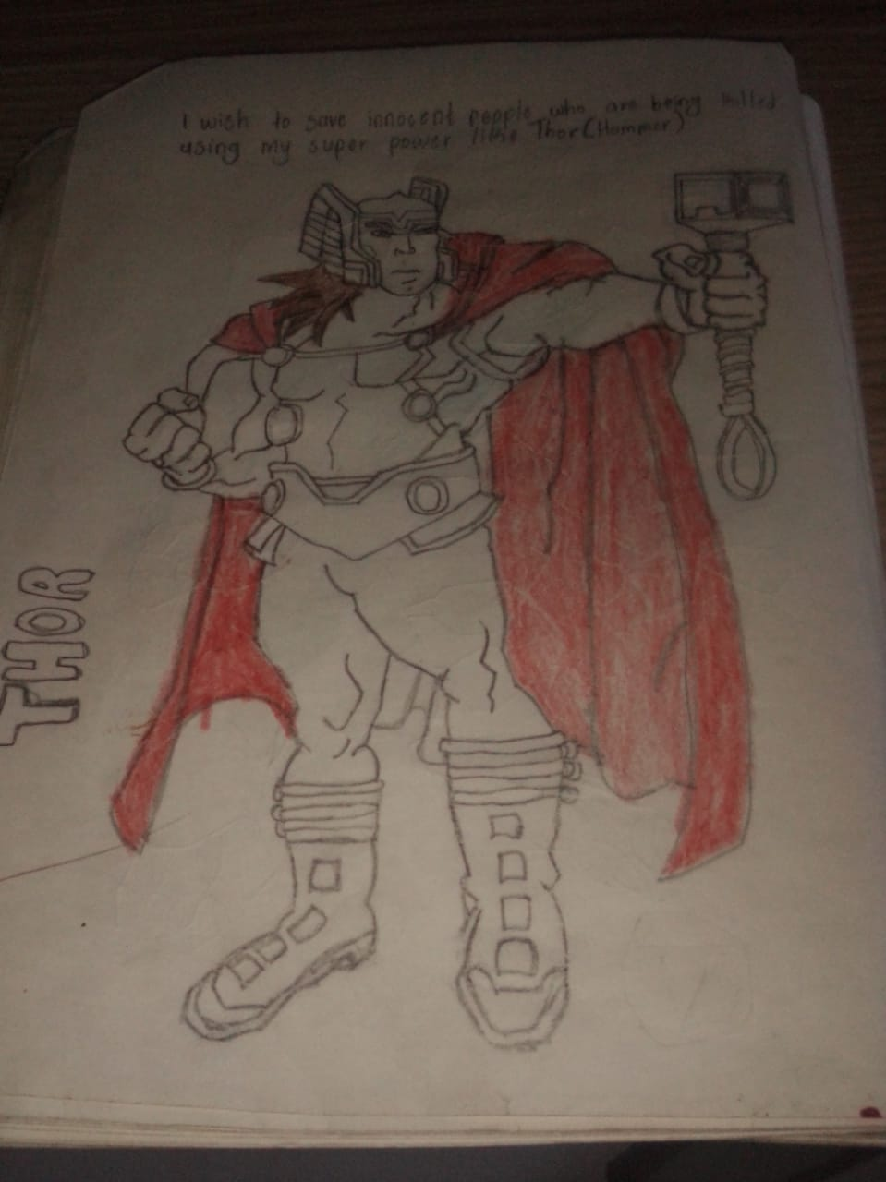
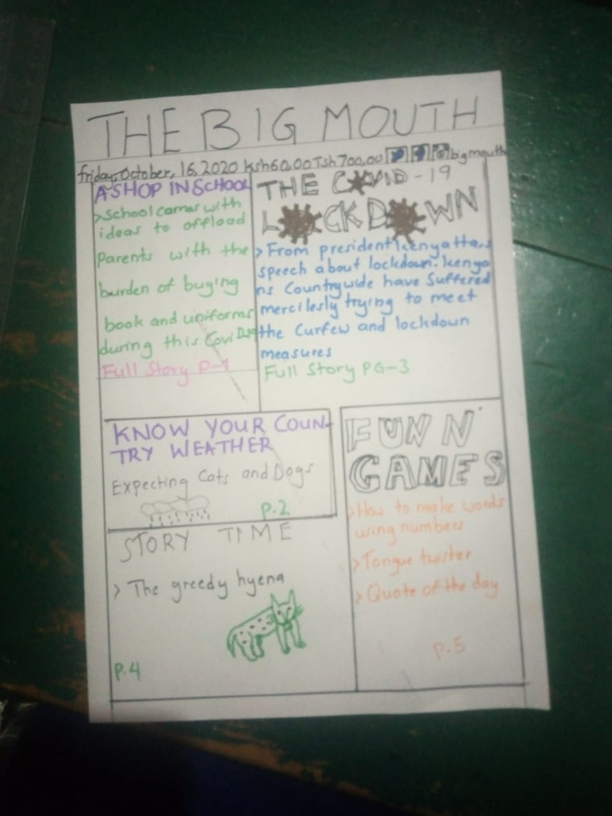
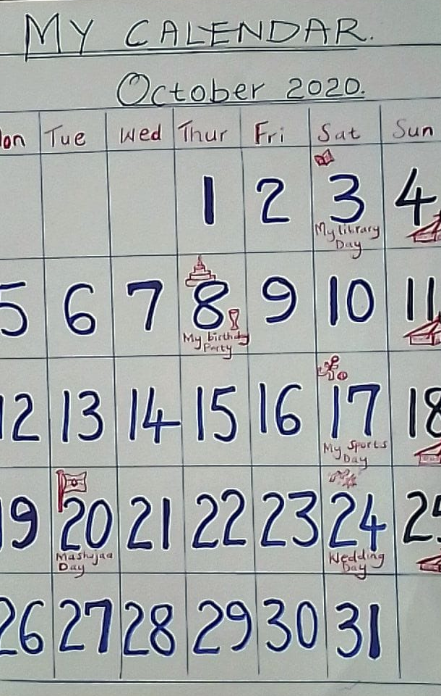
Booklet 3 – Project Implementation
3.3. Fostering Effective Learning Environment (3/4)
3.3.3. Guidelines to working with students – KWL Framework (1/2)
An effective learning environment that fosters interest, curiosity, creativity, ownership, and reflection skills.
You can develop this environment by applying the KWL framework.
The KWL framework consists of three main questions to ask your students at the right stage of the lesson, activity or project, Figure 3.5:
An effective learning environment cannot be successfully fostered without properly managing students with different learning and skills levels. Refer to section 3.2.2. for more on Differentiation Instructions.
Next, this toolkit will go over guidelines and tips for working with your students to help you:
Figure 3.5: KWL Framework Questions
Further Reading
What I Know - Hence, students’ interest will be built.
What I Want to Know - Hence, students’ ownership of the lesson’s outcome will be achieved along with building curiosity in the topic.
What I Learned - Hence, students will learn how to reflect on their learning and what made it possible.
You can read more about KWL framework: https://study.com/academy/lesson/kwl-chart-example-graphic-organizer-and-classroom-applications.html
Engage students by building curiosity and interest
A
Develop students’ creativity and ownership
B
Develop students’ reflection skills
C
Build curiosity and interest - What I Know
When you share the leading question of your project, you spark students’ curiosity on the topic.
At the beginning of the project, you can ask your students what do they already know about the topic; “What I Know!”
Besides the fact that this question will give you an indication about your students’ previous knowledge, it is mainly used to build interest in the topic to be covered.
Another way to build students’ interest in the project is to let them know the end result that they will be working towards. For example, you can show them a picture of completed projects or share with them that they will be presenting their work for their teachers, parents and/or peers. Refer to section 3.3.1. for tips on how to guide students to conduct their presentations.
A
Tip:
If the topic is completely new to your students, be prepared that they might not know anything about it. In this event, using the project’s leading question should be sufficient.

Slide 39





Booklet 3 – Project Implementation
3.3. Fostering Effective Learning Environment (4/4)
3.3.3. Guidelines to working with students – KWL Framework (2/2)
Creating space for creativity and ownership- What I Want to Know
B
1
When you ask your students about what they want to know about this topic, you are engaging their interest in the topic while outlining the project or activities outcome.
Moreover, you will create a sense of ownership when they state what they want to know.
Another way to create this ownership is to allow students to make decisions about the project, including how they work and what they create. For example, they can create their own comic book and choose any characters they want. Let students choose as early in the project and as often as possible because students’ voice and choice are important parts of PBL.
Lastly, be mindful with your instructions so that they allow autonomy (working independently) when performing activities. You do not want them to go through the activities mindlessly. To be able to do this, students need to be empowered with clear instructions including going over relevant supplies and resources.
Fostering autonomy can also be achieved by providing students with an example of the project’s final outcome so that they can envision what needs to be done.
1
Tip:
If there are targeted outcomes that were not listed by students, you can list the missed outcomes as the things you want to know about.
2
2
Develop capacity for reflection- What I Learned
When you ask students to list what they have learned from the activities, you are developing their capacity for reflection; especially when asked at the end of daily lessons.
Reflection is important for PBL projects because students need to have mental space, away from all hands-on activities and excitement, to connect with what they have accomplished, and how did they apply their new knowledge and learning.
After the project completion, educators can have a conversation with students to understand how much they have learned by asking questions such as:
C
Tip-Advanced:
You can also give your students a list of options for what their final product will be. For example, they can either write an essay, paint a drawing or prepare a presentation; as long as the essence of the project is not compromised.
New Learning
Difficulties
Compare knowledge
Fun parts
Outcome
What were the new things they learned through this project?
What was the part they found most difficult and how did they overcome it?
What did they know before? Did the project help them discover anything different?
What was the most fun part of the project and why?
Describe the final outcome of the project and what makes it special?
Another reflection capacity that you can develop for your students is self-evaluation, which can be defined as: “… an opportunity to highlight how you used your unique strengths to accomplish your goals while also being honest about areas you could improve.” – [sources: 4]
Younger students can rate their own work using “average, good, great” or emoticons “☹ :I ☺” rating based on two to three (2-3) criteria including effort, clarity of drawings etc.
Older students can be given a few generic rubric or criteria so they can rate themselves on a numerical scale: e.g., 8/10 on the essay, 6/10 on the creativity in the story etc. They are also encouraged to add comments for their numerical rating.
Tip:
Self-evaluation can also be applied after students complete their presentations. However, be careful not to focus on the weaknesses as this is for them to choose how they want to grow; they are taking ownership of their own growth and improvement in presentation skills.
3
Tip:
You can also involve parents by educating them about how self-evaluation can be developed:
Parents who have the time and higher literacy levels can read the assessment criteria and then rate students accordingly or be given a rubric to fill.
Parents who are less educated and have less time can be given very simple criteria and rating on a scale of 3 e.g., average, good, great.
4

Slide 40


Booklet 3 – Project Implementation
3.4. Receiving Students’ Work
Collecting students’ work can be challenging when teaching remotely. Therefore, you will need to think of different ways to collect students’ work/assignments or final product.
Make sure that you give clear instructions on how you want the students to deliver their assignments.
Below is a list of real-life, practical recommendations to collect work, assignments or assessments from students:
Tips:
Try to manage students’ and parents’ expectations about when assignments are due.
It is recommended to set up special sessions just to discuss the assignments.
Phone:
Voice/Audio:
SMS/TEXT:
Internet based multimedia messaging apps (e.g. WhatsApp):
Students will have to verbally describe the project or what they learned. If it is difficult for the students to describe their tangible work, then try to ask explicit questions to rate how much they learned (See: Section 3.3.3. “Develop capacity for reflection”).
With this communication channel, students can only send you a written description of their work. If the student is too young to construct sentences, then maybe their parents or caregivers can type the description for them.
If you are using video call, students can show you the work on the camera. However, If you are only using audio messages, students can deliver the assignment orally or describe their work orally. They can also take a picture/video of their work with their phone and send it via WhatsApp.
Radio: If there is a facilitator with the students listening to the radio, the facilitator can collect the work and answer students’ questions. However, if an educator is teaching on radio without a facilitator, then there are multiple ways for students to ask questions and deliver their work: 1) Students can call the radio station to describe their assignments or projects outcomes to the educator– same way a listener calls radio stations to request songs. 2) Students may want to send their work (pictures or document) via email or mail to radio station or wherever the educator prefers.
Internet-Based Video Conferencing – (e.g., Zoom): You can ask students to show you their work on camera or even share their screen if their work is saved on the device they are using. They can also email or their work if internet connection does not permit video conferencing.
Suggestions based on what other educators, who implemented IFERB projects, have done:
Some educators visited students’ homes to collect assignments.
Some parents mailed the assignments to educators.
Other parents took pictures of the assignment and emailed it back to educators.
A few parents would go the extra mile and drop off students work at the educator’s place of work (e.g., school or organization).
Keep striving for progress!
You almost completed this toolkit!

Slide 41


Booklet 3 – Project Implementation
3.5. Conducting Assessments & Evaluation - Assessments Framework (1/4)
1
When implementing PBL with your students, you can either choose to implement one project or a series of projects.
Please note that throughout each project, you will be probing for students’ understanding and learning through the following three techniques: KWL framework, Daily observations, and Quizzes.
If you choose to implement a series of projects (more than 3 projects), then try to do an assessment before you start teaching the first project (baseline assessment) and an assessment at the end of the last project to measure the growth of your students (end-line assessment).
Please note that if you are only conducting one project with your students, there is no need for baseline and end-line assessments. However, you are highly advised to follow the three techniques for all projects.
Below is a graphic overview of the recommended Assessments Framework:
The objective of conducting assessments is to use what you learn about students’ current and learned skills to adjust the project(s) accordingly. You can refer to section 2.3.1 (in Booklet 2) to adjust your project contextualization based on students learning level. Kindly note that you might need multiple iterations of such adjustments until you can see that the project is effectively contextualized, as mentioned in Booklet 2; i.e., your students are learning and growing.
Let’s learn about these assessments in more details.
Tip:
Assessments include three steps:
ask question (giving instruction to students)
student answers (receiving students work – i.e. presentation or project product)
assess answer (conducting assessments & evaluation – assessment framework).
Section 3.6. (in Booklet 3) covers conducting assessments remotely in more details.
KWL framework: What I Know, What I want to Know, What I Learned
Baseline Assessment
Daily observations on students’ progress
End-line Assessment
Before Starting First Project
Quizzes to assess students’ understanding
After Completing Last Project
During Each Project Implementation
1
2
3.5.1. Baseline & End-line Summative Assessments (1/2)
2
When teaching multiple projects over a period of time, try to conduct assessment before you start your first project (baseline assessment) to measure what your students already know and what knowledge gaps they have. After the last project is finalized, conduct the same assessment you conducted at the beginning to measure how much your students have grown during this journey (summative assessment).
Usually, you use the same baseline questions, or rubric, for conducting end-line assessment to better measure students’ growth.
IFERB includes two types of assessments: Academic and Non-Academic. Academic assessments assess students’ academic skills and knowledge, while non-academic skills focuses on non-academic acumen, such as 21st century skills and social and emotional learning.
There are three types of academic questions in IFERB’s academic assessment:
Tip:
Baseline and end-line assessments are summative assessment; which measures for student’s overall growth.
Quizzes are a type of formative assessment; which checks for understanding.
Knowledge
Skills
Discovery / Conceptual
These questions test learners' knowledge of concepts covered in the projects that do not require application skills and are more theoretical in nature. Examples: list two uses of plants; name three planets; how many sides does a rectangle have?
These questions target learners' ability to demonstrate both understanding of concepts and application of knowledge in different ways including writing, reading comprehension, illustration and representation of information in different formats etc. The skills may be directly or indirectly related to the project theme. Examples: compare between two concepts; represent the data in a graph; draw a diagram; solve the following problem; choose the correct tense.
These questions test learners' understanding of concepts that are central to the project theme and acquired by applying learning. Learners should be able to understand these concepts through the execution of the projects' tasks, experiments etc. Examples: What are some ways we can conserve water? What happens if we bury a plastic item?

Slide 42



Booklet 3 – Project Implementation
3.5. Conducting Assessments & Evaluation - Assessments Framework (2/4)
3.5.1. Baseline & End-line Summative Assessments (2/2)
1
IFERB provides Projects’ Questions Bank in an Excel document that includes questions (the three types of academic-assessments) for all available projects. You can choose from these questions to form your baseline and end-line assessments. This Excel document, along with instructions on how to use it, can be found in Appendix B – (B.4: IFERB Projects’ Questions Bank).
You can also benchmark your students 21st century skills during your first session with them. You can use 21st Century Rubric in Appendix B – (B.5: 21st Century Rubric) to perform baseline and end-line assessment; non-academic assessment.
Baseline assessment reflects what the students already know. If they score high, the project needs to have higher level to be more challenging and interesting to them. However, if they score poorly, then you need to decide if the project level is sufficient to teach them the new skills/topics, or if you need to chose a lower level. If the project is too hard for your students, they might lose interest in it very fast.
Tip:
When selecting the questions for academic or non-academic assessments, keep in mind that you want to test for skills that are relevant to the project and/or targeted by you, your school or your organization. After all, you will be focusing on developing these skills for your students and it is a good idea to assess how much they already know and how much they will learn by the end of the program’s duration; a program includes selecting, contextualizing and implementing more than 3 projects.
1
Best Practices in Conducting Baseline and End-line Assessments:
Choose 10-12 questions for baseline and end-line assessments; more details on how to choose questions can be found in Appendix B – (see B.4).
Make sure that students understand why they are going through this assessment. Explain this to parents as well! From our experience, parents and students may think that it is a major exam and tend to be overly stressed about it or even cheat! It is important to explain to students and parents that this is just for educators to know how to help students improve throughout the project’s duration and that it is not graded.
Another common error is underestimating students’ levels. One recommendation is to pick questions with different difficulties (based on what you know about your current students’ learning levels) and display them from easiest to hardest to see how many students complete the whole assessment. This way you can have a more realistic indication about where your students stand, academic level wise.
It can be challenging to conduct these assessments over the phone (audio, text or WhatsApp) or other remote channels like zoom. There are some signs that can give you an indication if a student is receiving help from their parents or from another source.
Some of these signs are:
2
Tip:
When choosing the questions, take into consideration what you know about your students’ levels.
If you are conducting a full program that includes 12 projects or more, then you can do 2-3 baseline and end-line assessments (for example, every 6-8 weeks); especially if the projects are spaced out.
Students are taking too long to answer.
Students are answering but keep rapidly changing their answers.
You keep hearing a voice of someone helping them in the background.
Please know how to differentiate between students who are getting external help and those who like to think before they answer or who usually self-correct their answers if they realized it is wrong.
These signs are critical for you to adjust your student’s behavior and re-explain why it is important not to get any extra help. Try to explain that the consequences of this help could be that students are placed in the wrong group or given wrong tasks. This would not allow them to learn or grow from this experience.
When realizing that a student is receiving extra help to answer assessment questions, it is important not to punish them. Just re-explain the reason you are doing this assessment and politely ask them to try again without any help.
2
Keep an open mind & a big heart!

Slide 43




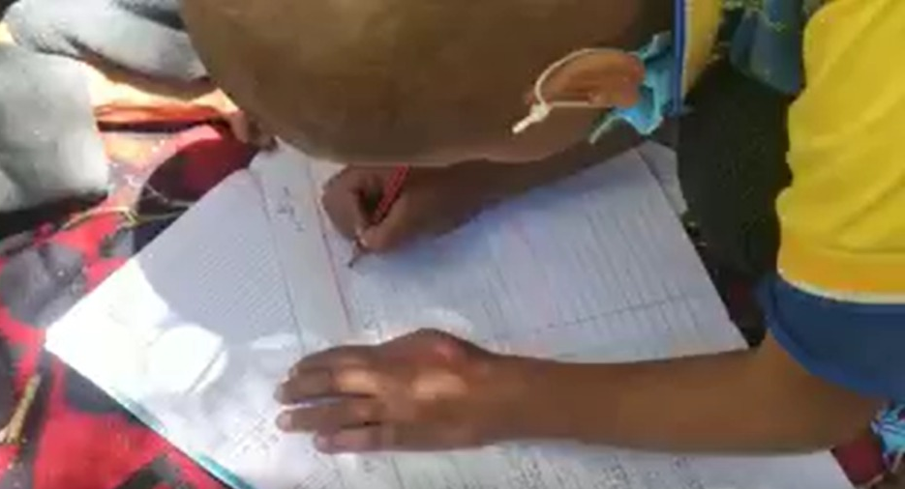
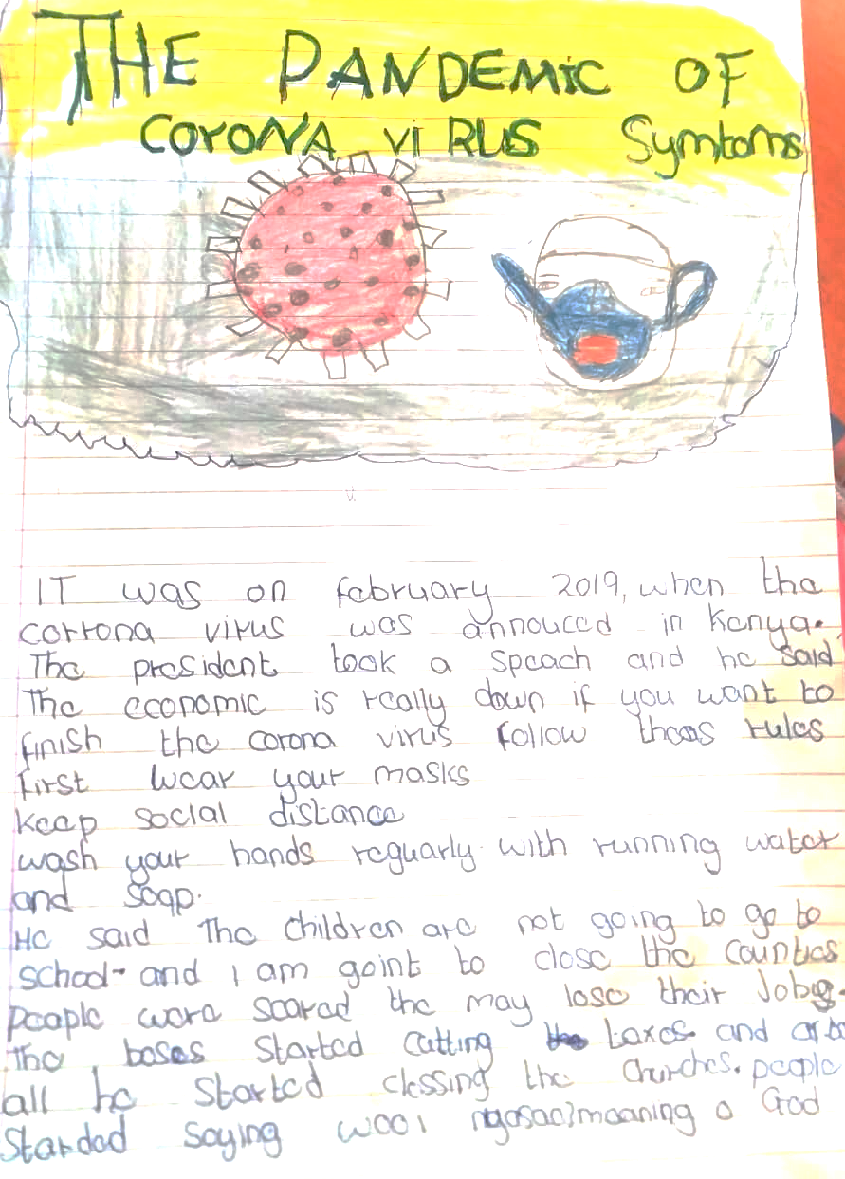
Booklet 3 – Project Implementation
3.5. Conducting Assessments & Evaluation - Assessments Framework (3/4)
3.5.2. KWL Framework for Assessments Purposes
The KWL framework in Figure 3.5 was used for the purpose of engaging students.
It is important to understand how this framework is enabling you, as an educator, to conduct assessments to gather what your students already know about a topic or an activity (what I Know) and how much they learned afterwards (What I Learned).
There are four times you can apply the KWL for assessment purposes:
Figure 3.5: KWL Framework Questions
Remember:
You can always refer to the baseline assessment to see which skills are not developed yet and you need to pay extra attention on developing them. You need to use KWL to ensure that your students grow in these identified weak areas.
At the beginning of the project (on the first day)
At the end of the project
(on the last day)
On daily basis
Before & after specific activities
Before you start the set of activities of the day, you can prompt students with – “What I Know” to establish a daily initial assessment. At the end of the day, you prompt them to answer the question “What I Learned” to help you assess what they have learned on each day of the project.
You might not be too sure about students’ previous knowledge about certain activities. To help you fill these gaps in students’ previous knowledge related to a certain activity, you can apply KWL framework before you start the activity; “What I Know” and “What I Want to Know”. You can also assess what they have learned from the activity by prompting the students to answer “What I Learned” question at the end of the activity.
“What I Know” will help you assess students’ previous learning before you start the project. This interactive, initial assessment can complement any other forms of initial assessments you have conducted before the program. It can help you identify which topics are new to your students.
“What I Learned” will help you assess what students learned throughout the project.
Make sure not to wait until the end of the project to assess if learners are understanding the instructions.
If you use the (L: “What I Learned”) after every activity, or at least after challenging ones, it will give you guidance on whether you need to regroup students or re-explain activity; you might need to further adjust the activity if you find out that students did not learn its targeted outcome(s).
Tip:
If your students find an activity too easy or too challenging, you can include additional support (such as modeling, breaking down the task, etc.), eliminate it, or replace it with simplified or enriching activities provided in the Project Document. For more details, review section 2.3.1: Students’ Learning Level in Booklet 2.
.

Slide 44






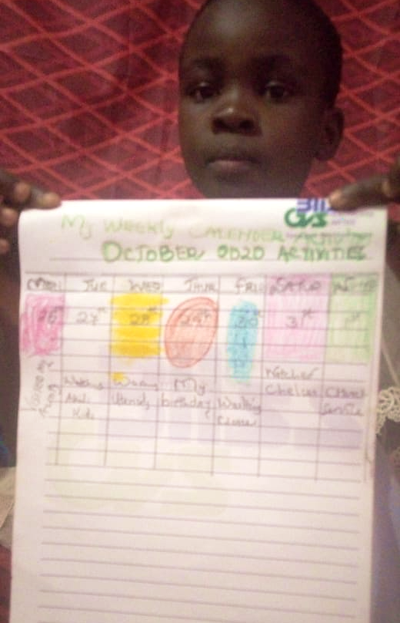
Booklet 3 – Project Implementation
3.5. Conducting Assessments & Evaluation - Assessments Framework (4/4)
3.5.3. Daily Observations
Daily observations complements the (L- What I Learned) from KWL framework as observing students’ engagement and performance on daily basis helps you adjust your teaching style based on what you observe while working with your students. You will also eliminate activities or adjust them if they are not working.
There are different ways for conducting these daily assessments/observations:
Observing students’ engagement:
Observing students’ body language:
Conducting daily assessments:
Students usually engage in the activities or tasks that they understand. If they are not participating in group discussions or activities, it might be because this specific task is particularly hard for them or because they need extra help to develop communication skills from 21st century skills set.
Students might also not engage in an activity if it is too easy for them or not enjoyable for their age group. You can either (1) adjust activity’s difficulty by referring to enrichment activities provided in Project Document or (2) further contextualize the activity to be more compatible with your students’ interests.
You can use your body language, like thumbs up ( ) or nodding your head to see if the students mirror your body language. If the student hesitated to mirror your body gesture, this can be an indication that the student is still struggling to understand what you are explaining.
If you observe a hesitation from a student when answering a question or a hesitation to volunteer to answer a question, then this might be an indication that they need extra help to understand or to develop non-academic skills, such as 21st century skills and SEL.
You can assess students’ learning by asking direct questions or initiate discussions among students about targeted skill or topic that you want to assess. Based on your students’ interactions, you can observe who is having trouble grasping the concepts so you can help them later. Please refer to section 3.2.2. Differentiation Instructions to review how to teach students with different levels.
You can also use student’s self-evaluation and reflection sheets to ensure that they are on the right track to successfully complete the project and learn the targeted learning outcomes.
3.5.4. Quizzes (Formative Assessments)
Checking for students’ understanding needs to be done throughout the project; using the KWL framework and Daily Observations.
Another assessment tool you can use to be sure that all students understood a new and/or a challenging concept is to conduct quizzes on regular basis.
Quizzes are type of formative assessments, which checking for understanding.
You can either select these questions from the IFERB Projects’ Questions Bank, found in Appendix B (see B.4), or you can create these questions based on what you are trying to assess. For example, a quiz can include the following questions form the project Water is Life (Level 1), covering all types of academic-questions:
Tip:
The baseline will be conducted before you start project 1 and the end-line after you finish the last project, but this does not give you an idea about what helped students progress throughout their IFERB journey. Therefore, you will need to use quizzes to monitor students’ growth and keep adjusting the following projects based on your findings to achieve higher students’ growth.
What are two sources of water?
Draw two trees: one gets water on a regular basis, and one did not get water for two weeks.
How would you feel if you did not drink for one day?
If you are conducting only one project with your students, then conducting a quiz at the end of the project will inform you how much they have learned from this project. Remember that based on assessment framework, if you are conducting one to three projects, you do not need to do baseline and end-line assessment. In this case, use the KWL framework, daily observations and quizzes for your assessment purposes.
Conducting a quiz at the end of the project will be helpful to assess:
You can use your findings to further adjust the next projects.
Effectiveness of your teaching methods
Effectiveness of project selection and contextualization
Students’ growth

Slide 45


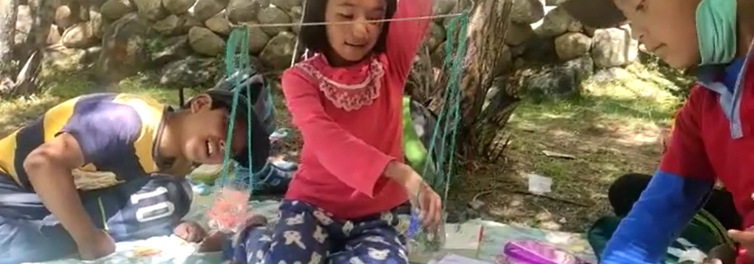
Booklet 3 – Project Implementation
3.6. Conducting Assessments Remotely
If you are conducting these assessments remotely, then you can use the following strategies to help you assess your students:
Internet based multimedia messaging apps (e.g., WhatsApp) & Online video conferencing (e.g., Zoom):
Voice/Audio:
SMS/TEXT:
Radio
1
Assessments will be conducted orally. You can either directly call the students or leave them voice messages.
Ask one question at a time and try to simplify the wording for the question as much as you can. Make sure to receive the answer from your students before asking the next question so you can keep track of responses and to avoid overwhelming students by asking multiple questions at the same time.
Assessments will be conducted via written messages. Same guidelines for conducting assessment over the phone (audio form) will apply over here except that the question and the answer will be written as an SMS/TEXT message. Keep in mind that the longer it takes for the student to reply (longer than you are accustomed to when conducting project’s instructions), the more thinking he/she is doing. This might be an indication that they need extra help to master the skill being assessed.
All audio and text messages assessment will be conducted the same way for phone [Audio] & [SMS]. WhatsApp and Zoom also have video conferencing and ability to share images and text. The questioning strategy used for Audio and SMS channels still applies to WhatsApp and Zoom communication channels. In addition, whenever you have access to real-time video conferencing, you will get to see students’ body language and reactions to your questions. You can form an understanding if your student(s) are following the questions or if you need to repeat them or rephrase them.
Radio educators need to make sure that they have informed their students about the assessment session so students can be prepared. Educators can say the questions over the radio while students answer the questions with the help of facilitators. Students without facilitators’ help can either email, mail or call the radio station to submit their answers. It would be helpful to have radio instructors repeat questions several times before moving on to the next question.
Tip:
Set a specific time for assessments and arrange with parents, so students have access to the phone (or any other used remote channel tool).
Check section 3.3.2 – How to Effectively Involve Parents..
2
Tip:
Avoid using questions that require visual illustrations when remote channels do not allow visual presentation, such as phones’ audio communication and some SMS applications that do not enable sending images.
1
2
Extra Reading
Tips for Projects’ Evaluation for NGOs & Schools can be found in Appendix D – (D.2: Projects’ Evaluation).

Slide 46

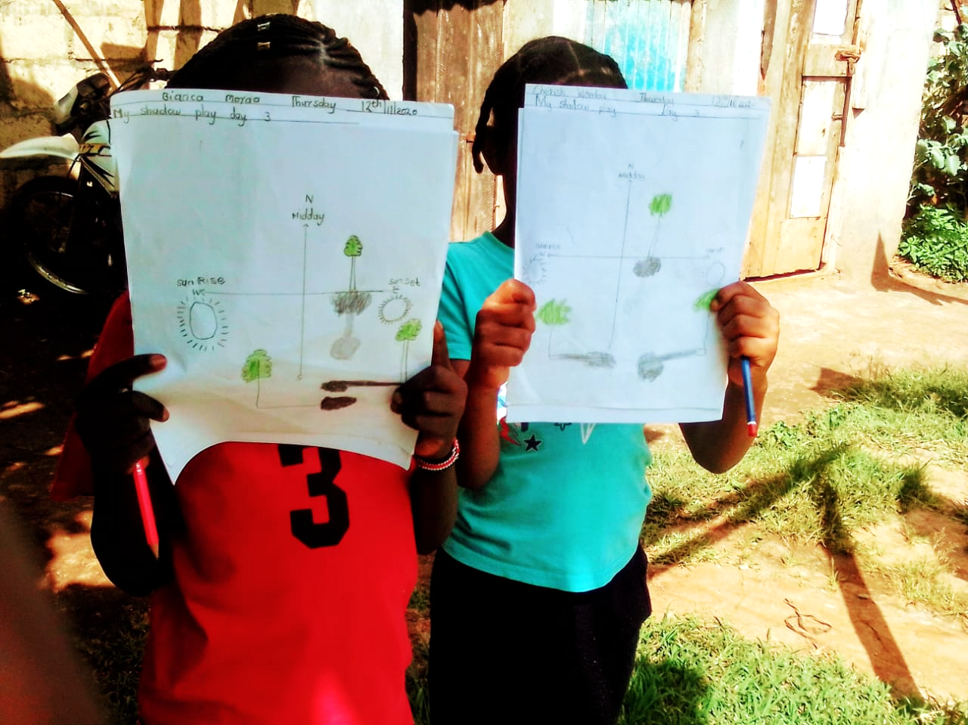


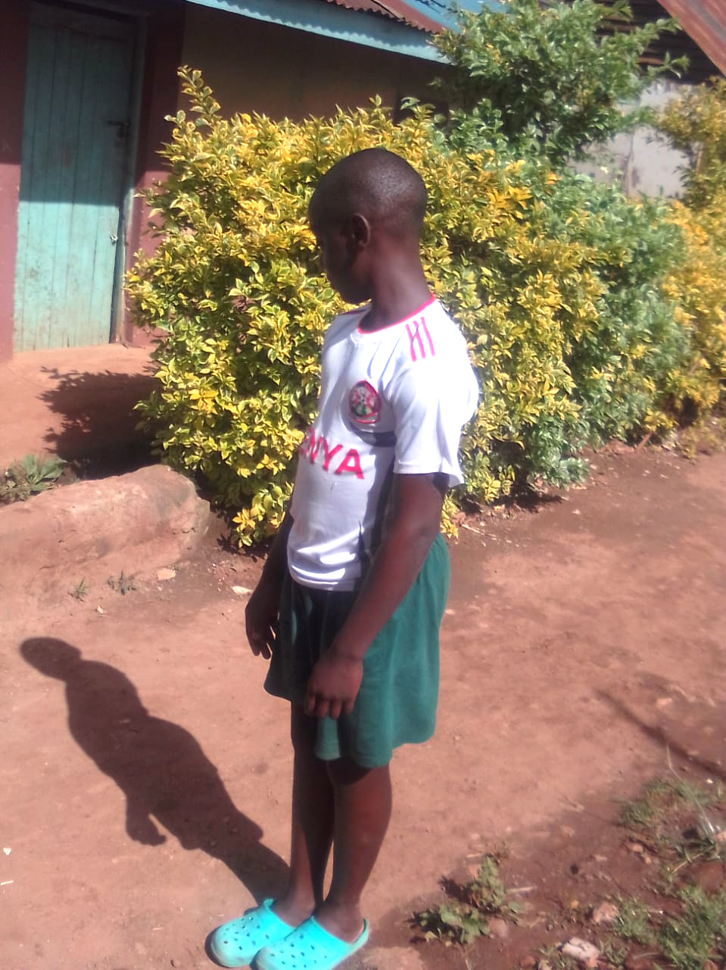
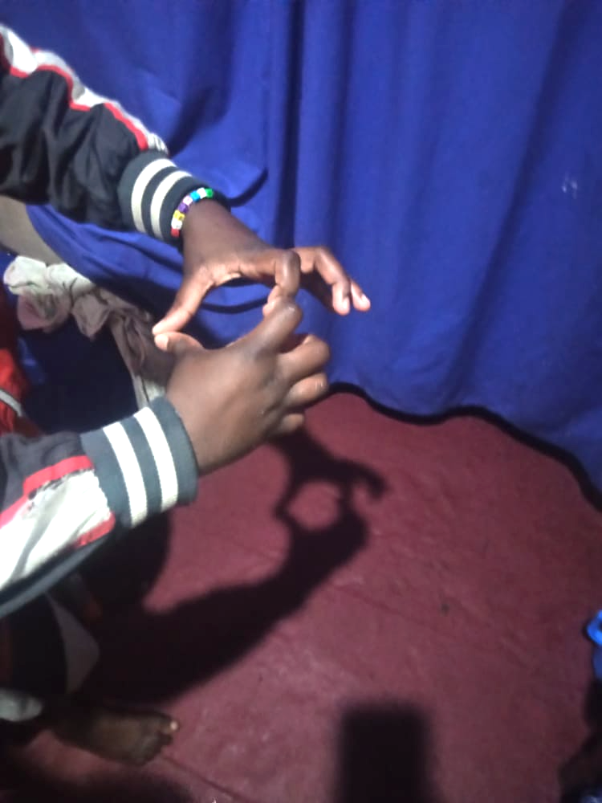
Booklet 3 – Project Implementation
3.6. Summary/Checklist (1/2)
General Environment
To successfully teach your project, you will need to use best practices to engage your students. On the side is a summary and/or checklist for the main highlights to be aware of when setting up your educational environment, using instructions that are clear, simplified and differentiated, and conducting assessments to measure growth and/or decide if you need to further adjust anything in your project and/or your teaching practices.
Having a positive learning environment is very important to ensure achieving educational objectives and learning outcomes.
Actively engage parents in the learning process; specially to coordinate when session and/or assessment is taking place. You will also need to know how to engage students for them to successfully learn and grow throughout this unique, relevant experience.
You will need to adjust your face-to-face teaching techniques (instructions, receiving students work, assessments, …etc.) when using remote communication channels to teach using PBL:
Identify how you will be receiving students’ work remotely: take into consideration the communication limitation imposed by the remote channel available for you and your students.
Receiving work over remote channels can be challenging. However, with practice, it will get easier to collect work from students so you can assess their work.
phone
Voice/Audio:
SMS/TEXT:
Internet based multimedia messaging apps (e.g. WhatsApp):
You will need to heavily count on your words because you cannot use visual aids. You will also need to assess received audio as project’s work or final outcome.
You will heavily count on your written words to deliver instructions and on students’ written words to collect feedback and receive students’ work.
You have more features that you can use, such as ability to communicate images and videos; hence, visual aids can be used.
Internet-based video conferencing (e.g. Zoom)
You can have real-time feedback and adjust your instructions accordingly whenever needed. This is the best alternative for the face-to-face option as it provides you with a lot of features that can make the remote teaching smoother than using phone as a remote channel.
Radio
Remember that with radio remote channel you can have an educator at radio station teaching while a facilitator is with the students to help them implement. If you are the radio instructor, make sure you are clear and repeat questions if you are giving an assessment type.

Slide 47



Booklet 3 – Project Implementation
3.6. Summary/Checklist (2/2)
Instructions
Assessments
Are your instructions simple and clear to my students?
Are your instructions clear enough and will not compromise students’ independence?
Did you consider the remote channel you are using? For example, if you are using Audio channel, then you cannot use visual aids.
Did you take into consideration how I might need to create differentiating instructions?
Are you aware of the different practices that can help me manage multiple students with different learning levels?
Are you comfortable using the KWL (What I Know, What I Want to know, What I Learned) framework when delivering my projects?
Have you figured a way to use KWL and the leading question provided in the Project Document to build curiosity and interest with students?
Have you figured a way to create space for creativity and ownership? Can I provide options for my students to choose from when working on a project, so they feel a sense of ownership and allow them to create?
Are you familiar with recommended techniques to develop capacity for reflection and self-evaluation?
You have been careful about clear instructions when assessing and communicating with parents.
If you have more than 3 projects in your program, you know that you have to prepare the baseline (before staring the first project) and end-line (after finishing the last project) assessments.
You have reviewed questions from the IFERB questions bank for academic-base questions and familiarized myself with the IFERB 21st rubric for non-academic assessment. Both documents are included in Appendix B – (see B.4 & B.5).
You have prepared one assessment to be used for baseline and end-line to measure your students’ growth.
You are aware of how KWL framework can also help you to assess your students in real-time.
As part of Daily Observations practice, you keep an eye on my students’ body language, project products, self-evaluation, questions, answers, presentations …etc.
Do you have evidence that learners are engaged? Are they on track to mastering the targeted skills in the projects?
You have prepared quizzes’ questions using IFERB questions bank included in Appendix B (see B.4)
When assessments’ results are not too favorable, you have made adjustments for the next round (whether it is next activity, next session or even next project). (For example, you might have changed your selected project, modified its contextualization, or revisited current instructions, parents’ involvement and anything else that assessments reveals to you).
You have kept an open heart and mind! Iterations and modifications are part of the educational process; especially PBL!
Project Contextualization
Stage 2
Stage 3
Stage 1
Project Selection
Project Implementation

Slide 48
Appendix A Additional Reading
Appendix Content
A.1. IFERB Overview Document
A.2. Exercise Projects Options
A.3. Exercise Projects Options’ Contextualization Examples
A.4. Toolkit Contextualization Example – Water is Life Project
A.5. Project Selection Checklist
A.6. IFERB Project Contextualization Examples
A.7. Original Project & Contextualized Project Scripts
A.8. Extra Example for Project Selection & Contextualization – Code Languages (Level 2)

Slide 49
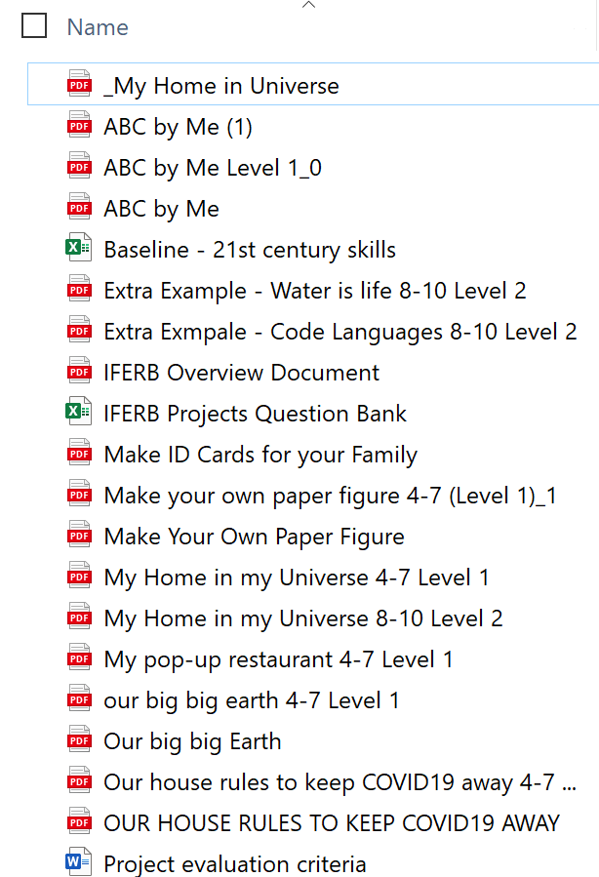
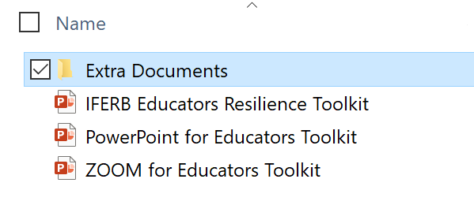
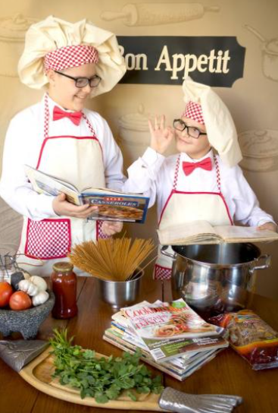



A.1. IFERB Overview Document
Appendix A – Additional Reading
Click here to directly access PDF document: IFERB Overview Document.
You can also find (IFERB Overview Document) in the “Extra Documents” folder of this Toolkit Package.
A.2. Exercise Projects Options
All the documents linked in the Appendices can be found in the “Extra Documents” folder. You can either click on the provided links or directly access the documents available in the “Extra Documents” folder.
Option 1: MY POP-UP RESTAURANT (LEVEL 1)
Option 2: SHADOW PLAY (LEVEL 2)
Option 3: WHY ALL THE PLASTIC? (LEVEL 3)
Click to access PDF document: My Pop-up Restaurant (Level 1)
Click to access PDF document: Shadow Play (Level 2)
Click to access PDF document: Why All The Plastic? (Level 3)
A.3. Exercise Projects Options’ Contextualization Examples
Option 1: MY POP-UP RESTAURANT (LEVEL 1)
Option 2: SHADOW PLAY (LEVEL 2)
Option 3: WHY ALL THE PLASTIC? (LEVEL 3)
Part 1 - https://bit.ly/32U2fwR
Part 2 - https://bit.ly/2OWFqk0
Part 3 - https://bit.ly/2EsSA6n
Part 4 - https://bit.ly/3f5Oo97
Part 5 - https://bit.ly/31h2VKy
Part 6 -https://bit.ly/2ELxrVc
Part 1 - https://bit.ly/2XLs6nc
Part 2 -https://bit.ly/3kDtSRk
Part 1 - https://bit.ly/3cTsiaA
Part 2 - https://bit.ly/3lnJzeZ
You will need internet access for accessing these links
A.4. Toolkit Contextualization Example – Water is Life Project
Our Example: Water is Life
Click to Access PDF document - (Our Used Example - Water is life 8-10 Level 2)
Below is another contextualization for the same Project:
Contextualized Project Example Water is Life
A

Slide 50

Appendix A – Additional Reading
A.5. Project Selection Checklist
Click to access PDF document: Project Selection Checklist Document.
You can also find (Project Selection Checklist Document) in the “Extra Documents” folder of this Toolkit Package.
A.6. IFERB Project Contextualization Examples
You can click on the links below to access the documents. You can also find the following linked documents in the “Extra Documents” folder of this Toolkit Package.
If you are not sure where to find them, refer to A.2. as it includes further instructions on where to find these documents.
Contextualized Project Document | Original Project Document
My Home in my Universe | Level 1, Level 2
ABC by Me | ABC by Me - Original Project PDF
Make your Own Paper Figure | Make your Own Paper Figure - Original Project PDF
Our Big Earth | Our Big Earth - Original Project PDF
Our House Rules to Keep COVID19 Away | Our House Rules to Keep COVID 19 Away - Original Project PDF
You are a Superhero | You are a Superhero - Original Project PDF
A

Slide 51




Appendix A – Additional Reading
A.7. Original Project & Contextualized Project Scripts
Can you spot the differences between original and contextualized scripts samples below?
ORIGINAL PROJECT
CONTEXTUALIZED PROJECT
ORIGINAL PROJECT
CONTEXTUALIZED PROJECT
A

Slide 52


Appendix A – Additional Reading
A.8. Extra Example for Project Selection & Contextualization (1/4)
Our Example:
Step 1: Project Selection
I chose Code Languages (Level 2) because my targeted skill focuses on Arabic oral (verbal) and written communication for Grade 5 students.
I was excited about this project because right now there is a movement in Lebanon to make the spoken Lebanese dialect an official written language. Therefore, my students can relate to the activities included in this project. Resources and Guidance Required to conduct this project are suitable for my students and their context.
You can check out my selected project, Figure A.1, here:
Click to Access PDF document: Extra Example Code Language 8-10 Level 2.
You can find (Extra Example – Code Languages 8-10 Level 2) in the “Extra Documents” folder.
You can also directly find it on EAA IFERB web page:
https://resources.educationaboveall.org/sites/default/files/resources/attachments/2020-07/Code%20Languages%208-10%20Level%202.pdf
Figure A.1: Advanced Exercise Selected Project Overview
Step 2: Read & understand the project
I carefully read the project brief for Code Language, Figure A.2. I also read the Project Document very carefully to make sure that I am familiar with all the concepts covered in the included activities.
I have identified some vocabulary and concepts that are important for understanding the project. I made sure to find the meaning of the following words, which are highlighted in Figure A.2:
Glyphs
Auditory impairments
Numerical patterns
Figure A.2: Advanced Exercise Selected Project Overview – Understanding Project
A

Slide 53




Appendix A – Additional Reading
A.8. Extra Example for Project Selection & Contextualization (2/4)
Step 3: Assess students’ previous learning
Activity from Project Document:
As you can see in Figures A.3, A.4 & A.5, I wrote down My Questions to help me assess my students’ learning.
Activity from Project Document:
My Question: Do my students know what does “culture” mean?
Figure A. 4: Assessing Students’ Previous Learning - Example B
Activity from Project Document:
My Questions:
How many languages do my students know?
Do they know how to write these languages or only speak them?
My Question: Do my students know about sign language?
Figure A.3: Assessing Students’ Previous Learning - Example A
Figure A.5: Assessing Students’ Previous Learning - Example BC
Step 4: Make project relevant to your students
Check Figure A.6 to see how I Contextualized the Activity description and made it relevant to what is going on in Lebanon.
I will use Arabic language instead of the listed ones because Arabic is more relevant to my students’ context and culture; which means they will engage more with it.
Activity from Project Document:
My contextualized script for the above activity:
Begin to explore how oral language evolved and the importance of writing.
Different languages can be written in different scripts or are often written with the same script. Either these languages have similar roots or backgrounds (e.g. Arabic, Urdu and Farsi have the same origins. Another example is how English, French and Spanish share the same origins). Lebanese is an oral dialect that is being advocated to be officially recognized as a written language using Arabic letters (scripts).
Figure A.6: Make Project More Relevant to Students- Example A
A

Slide 54






Appendix A – Additional Reading
A.8. Extra Example for Project Selection & Contextualization (3/4)
Step 5: Prepare supplies and/or their alternatives
I tried to use more available resources for my students.
Figure A.7 shows the identified limited supplies and how I replaced them with more accessible ones. I also kept in mind not to compromise the objective of the activity when I was replacing the main supplies with my alternatives.
Matchstick can be replaced by Lolistocks or branches
Lemon Juice can be replaced by Vinegar
Figure A.7: Examples of substituting unavailable supplies with more accessible ones
Advanced: Extract subjects covered in the project (1/2)
I know from Figure A.1 that the main two subjects covered in this project are Math and Literacy. I also know that there are other subjects and skills that are covered by the project’s activities..
Rhyming verse
Subject(s): Arabic/ French/ English
I read all project’s activities and started to highlight included concepts that are not related to Math or Literacy.
Someone who is deaf
Subject(s): Civic Studies
Explore the effects of oxidation.
Subject(s): Science
An example of what I did can be found in Figures A.8, A.9 and A.10.
In fact, my project covers the following extra subjects:
History, Civic Studies, Arabic/French/English, and Science
Figure A.8: Extract Subjects Example A
A

Slide 55


Appendix A – Additional Reading
A.8. Extra Example for Project Selection & Contextualization (4/4)
Advanced: Extract subjects covered in the project (2/2)
Exploring and understanding the history of languages.
Subject(s): History
Desciption of the languages’ history, how did the languages evolve.
(Mesopotamia, alphabet Phoenicians, hieroglyphs)
Do you know our language represents culture…
Subject(s): Civic Studies
Figure A.9: Extract Subjects Example B
Figure A.10: Extract Subjects Example C
Advanced: Map curriculum to project
I found the chapters from the curriculum that correspond to the skills and concepts included in my project. See Figures A.11, A.12 and A.13 for examples.
Now I can adjust the difficulty of the activities according to the curriculum expectations.
I can also add any other concepts into the activities
Oxydation
In the Lebanese curriculum
Science: Module 2: Matter & Energy
Figure A.11: Curriculum Mapping - Example A
Civic Curiculum
Grade 3: Lesson 4:
Our Arabic Language The language of culture
Civic Curiculum
Grade 4-Lesson 2:
Unity and Respect between People
History of Languages
In the Lebanese curriculum
History: Grade 8 – Civilizations (Egyptian, Phynitians)
A
Figure A.13: Curriculum Mapping - Example C
FigureA.12: Curriculum Mapping - Example B

Slide 56
Appendix B Educators’ General Tools
Appendix Content
B.1. Non-Academic Skills
B.2. Activities’ Strategies & Instructions
B.3. Managing Students’ Behavioral Challenges
B.4. IFERB Projects’ Questions Bank
B.5 21st Century Rubric

Slide 57




Appendix B – Educators’ General Tools
B.1. Non-Academic Skills
There are two main non-academic skills related to IFERB: 21st century skills and Social-Emotional Learning (SEL) Skills.
21st Century Skills
Social-Emotional Learning (SEL) Skills
Extra Reading
21st century skills are important skills to help today’s students to stay up-to-date with current competitive markets; especially in the age of the internet. These skills are grouped in three categories as follows [sources:1,2]:
1) 21st Century Skills:
https://www.aeseducation.com/blog/what-are-21st-century-skills
2) 4Cs:
https://www.aeseducation.com/blog/four-cs-21st-century-skills
3) SEL:
https://www.cfchildren.org/what-is-social-emotional-learning
Learning Skills
(known as the four C’s – 4Cs)
Literacy Skills (IMT)
Life Skills (FLIPS)
Social-Emotional Learning (SEL) “is the process of developing the self-awareness, self-control, and interpersonal skills that are vital for school, work, and life success. People with strong social-emotional skills are better able to cope with everyday challenges and benefit academically, professionally, and socially” [sources: 3]
[sources: 5]
Critical Thinking – is about problem solving and considering different perspectives.
Creativity – is about thinking outside the box and trying to capitalize on students’ inner strengths to foster innovation.
Collaboration – is about working together to achieve one goal.
Communication – is about expressing ideas in a clear way; i.e., talking clearly.
Information Literacy – “ Understanding facts, figures, statistics, and data.”
Media Literacy – “Understanding the methods and outlets in which information is published.”
Technology Literacy – “Understanding the machines that make the Information Age possible.”
Flexibility – changing the plan as needed.
Leadership – “Motivating a team to accomplish a goal.”
Initiative – “Starting projects, strategies, and plans on one’s own.”
Productivity – “Maintaining efficiency in an age of distractions.”
Social Skills – “Meeting and networking with others for mutual benefit.”
B.2. Activities’ Strategies & Instructions (1/4)
As you already know by now, Activity and Description block in Project Document already describes how to deliver an activity.
You can change an activity if you have an alternative that might be more engaging to your students and still relevant for the projects.
When you change the way you deliver an activity (i.e., the learning strategy), you will also need to adjust your instructions set.
To do so, you will need to apply the following steps, which will be discussed in details hereafter:
Tip:
IFERB projects focus on the 4C’s of the 21st century skills and on Social-Emotional Learning (SEL).
If your targeted skill is SEL related, IFERB online filter can help you find related projects as SEL is one of the included subjects under the Subject Filter.
However, 21st century skills are already embedded in all projects’ activities.
Step 1: Read and understand the contextualized Daily Activity you want to adjust
Step 2: Write down main elements/points that students need to understand & complete the activity
Step 3: Choose your strategy
Step 4: Draft your sentences to create meaningful and simple instructions
Step 5: Review and modify
Step 1: Read and understand contextualized Daily Activities you want to adjust
The Day 1 activity from Water is Life project will be used for this example, as in Figure B.1.
The main objective of Day 1 activities of this project is to “…find out the different ways we use water!”
In the first activity, though, we start by talking about “what happens when you don’t drink water for a long time?”.
When reading the rest of the activity’s questions, you can see how they relate to the main lesson objective: one way we use water is drinking it to stay alive.
B
Figure B.1: Water is Life Daily Activity Example

Slide 58

Appendix B – Educators’ General Tools
B.2. Activities’ Strategies & Instructions (2/4)
Step 2: Write down main elements/points that students need to understand & complete the activity
After understanding the Daily Activity and its main objective, you will need to write down the main elements needed for your students to understand the essence of this activity.
For example, by the end of the first day activity, students need to have two main takeaways:
Takeaway 1: All living things (humans, animals, plants) need water to survive.
Takeaway 2: Human body is mostly water (60%)
Tip:
You might need to use multiple examples based on the age of your students and the complexity of the topic. The younger your students are and/or the more complex your topic is, the more examples you need to use.
Exercise: Choose an activity. Read it, understand its essence and write down the main takeaways you need to make sure your students learn.
Step 3: Choose your strategy
After identifying the main takeaways of the activity, you will need to choose a strategy that best fits your students’ age group and their learning level.
There are a lot of available strategies that you can use for your lesson plan. The following are some of the strategies that you can easily apply right away:
Using examples: Use examples to explain your activity and/or its elements. For instance, to explain that “all living things need water to survive”, you can use two pots where one has a green plant and the other has a dead plant. You can use this example to spark the conversation and try to answer the question “why did the plant die?” This strategy works with all ages and all subjects.
Brainstorming: You can divide students into groups where they collaborate to find an answer to a question you ask them. You can also present a problem hoping that they can work together to find multiple solutions. The key for succeeding using this strategy is to make sure that you ask open-ended questions and to make sure that students understand that there is no one right answer. Also, remember to emphasize that there are no “stupid” ideas and that all ideas are welcomed as you can build on them. An example question from Water is Life project is “what happens when you don’t drink water for a long time?” This strategy works best for ages 8+ years old; i.e., level 2 and 3 in IFERB resources bank.
Riddles: Unlike Brainstorming, this strategy has one right answer. After starting the riddle (or asking the question), you need to give hints and tips so students can figure out the right answer. For example, you can have an item hidden in a box while the students need to guess what is in the box based on the clues you give. These clues can be a description of this item, a tip on how to use it and/or any other helpful information. A riddle can be used for the Water is Life project, where you can give students tips and descriptions about water to help them figure out that you are talking about water. This strategy works with all ages and all subjects.
Pairing – or peer learning: This strategy consists of pairing students together to accomplish one activity or to help each other to accomplish their own separate activities. This strategy is used to build collaboration skills among different students. For instance, you can pair two students to perform the drawing activity from Day 1 Activity of Water is Life project. After each one finishes their own drawing, they pass the drawings to each other to exchange feedback to enhance their work. This strategy works best for ages 8+ years old; i.e., level 2 and 3 in IFERB resources bank.
Please note that not all strategies can be applicable in remote settings. For example, it will be hard to show your students the plant pots over the phone unless you have coordinated with parents; so that parents can prepare this visual aid at home. You can also try using visualization/imagination techniques instead of visual aids whenever applicable.
B
B

Slide 59

Appendix B – Educators’ General Tools
B.2. Activities’ Strategies & Instructions (3/4)
Step 4: Draft & simplify instructions
Your role as an educator is to find a way to introduce each activity in an engaging way.
For students to be engaged, they need to follow what is being requested from them (i.e., instructions). The moment they feel lost, you have lost their engagement.
If your explanation is too complicated, your students may not understand the activities. Also, if it is too simple and is missing the main points, your students may not learn from the activity.
Typically, your explanation will include a series of instructions that can be statements, questions and/or requests.
The art of breaking down the activity into a set of simplified instructions can be learned by following these general rules:
Organize instructions in steps
Deliver one step/instruction at a time
Your instructions need to be broken down to the smallest tasks and then build on them.
Each instruction is a building block. You use these blocks to build the activities that need to be performed by students. Figure B.2 is a visual illustration of how an activity is constructed using multiple instructions-blocks.
Let’s try to write down a set of instructions for our example activity from Water is Life project, chosen earlier (Figure B.1). First, this is what you know about this activity:
Objective: “find out the different ways we use water!”
Main elements: All living things (humans, animals, plats) need water to survive.
Strategy: Let’s combine two strategies; Teach by examples + Brainstorming by using two plant pots, where one pot has a living plant and the other has a dead one.
Activity
Request 2
Instructions-blocks
Request 1
statement1
Question 1
Figure B.2: Instructions-Blocks - Visual Illustration describing relationship between a set of instructions-blocks and an activity.
Instructions Set #1:
These are my two plant pots.
Can you tell me what is the color of this plant (pointing at the alive plant)?
What about the color of this plant (pointing at the dead plant)?
What do you think happened to this one? (pointing at the dead one).
Wait and see if their brainstorming reach to the conclusion that plants die without water.
If not, then you will need to prepare more prompting questions.
Instructions Set #2:
These are my two plant pots that I take care of everyday.
Sometimes I forget to water one of them.
Can you guess which one I forget to water?
Wait for their responses to assess if you need more prompting questions.
How did you guess?
So, plants need water to live.
Can both instructions sets work in a remote setting?
Notice how I kept the instructions interesting and still built curiosity with students.
I want to make sure that my students will be engaged with me until the activity is over.
I learned that telling students “focus with me” does not really help. What worked for me is to make sure my instructions and story-telling skills are interesting enough for their age group and interests.
Tip:
It is recommended to give one instruction at a time and not to move on to the next instruction unless you are sure that all students understood the one you just presented.
There are always multiple ways to write instructions. You will need to consider the ages of your students and complexity of topic to create a suitable instructions set.
Remote learning is also another factor that will determine how detailed and simplified these instructions should be; review Booklet 3 (section 3.2) for further details on this topic.
B
Exercise:
Write down an instructions set for your chosen activity from you contextualized projects. For practice purposes, try to choose a different strategy for delivery; you can choose from the list provided in step 3.
B

Slide 60
Appendix B – Educators’ General Tools
B.2. Activities’ Strategies & Instructions (4/4)
Step 5: Review and modify
As you know, practice makes perfect! The more experience you gain with simplifying instructions to build up activities, the easier it gets.
In the meantime, you might not have tried this method before. It is always a good idea to go through the steps yourself and see if they make sense or if you need to add or remove steps.
Tip:
Try to engage your students’ curiosity and interest every day and in every activity.
For example, after I wrote instructions set #1, I realized that my 8-10 years old students might get lost or distracted from my main end-goal, which is plants need water to live. They might say that the dead plants did not see the sun or any reasons other than the lack of water. Because I needed to narrow the story down by probing them to the end-goal conclusion, I created instructions set #2 and I ended up choosing it.
Also, I learned that if something did not work for one class, I will keep adjusting and improving my methods to increase the chances for successful project implementation.
Tip:
Parents who are teaching their children at home can also use the instructions-blocks strategy to ensure a pleasant teaching and learning experience at home.
Practice makes perfect!
B.3. Managing Students’ Behavioral Challenges
Behavior Profile Name | Behavior Indications | Best Practices
Emotional problems | Tendency for confrontations Inability to suppress anger Tendency for isolation Difficulty managing emotions | Be a calm and a positive role model Be consistent in your expectations Avoid shouting Praise good behavior
Attention deficit hyperactivity disorder (ADHD) | Hyperactivity Difficulty sitting in one place Difficulty concentrating Losing their belonging Not being able to follow multiple instructions at the same time | Set small goals Give something to fidget with to help them to focus during class Provide shorter activities Provide more breaks between activities Praise good behavior
Learning problems - Spelling - Writing - Numeracy | Feeling frustrated Showing embarrassment Misbehaving during activities that they find challenging | Consult a specialist if possible Provide special activities to help them build these skills; maybe individual attention would be best suited. Avoid embarrassing the student Avoid drawing attention to his/her weakness Highlight their strengths Praise good behavior
Satirical & Mockery | Using sarcasm to provoke Expressing complaint with mockery Getting angry when you give advise | Ask for clarification Use polite words when communicating Try to change the topic Assign them the responsibility to find a solution for what they have just criticized – you might be surprised! Praise good behavior
Aggressive & Hostile Behavior | Anti-social Tendency for physical aggression Tendency for bullying Tendency for screaming Stirring up trouble | Try to bond with these students Try to learn about his/her specific situation – what is causing the aggression Avoid confronting him/her Praise good behavior
B
B
B

Slide 61



Appendix B – Educators’ General Tools
B.4. IFERB Projects’ Questions Bank
Step-by-step instructions to access to use IFERB Projects’ Question Bank
First, click here or go to https://drive.google.com/file/d/1TZ5A1ZLzdjGx0eJOA9rSir0U31ssotlC/view to view or download the document.
Figure B.3 shows a sample from what is in this excel sheet.
You will need internet access for accessing these links
Figure B.3: IFERB Projects’ Question Bank Excel Sheet Sample
Usually, these questions are used to form baseline and end-line assessments.
When forming your baseline and/or end-line assessment, it is recommended to selection 1-2 questions from each of the selected projects.
Make sure to choose questions from all three types: Knowledge, Skill and Discovery.
Total number of questions is expected to be 10-12.
You need to include questions with different difficulties to get a better idea about what the students know about the project or your targeted skills (academic and/or non-academic).
Please note that increasing questions’ difficulty does not mean to use questions from higher project level; stick to your project’s level. For example, stick to the questions bank for Water is Life (Level 1) and do not use questions from Level 2 or 3.
Questions’ difficulty can be measured against what you know about your students’ previous knowledge.
Tip:
You can try using these questions to form your quizzes.
B.5. 21st Century Rubric
Step-by-step instructions to access to use IFERB 21st Century Rubric
First, click here or go to https://docs.google.com/document/d/1iUDz67JWlhACXKvB4e1vl-Sr1K4icBtSzaVkYMl5C3c/edit to view or edit the document.
Figure B.4 & B.5 show samples of the rubric that can be found in the excel sheet.
When using the rubric system, you need to prompt students with activities and/or questions (such the ones in Figure B.5) while observing their reaction, interaction and/or answers.
Then, you can match students’ performance with the right level from rubric table (such as the one in Figure B.4). To do so, you need to read the description for Level 1, Level 2 and level 3 and then you need to decide which level description mostly fits with your observations.
Figure B.5. incudes another example of how to use 21st century rubric.
B
Figure B.5: IFERB 21st Century Rubric Example using Prompts
Figure B.4: IFERB 21st Century Rubric Excel Sheet Sample

Slide 62
Appendix C Educators’ Advanced Tools
Appendix Content
C.1. Project Selection – Advanced Practices (Optional)
C.1.1. Select by Specific Skill (Academic or Non-Academic)
C.2. Project Contextualization – Advanced Practices (Optional)
C.2.1. Before Contextualization: Extract Subjects from Project Document
C.2.2. Curriculum Mapping & Contextualization
A) Map Curriculum to Project
B) Map Project’s Difficulty to Curriculum C) Map/Inject Curriculum Skills into Project

Slide 63








Appendix C – Educators’ Advanced Tools
C.1. Project Selection– Advanced Practices (Optional) (1/2)
Before you start selecting suitable projects, it is important to learn about the main educational skills that are frequently included in IFERB projects.
There are two types of skills for students to acquire: academic and non-academic skills.
Remember that a lot of projects focus on non-academic skills like socio-emotional learning, global citizenship education and/or 21st century skills.
1
Academic skills
Non-academic skills
Tip:
When filtering a project, you can filter for SEL skills while 21st century skills are already embedded in the projects’ activities.
Academic skills are related to local curriculum for different subjects, such as literacy, numeracy, geography, history ..etc.
Non-academic skills are related to 21st century skills and Social & Emotional Learning (SEL) skills. If you are not familiar with these non-academic skills, please spend 10 minutes reading about them in Appendix B – (B.1: Non-Academic Skills), such as creativity, communication …etc.
1
C.1.1. Select by Specific Skill (Academic or Non-Academic) (1/2)
Multiplication
At this point, you have accessed the age-appropriate projects from IFERB Projects’ bank; Level 1, 2 or 3.
You also know the skill(s) you want to reinforce or introduce as a new one.
If you are targeting an academic skill, for example multiplication for grade 5 students, then you need to work with the subject that covers this skill. In this specific example, your targeted subject is mathematics.
For advanced Project Selection, it is easier to use IFERB free online filter.
You will simply need to go to IFERB online resources and use Subject Filter to look for your targeted subject. Please note that you can check multiple subjects in the filter, if needed.
Figure C.1: Find Tool
2
Tip:
IFERB projects include multiple skills from multiple subjects. For example, a project covering numeracy, can also cover literacy.
Figure C.2: Apple Command+F & Windows Ctr+F
2
The fastest way to search for your specific skill is to use keyboard shortcuts (Ctr + F for windows , and Command + F for Apple) as shown in Figure C.2.
Once you click these two keys together, a “Find” tool will be displayed at the top of your browser page, as shown in Figure C.1. Type the specific skill you are looking for, then click on the next arrow (as indicated in Figure C.1 - ) to take you the correct project.
Now, you should be able to identify all relevant projects.
Please note that your search for a specific skill can result in finding one project only; in other cases, you might not be able to find any projects this way.
If you cannot find enough (or any) relevant projects, then you need to do couple more steps. You can click on the Download Project button, as shown in Figure C.3, to get access to more information about what is covered in the project(s).
Once the Project Document is displayed in the browser or downloaded on your device, you can repeat the steps in Figure C.1 and C.2 to look for your targeted skill(s) within the Project Document itself.
If you are targeting a non-academic skill, IFERB online Subject Filter includes SEL (Social Emotional Learning) as a subject.
If you are targeting other non-academic skills, you will need to click on Download Project button and read the project’s activities to decide if they focus on your targeted non-academic skills. Keep in mind that all projects cover the 4Cs of 21st Century skills.
Remember:
All detailed steps on how to access IFERB online resources can be found in Booklet 1 (section 1.2.2).
You can also use IFERB online filter to narrow down projects by Guidance and Resource Requirements as well as Subject(s). However, this section is focusing on filtering by skills (i.e. using Subjects Filter).
C
Practice makes progress!

Slide 64


Appendix C – Educators’ Advanced Tools
C.1. Project Selection– Advanced Practices (Optional) (2/2)
C.1.1. Select by Specific Skill (Academic or Non-Academic) (2/2)
You can apply the following steps to try for yourself.
For Example, our targeted skill is “subtraction” for grade 1.
We accessed projects in Level 1 from IFERB resources online page.
Then we used the Subject Filter and checked Mathematics and Numeracy.
There were many filtered projects displayed.
We used Ctr+F to fetch the Find Tool. We typed “Subtraction” and it showed “0” results. We tried “Subtract” and also “0” results.
So, we went to the next page, as shown in Figure C.4 ; this can be found at the end of the projects lists. We found two more projects.
After you filter by targeted skill, you will need to finalize your selection by following the steps included in Booklet 2 (section 2.2.2). Select by Context.
Figure C.3: Project Overview for the Filtered Example Project
Figure C.4: Pages Navigation to Display rest of Projects
Tip:
The projects are designed based on learning standards expected of that age group across 5 different international curriculum standards (UK, US, Qatar, India, and Australia). However, if you find that your students’ learning level is not aligned with their grade-level, make sure to select projects that are appropriately challenging for your learners. You can do that by checking all the levels to choose the level your learners will be comfortable with and/or adapt some of the activities from the “modifications for simplification / enrichment activities” or your own experience for your context. You can have smoother access to projects’ different levels from Educator’s Resources page, which can be accessed by clicking on this link: https://resources.educationaboveall.org/resources/educator-resources. When clicking on “Download Project” you will have access to all available levels in one Document.
Tip:
If you do not have access to local curriculum, or if you are conducting the projects during a holiday (such as summer break), it is recommended to focus on non-academic skills.
Extra Reading
You can go over a detailed project selection checklist that can be found in Appendix A – (A.5: Project Selection Checklist).
C

Slide 65


C.2. Project Contextualization – Advanced Practices (Optional) (1/4)
Appendix C – Educators’ Advanced Tools
C.2.1. Before Contextualization (1/2)
Extract Subjects from Project Documents
Before contextualizing (adapting) the project to specific aspects of your student’s context (curriculum, environment, level, resources …etc.), you will need to extract the subjects covered in the selected project.
First, you can refer to project overview, Figure C.5, to check the main subject(s) covered in this project.
Exercise: Using one of your selected projects, write down the main subjects covered in it – you can find these subjects listed in Project Document brief .
However, please note that these might not be the only subjects covered.
If you start reading Daily Activities sections in the Project Document, you might find that an activity can be related to another subject.
Our Example (1/2) :
Based on Figure C.5, the main subject overed in this project is Science. I can see how Science is the main subject used in most of the activities. For example, Figure C.6 shows how the activity is using concepts from Science subject.
However, I also noticed that some activities, like the one in Figure C.7 are using math instead of Science. So, I asked Mariam to look further into this and to identify what other subjects are used for this project’s activities.
Figure C.5: Advanced Exercise Selected Project Overview - Subjects
Activity from Project Document:
I carefully read the activities and write down all the subjects that are related to the skills or topics covered. For example, Figure C.8, showcases how Science is the main subject for this activity as human body and water are covered. However, as you can see in Figure C.7, I need to teach kids how to calculate the percentage of water in the human body. The percentage and the fractions are covered in Math; hence, the second covered subject is Math.
I kept reading the Daily Activities to extract all the covered subjects. As you can see in Figure C.8, Geography and Civic Studies are covered because we will be exploring sources of water and ways to reduce pollution.
Extracted Subject(s): Science
Key skills/indicators:
- Different ways we use water
- The importance of water for our body
Figure C.6: Selected Project Daily Activities – Extract Subjects Example A
C

Slide 66



C.2. Project Contextualization – Advanced Practices (Optional) (2/4)
Appendix C – Educators’ Advanced Tools
C.2.1. Before Contextualization (2/2)
Our Example: (2/2)
Activity from Project Document:
Activity from Project Document:
Activity from Project Document:
Extracted Subject(s): Mathematics
Extracted Subject(s): Geography
Extracted Subject(s): Civic Studies
Key skills/indicators:
- Percentages and fractions
Key skills/indicators:
- Source of water
Key skills/indicators:
- Reducing pollution
Figure C.7: Selected Project Daily Activities – Extract Subjects Example B
Figure C.8: Selected Project Daily Activities – Extract Subjects Example C & D
Exercise: Read your project’s Daily Activities to extract any extra covered subjects. Make a note of the key skills or indicators that helped you conclude what the extra subjects are – refer to Figures C.6, C.7 and C.8 for examples.
C.2.2. Curriculum Mapping & Contextualization (1/3)
A) Map Curriculum to Project (1/2)
Now you need to get access to the local curriculum corresponding to your extracted subjects. For example, Mariam needs to access the curriculum for Geography and Civic Studies – as shown in Figure C.8.
Try to find chapters that cover your identified key skills (or indicators). For example, the key skills/indicators for the activity shown in Figure C.7 are percentages and fractions.
Start reading curriculum’s corresponding chapters to learn more about what your students need to learn to be in alignment with government curriculum.
Please note that there might be some skills that are covered by the curriculum but not in the project.
You can use your findings to further adjust your project activities’ difficulty and/or add more skills to them.
Curriculum-based contextualization will be covered in more details in following sections.
Tip:
If you are working with an NGO or school, you can ask for the curriculum. You can try to find it online (e.g., google.com). You can also ask your friends and family for the curriculum.
Exercise: Curriculum Mapping
Find curriculum chapters that corresponds with your project’s extracted skill(s).
Check out our example next to help you with this exercise.
C

Slide 67
C.2. Project Contextualization – Advanced Practices (Optional) (3/4)
Appendix C – Educators’ Advanced Tools
C.2.2. Curriculum Mapping & Contextualization (2/3)
A) Map Curriculum to Project (2/2)
Our Example:
To be able to map my local curriculum to my project, I need to understand the skills covered in my project and to also understand the skills covered in the curriculum. I know, from my Project Document, what activities cover what skills. However, I do not know if these skills are part of my local curriculum here in Lebanon. Therefore, I need to first try to locate where these skills are covered in the Lebanese curriculum. Then, I can decide if I need to adjust activities’ difficulty and/or add extra skills covered in the curriculum (but not in the project). Please note, that you might not find all the identified skills in your local curriculum; in this case, focus on the ones you find.
Skills/Topics: Source of water
Curriculum Subject: Geography – Grade 4
Chapter: Humans and their geographical environment
Skills/Topics: All living things need water to survive
Curriculum Subject: Science Grade 6
Chapter: Human & Health - Body structure
Figure C.9: Activities- Curriculum Mapping Example A
Figure C.11: Activities- Curriculum Mapping Example C
I briefly scanned the Lebanese local curriculum for Science. I was scanning and looking for main concepts included in my project, such as sources of water, and I was surprised that it was covered in Geography Grades 3 and 4.
I took note for curriculum chapters that cover my project’s skills. Check out my mapping in Figures C.9 & C.10.
Skills/Topic: Pollution
Curriculum Subject: Civics – Grade 3
Chapter: The environment and us
Skills/Topics: Percentages and Fractions
Curriculum Subject: : Math - Grade 5 & 6
Chapter: Numbers - Fractions
If you are considering level 3 from this project, then the ages of the students will be 11-14; hence, look at curriculum for grades 5 & 6 instead of 3 &4; check Figure C.11 & C.12
Figure C.10: Activities- Curriculum Mapping Example B
Figure C.12: Activities- Curriculum Mapping Example D
B) Map Project’s Difficulty to Curriculum
After learning more about the curriculum, you will be able to adjust the difficulty level of the project’s activities to match the curriculum’s expectations.
You need to read the activities and compare the identified skills/indicators with those in the curriculum.
If the levels match, then no further modification is required.
However, if you find that the difficulty level of the included skills do not match those in the curriculum, then you need to consider the following:
If some of the activities include more skills than those included in the curriculum, then you need to simplify the activity. Let’s consider example D, shown in Figure C.12, where students are to tackle fractions (i.e., 3/5). If the curriculum for your students’ grade level does not even talk about fractions, then you will need to simplify this activity to deliver its main point. One way to modify this activity to convey that most of human body consist of water, without mentioning fractions, is to limit it to coloring most of the human silhouette.
Tip: If local curriculum level is lower than the project, but you are confident that you can explain the topic to your students and that they can handle more challenging tasks, then you can go ahead without further contextualization to simplify the activities.
On the other hand, if the curriculum includes higher level skills than those included in the project’s activities, then you might want to add these skills. Consider the same example D, shown in Figure C.12, where this time the curriculum shows that fractions have been already covered before along with decimals. Then, you might want to consider adding decimals to this activity. In this case, the next section will guide you how to add curriculum-skills to the project.
Tip:
Sometimes students’ learning level is much lower than the curriculum’s included skills. In this case, it is not wise to add more skills to the project. For example, your students might not even be familiar with fractions yet, although the curriculum expects otherwise.
Exercise: Map project difficulty to curriculum:
Based on the past couple of exercises:
Which activities need to be simplified to match the curriculum?
How can you simplify the identified activities?
Can you find any activities that need to be adjusted to match a higher level of learning required by the curriculum?
C

Slide 68


C.2. Project Contextualization – Advanced Practices (Optional) (4/4)
Appendix C – Educators’ Advanced Tools
C.2.2. Curriculum Mapping & Contextualization (3/3)
C) Map/Inject Curriculum Skills into Project
Now that you have identified what curriculum-skills need to be added to what activities, you will need to enrich current activities or even add activities to include these extra skills.
You can enrich a current activity by adding a discussion about a specific extra skill/topic or by adding extra activities or steps to cover the additional curriculum-skill.
The competency of injecting extra curriculum-skills can be mastered with practice.
Our Example:
I will read more about identified topics in the curriculum to investigate what extra information, skills and/or concepts are covered by the curriculum but not included in my project. Then I need to decide if I want to add any of the extra skills into my project to reinforce my students’ current knowledge or introduce it as a new topic.
For example, in the pollution activity, Figure C.13, the project mentions “human activities.” I remembered reading about human activities that cause pollution. This is an opportunity to include these curriculum-based “human activities” into the conversation during the project.
I also found another opportunity in Civic Studies curriculum (Official Public Services Institutions chapter). This chapter showcases how government provides clean water to our homes. I will make a note to add this to our conversation when we discuss how to get clean water, as shown in Figure C.14. I can also create an activity that will further engage the students. For example, I can ask them to count how many faucets do they have at their home. Then, they can draw some pictures of where do they think the faucet water comes from? (I can also ask them to observe how clean the faucet water is).
I must admit that I was not able to inject extra skills from curriculum into the project when I first started. It took some time to get used to the process. However, I was able to use the curriculum mapping exercise to help me figure out how to adjust and map project’s difficulty to the curriculum.
Tip:
Once project selection and contextualization process becomes easier for you, you can further experiment with adding more skills from curriculum into the project.
Figure C.13: Injecting Curriculum Skills - Activity Example A
Figure C.14: Injecting Curriculum Skills – Activity Example B
Exercise: Try to add extra skills to your project, either by adding points for discussion or activities to introduce these extra skills.
C
68

Slide 69
Appendix D Tips for NGOs/Schools
Appendix Content
D.1. Training the volunteers
D.2. Projects’ Evaluation

Slide 70
Appendix D – Tips for NGOs/Schools
D.1. Training the Trainer
EAA’s partner NGOs and schools select and contextualize projects to be implemented by their facilitators, teachers and volunteers.
As an NGO/School, you can choose to train your team on project selection, contextualization, and/or implementation.
Some NGOs/Schools choose to deliver these trainings on four workshops sessions: Project Selection, Project Contextualization, Project Implementation, and Assessments.
When training for implementation, follow these best practices:
Make sure that your trainees know how to read the different sections of Project Documents.
Empower trainees to learn how to select from your already selected and contextualized projects.
Sometimes, trainings focus on how to deliver the project in an ideal environment, where students are fully engaged. Therefore, make sure to show them the good, the bad and the ugly about managing remote PBL implementation. The more real-life examples you can bring to the training table, the more they will be prepared for managing their remote sessions with their students.
Provide training on how to manage students’ difficult behavior and how to use differentiating instructions to maintain PBL essence of develop academic and non-academic skills while maintaining students’ voice.
After the training is conducted, trainees can add value with their creative solutions to whatever challenges you might face; try to give them space for creativity and ownership.
D.2. Projects’ Evaluation
Below are some best practices to assist your NGO/School to evaluate projects:
Conduct focus group discussions at the end of each project to allow for an open discussion on areas of discovery, challenges and how these were overcome etc.
Peer review can also be encouraged on the final presentation of the project outcome.
Keep reviewing and adjusting the projects based on the evaluation at hand.
D

Slide 71
Appendix E Sources Used in Toolkit
Appendix Content
E.1. Sources

Slide 72
Appendix E – Sources Used in Toolkit
E.1. Sources:
21st Century Skills: https://www.aeseducation.com/blog/what-are-21st-century-skills
4Cs: https://www.aeseducation.com/blog/four-cs-21st-century-skills
SEL: https://www.cfchildren.org/what-is-social-emotional-learning
Self-Evaluation: https://www.tinypulse.com/blog/50-self-evaluation-phrases-for-your-next-performance-review
Leadership icon credits: https://www.flaticon.com/free-icon/leadership_489197
E

