Slide 1

Note to Facilitators
Before implementing PBL
If you begin implementing project-based learning without explaining it to parents, they might become confused about the expectations you have for their children, and in their frustration, they may paint the process as a negative one. If you clearly explain your reasoning for using PBL, then parents will often prove to be your greatest allies.
Hold a meeting with parents to explain to them the philosophy and the processes of using project-based learning. In this meeting, discuss the advantages to using PBL and what it will look like from their perspective when students bring home work that is unlike what they are used to seeing.
Many parents expect that their children's education will be just like their own. If a child doesn't come home with a worksheet or a set of problems from a book, parents may be concerned that nothing is being accomplished. PBL is foreign to them, and it is important that they understand it so that they can support their children and your efforts in the classroom. Remember to be thorough in your explanation of PBL.
We prepared this PowerPoint presentation for you to help you explain PBL to parents. You can also provide a sample project so that parents can see for themselves what PBL might look like.
Notes:
General Note: Try to conduct this session with parents before you start the program so that you can tailor the projects selected according to parents' availability at the contextualization stage.

Slide 2


Engaged parents
It is important to precisely explain what is expected from parents to support their kids in this program.
Try to simplify their role as much as you can. Keep in mind, parents have other jobs and responsibilities, and they might not be able to be there for their kids all the time. This does not make them bad parents.
These expectations need to be explained very clearly. Once you clarify parents’ role in the project, you need to investigate how realistic your expectations are. You can ask them “is this easy or will you need extra support for this item/task?” If your expectations are too much on them, then you will need to try to further simplify their role and/or involvement.
Note to Facilitators
Unengaged parents
When dealing with unengaged parents, try to get more creative on how to minimize parents’ involvement at home so students can participate and deliver assignments as independently as possible. For instance, if a project requires students to interview parents, have them interview their peers at school instead. You could dedicate an hour or so during school hours a few times a week to address any concerns or questions students may have.
For such independence to be achieved, you need to deliver crystal clear instructions to students so they can perform tasks with minimum support from parents.
You can also assign students’ groups, if you intend to work with groups, based on how close they live to each other to carve more support for students and parents. You could also create mixed ability student groups for learners to support each other.

Slide 3


Internet Free Education Resource Bank
Parent Guide

Slide 4
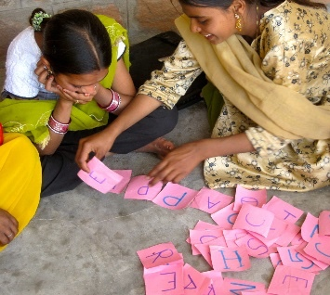
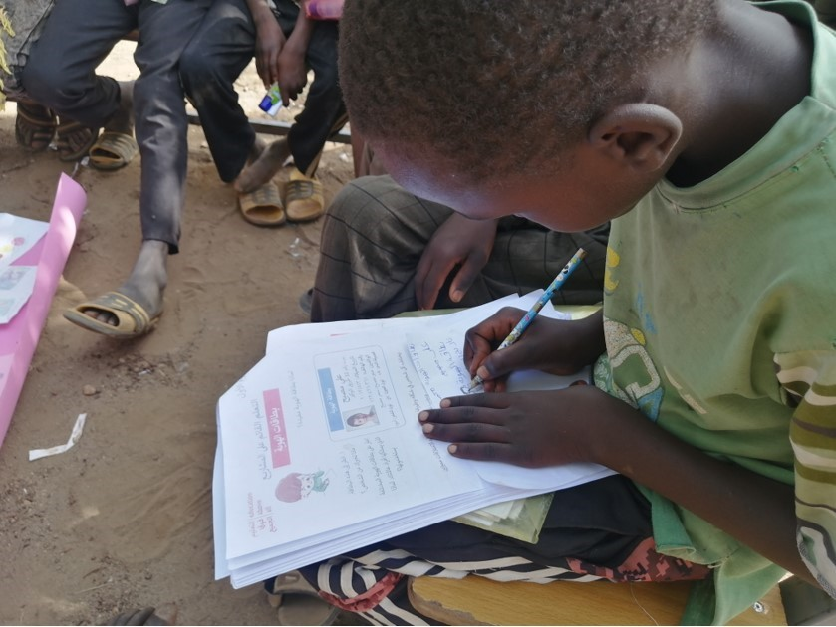




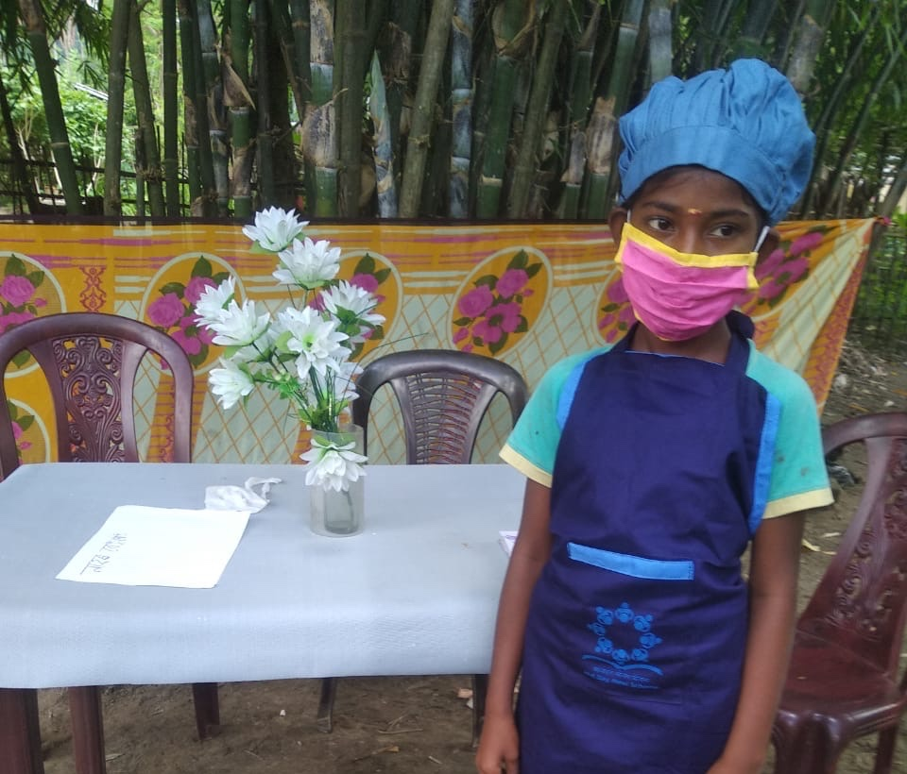

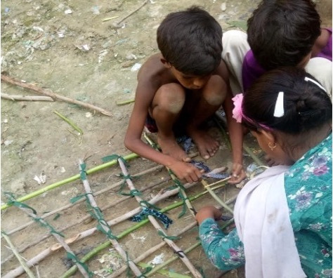


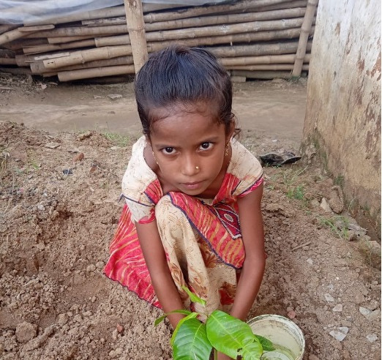
What Is Project-Based Learning (PBL)?
Project-based learning (PBL) is an educational method designed to give students the opportunity to develop and apply knowledge and skills through engaging projects that are set around challenges and problems they may face in the real world.
Curriculum Content
Real World Problem
21st Century Skills
In-depth Inquiry & Innovation
Student Voice & Choice
Reflection & Revision
Notes:
“Tell me and I forget. Teach me and I remember. Involve me and I learn,” is PBL in a nutshell.
You remember what it was like in school? You sat in class, memorised as much as you could and tried to pass a test at the end.
These days, learning could be more effective by focusing on what matters.
We need to do a better job in preparing students to solve real problems they might encounter.
How do we do that in the current system of reading textbooks, filling out worksheets, and taking tests?
How many times in your life have you had to take a test outside of an educational setting?
We live in a world of projects, whether it is a job assignment, home improvement, planning a wedding, etc, we need to actively solve problems.
If we truly want to get students ready for the real world, we should be teaching them how to handle the real-world problem solving of a project.
Project-Based Learning could be the solution.

Slide 5
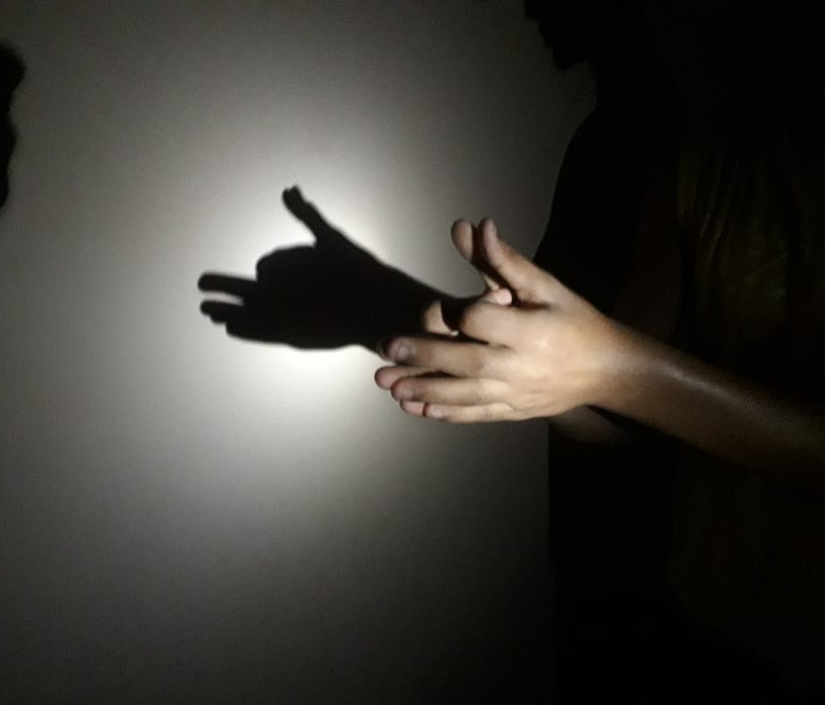
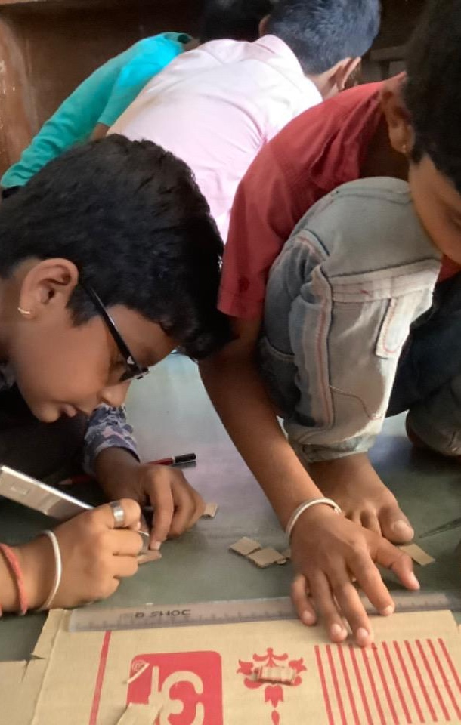




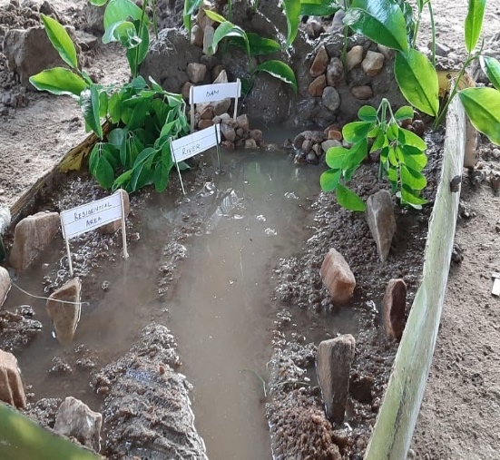

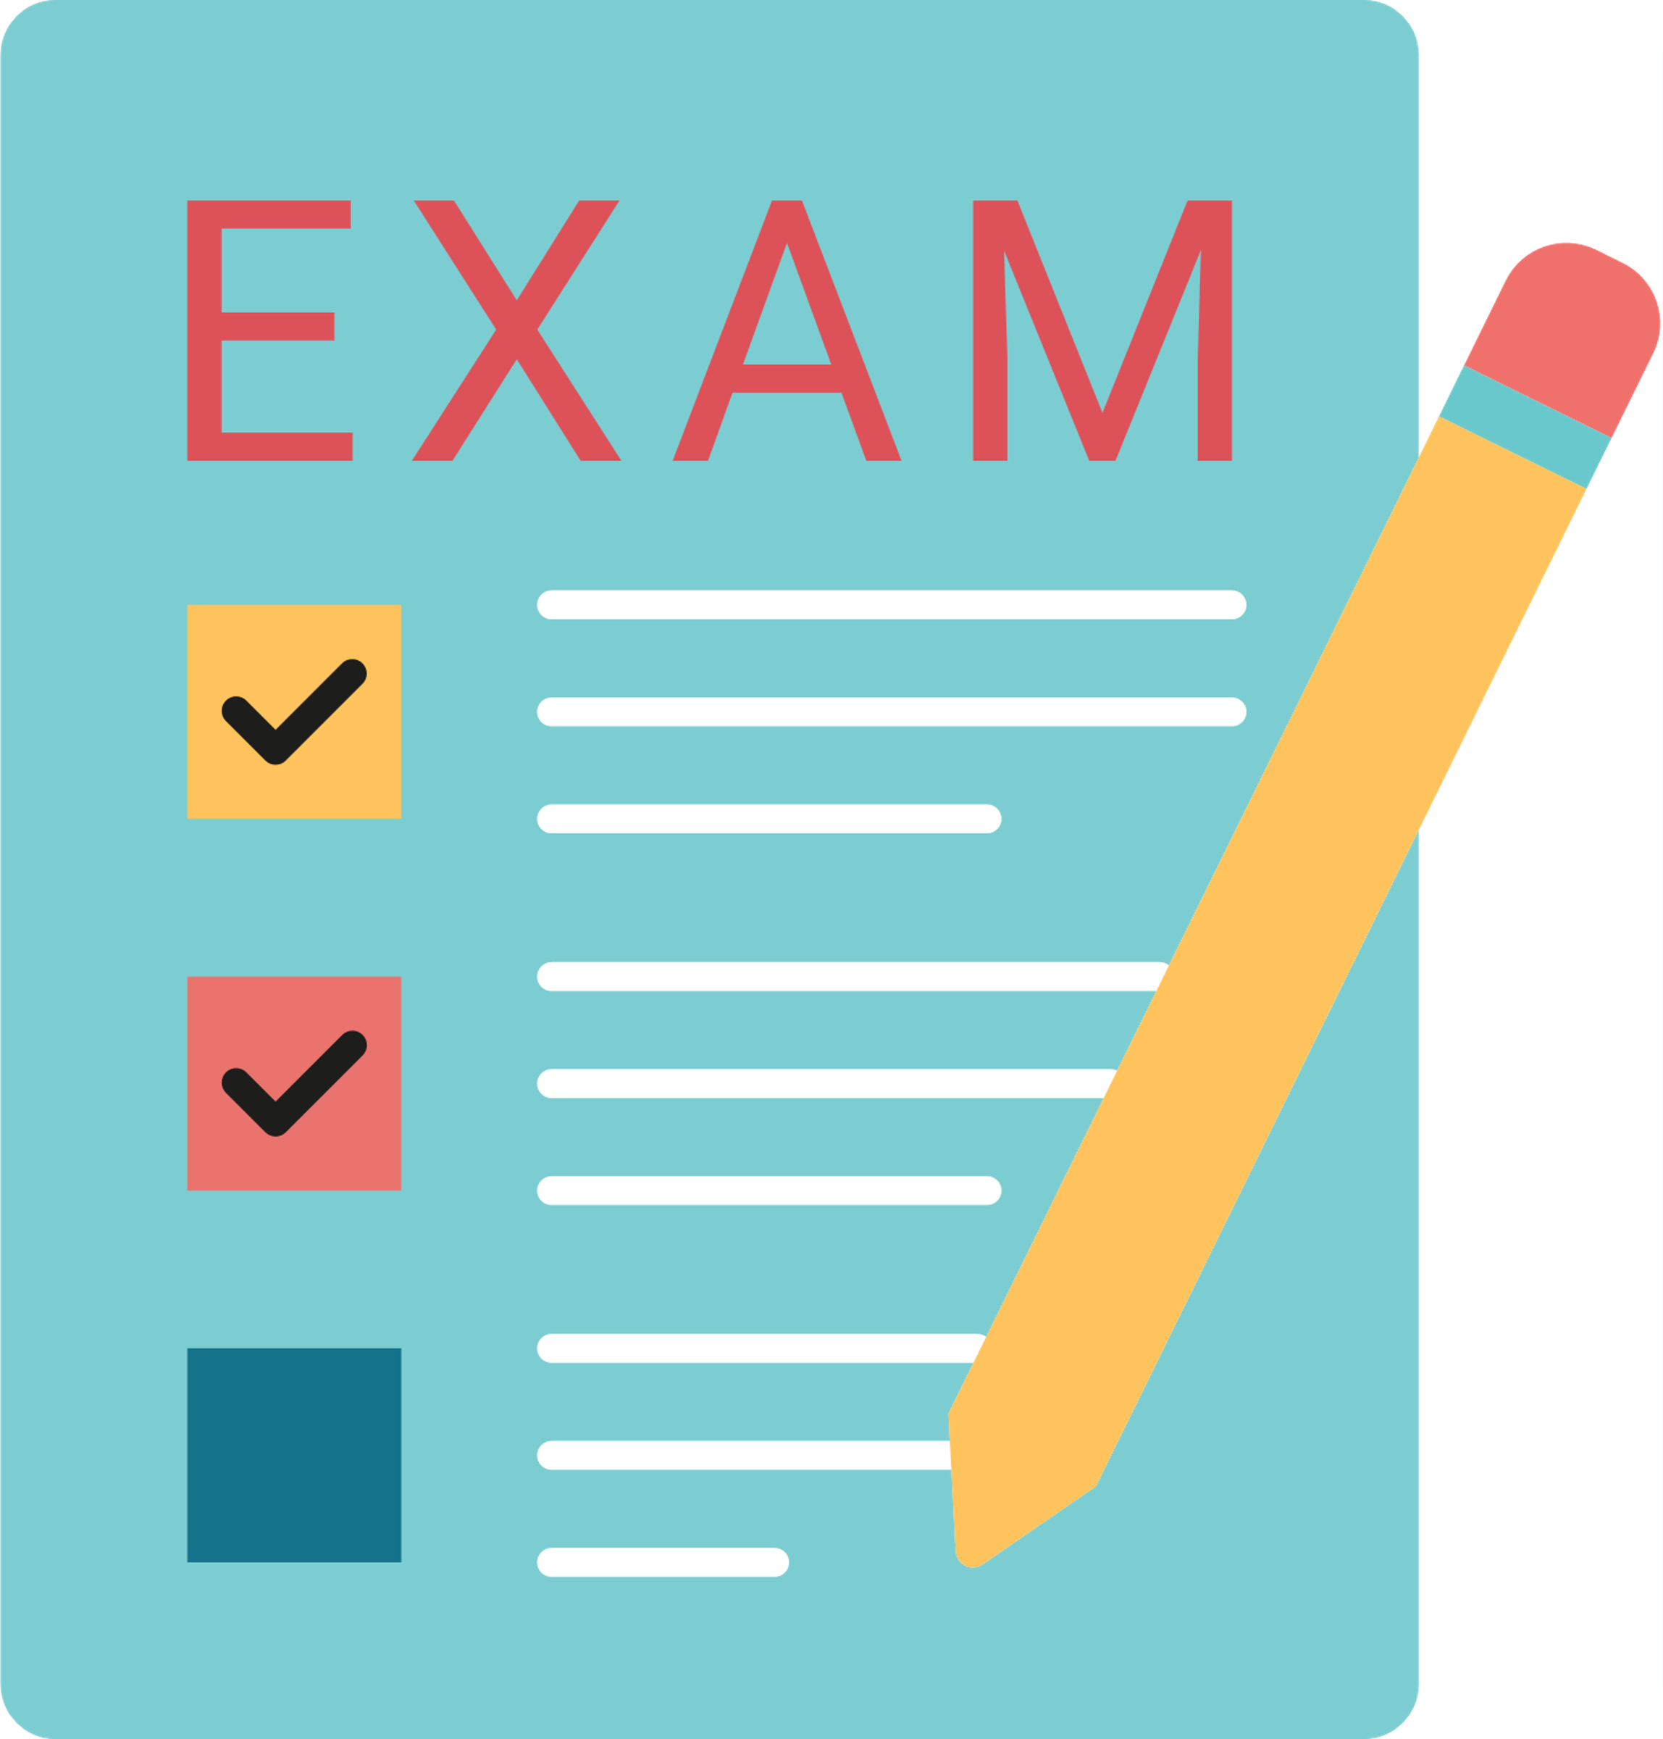

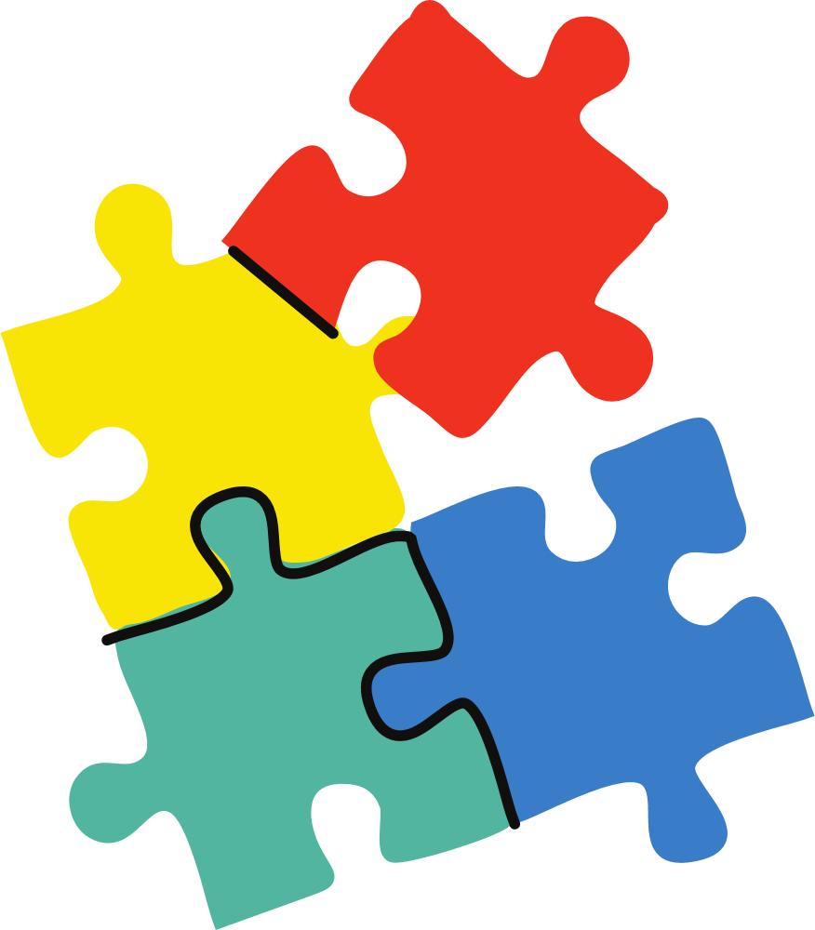

Why PBL?
ABC by me
Teacher-centred
Student-centred
Shadow Play
Textbook Based
Real world learning
Passive learning
Active & fun learning
Discipline-based
Interdisciplinary
Flood management
Notes:
- Focuses on skills and application of learning to go beyond rote memorization.
In ABC By Me – students author their own alphabet book using examples from their contexts and understanding phonics.
Relevant to students’ real-life environment in order to teach concepts or develop outcomes that are useful for them in life.
Through the Flood Management Project, students learn about science concepts and design their own life jackets and evacuation plans.
Energizes students and makes learning fun.
In Shadow Play, learners experiment with the properties of light and then make their own shadow puppet theatre.

Slide 6
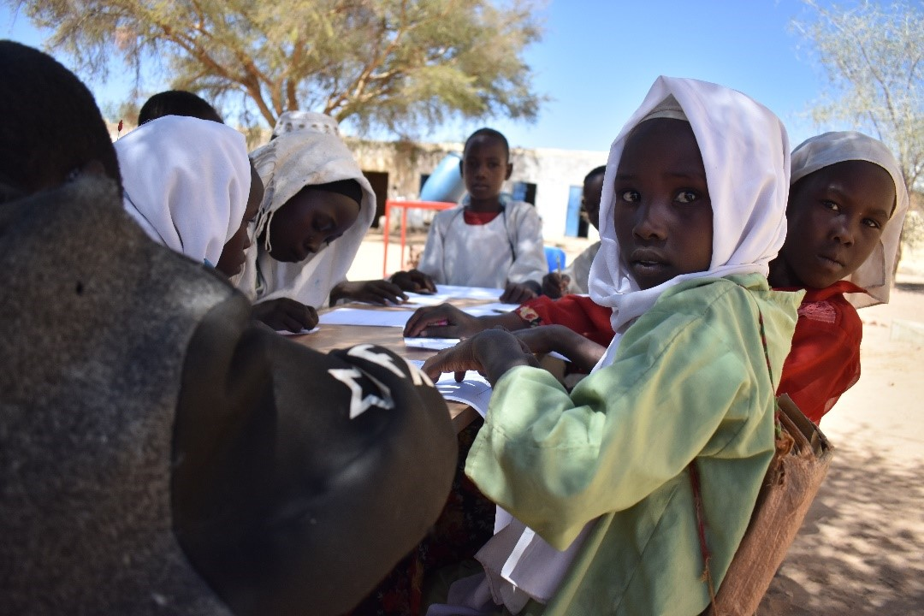

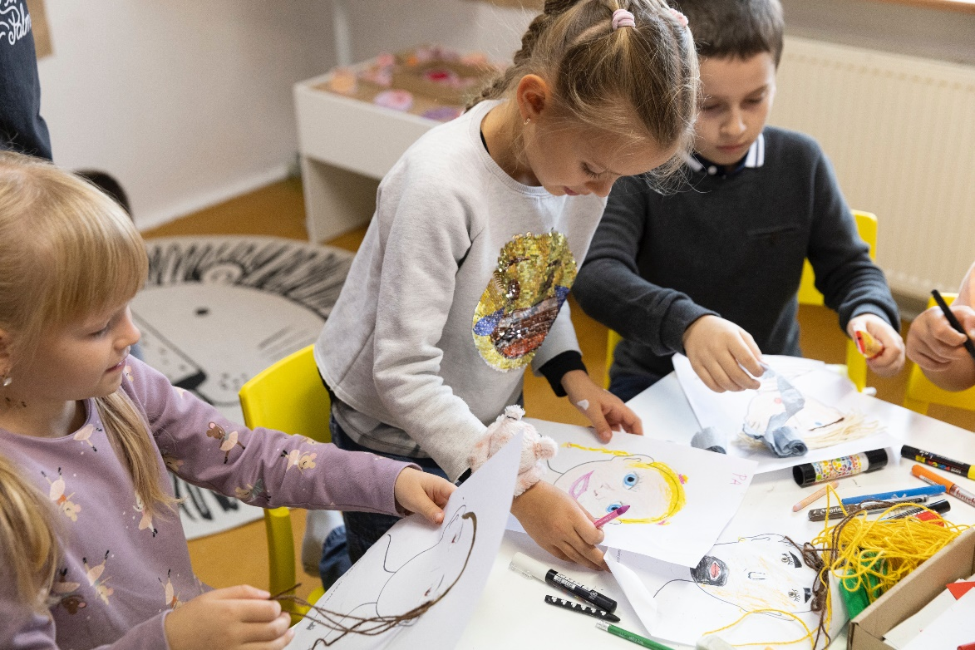

Is PBL effective?
Students shows academic growth
Improved social emotional learning
Improved 21st Century Skills
  %54 average increase in academic score
  %15 average increase in 21st century skills
  *
Notes:
*Statistics from 2021 pilots
Ask parents: What are 21st century skills? Why are they important?
21st century skills include critical thinking/reasoning, creativity/creative thinking, problem solving, collaboration, communication and global citizenship.
21st century skills help learners become more flexible and adaptable in a constantly changing world and workforce, increase their ability to work cross-culturally, and be able to take on positions of leadership.

Slide 7


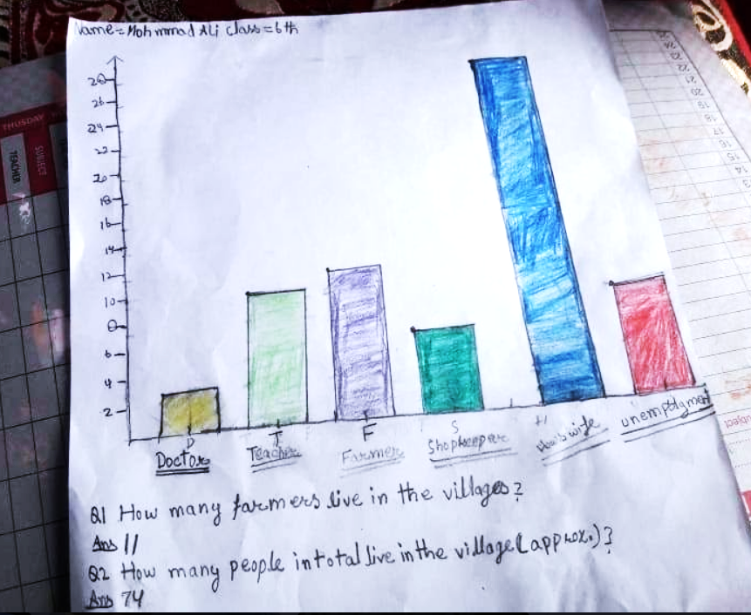

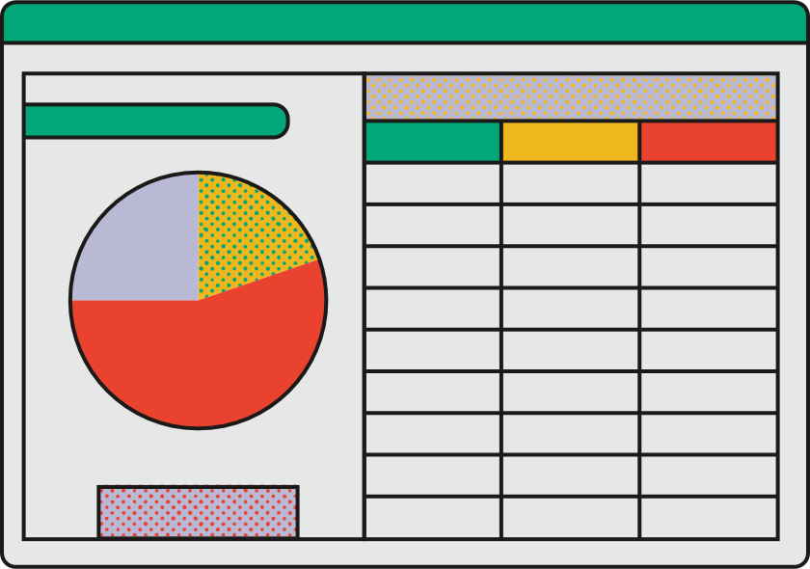


What does PBL look like?
Can we conduct a census to learn more about our family and community?
In Population Census, learners design their own census survey, gather and analyse data on the people within their community to understand their community better
Day 1
Day 3
Design and use a survey tool to gather information about their community.
Calculate percentages with two-digit numbers.
Interpret and present data using bar charts, pictograms and tables
Solve one-step and two-step questions using information presented in scaled bar charts and pictograms and tables.
Identify one issue facing the community based on the results of their census.
Endline assessment
Baseline assessment
Day 2
Create and survey the population of their immediate community including their own and their relatives’ households and their close neighbours.
Computing mean, median, mode, frequency and graphical representation of data.
Day 4
Write a short essay or design a campaign poster to address the issue they have identified from the results of their survey.
Present the results of the census and their essays.
Math, 21st century skills (communication)
Math (statistics), 21st century skills (critical thinking, communication, problem solving)
Literacy, 21st century skills (communication, problem solving), social emotional learning.
Math (data handling),
21st century skills (communication)
Provide support
Help learner collect info
Help learners interview community members
Review essays
Provide feedback

Slide 8
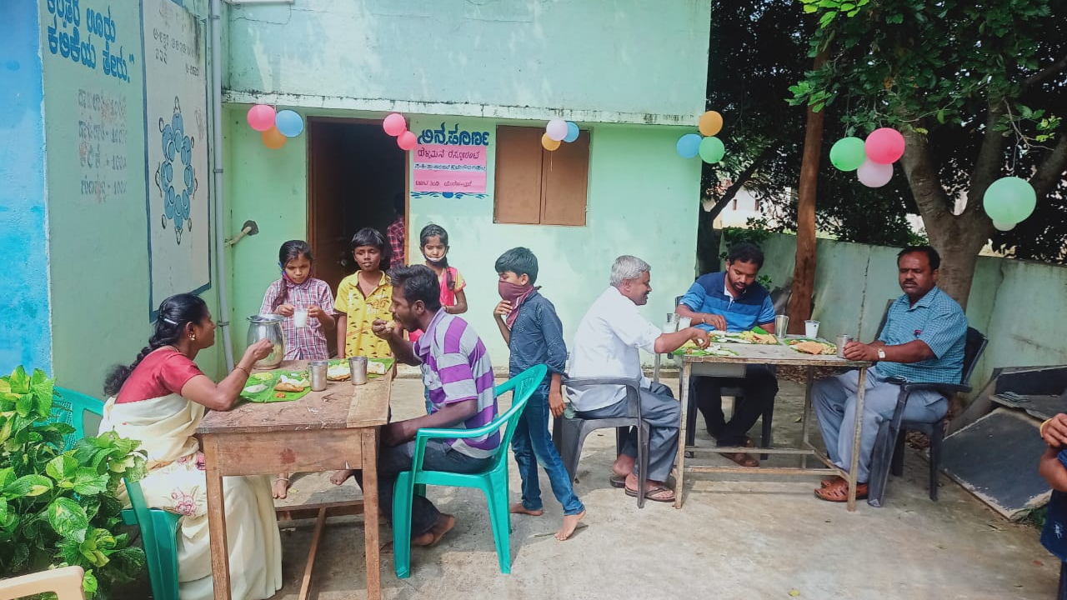
“The happiness, satisfaction and positivity we get from sharing our time in building next generation drives us to do more.”
- Teacher
“It is now my mission to ensure one day all the people in my village will have access to clean drinking water!”
- Student (after completing PBL project “Water is Life”)
In Swat [region], as most girls are married at a very young age, Laiba’s mother became an exception when she decided to break the tradition of early marriages.
- British council, Pakistan, 2020

Slide 9

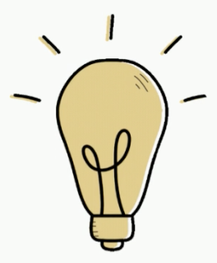

Possible Concerns
Projects are just for fun, but not really instructive or worthwhile on an educational level.
PBL does not prepare students for standardized tests
Academic Coverage
- Learning standards form the basis for all PBL projects.
- Core skills are practiced.
- Projects align with national and international curricula.
Higher Scores
- Students learn standards in more depth, ensuring lasting understanding through practical application.
Goes Beyond Academic
The top skill sets for the future require agency, adaptability, problem-solving, teamwork and communication– all prominent features of PBL.
“My daughter and I learned a lot of new concepts together in the days of lockdown. In the IFERB toolkit, the first project is about COVID-19 and it equipped us with authentic information that we were not aware of before. We trusted rumors/myths we had heard from people around us. Now, I along with my family members, read the IFERB toolkit and learn something new every day”
Parent, Pakistan
Notes:
in 2021 programs learners grew by 54% on average in academic learning skills.

Slide 10





Possible Concerns
My child won’t learn as much as they would in a traditional classroom
Authentic learning
A sense of purpose
PBL is more effective than traditional learning
Authentic audience
Students active in assessment
Integrated social & emotional skills
“Tremendous building of awareness, consciousness and sense of responsibility through real life projects. Things that would be taught or learned academically in older grades are being done sooner. There is a lot of sustained learning and students’ enquiry beyond the tasks allocated. Students really enjoyed tasks involving drawing and activities that were new to them.”
- Teacher
Notes:
PBL doesn’t only cover core subject material but also gives students the chance to spend time engaging in applied, investigative learning. PBL helps equip students to troubleshoot in the real world and develop fundamental skills for living in a knowledge-based society.

Slide 11





How to be involved
Support with facilitation.
Many projects have activities that require parents’ help.
For example, Pop-Up Restaurant requires help with cooking, Grandmother’s Tale requires students to create their own version of a folk story narrated by parents/grandparents and Make ID Cards requires students to interview family members.
You can review your child’s work or give feedback on a project activity or the final product they create.
Be an audience for your child’s presentation of their work and final product
Provide learners with resources and materials needed to do project activities.
Volunteering to support facilitators
Suggest topics for future projects to facilitators.
How would you like to be involved?

Slide 12
What if…
What would you do if your child asks you questions?
What would happen if you give your child the answers?
What would happen if you do the work for your child?
What would you do if you don’t have certain resources?

Slide 13
Remember
Give PBL a chance.
You might be tempted as a parent to try to solve problems that arise for your child while they are working on their project. Remember to step back and ask open ended questions to allow your kids to express their experiences.
Asking open ended and targeted questions is a great way to assess what the child has learned so far through the project. For example, you can ask them what they learned from doing a specific activity, or you can ask them to answer a specific question related to the project such as “do you think we would be able to make shadows in an unlit room?”
You can always do informal learning with your child (using any available resources). For example, you could attend a local community event together and discuss something new your child noticed or learned. Remember that you can play a role in building student inquiry by being a model of a learner yourself.

